Slide 1
Are you crazy enough to try? Updated Tools and Techniques that will blow your mind Part 3
DFW TRN – April 2017
Jim Schnyder @jimschnyder - PepsiCo Gail Houston @ghouston - Intuit

Slide 2
We are back again to Challenge You to Think Differently

Slide 3
In Order to Avoid Becoming the “LinkedIn Junkie”

Slide 4
So We Took Another Trip Around the World and this is what we found

Slide 5
AI is Coming – Be Prepared Human vs Machine OR Human + Machine
“Best developers don't polish resumes. They contribute to Github, post at StackOverflow, compete at Kaggle. They blog, code and impact communities across hundreds of sites.” Amazing Hiring
Notes:
Sourcecon Competition
https://www.eremedia.com/sourcecon/human-vs-machine-who-sources-best-the-results-of-the-2017-grandmaster-competition/
http://timsackett.com/2017/03/29/in-human-vs-machine-you-need-some-machines-on-your-team/
https://trymya.io/
Machine was a product called Brilent. This is a candidate matching software tool.
Sourcers and machine had to search thru 5500 resumes and find the appropriate candidates and eventual hire for 3 jobs.
https://www.forbes.com/sites/louisefron/2016/07/12/how-a-i-is-about-to-disrupt-corporate-recruiting/#45ae74073ba2
http://timsackett.com/2017/03/28/t3-ideal-a-i-for-recruiting/
https://www.smartrecruiters.com/blog/meetup-report-rise-of-the-machines-machine-learning-and-ai-takeover-recruiting/
AI Recruiting Tools
Brilent – candidate matching software used in 2017 Grand Master Sourcing Contest – Machine vs Human. Incorporates graph search (did the search in 3.2 seconds – that should totally blow your mind)
Ideal – screen resumes, uncover past applicants. Reaches out to past applicants, does the initial screen and gives candidates a score of A-D. Fully integrated and built into your ATS
IBM’s Watson for Recruiting
Google’s Cloud Jobs API in partnership with Careerbuilder and Dice
Entelo – matches candidates social info to the resume
Restless Bandit – searches companies database for past candidates
Amazing Hiring – searches the web, analyzes data and presents top talent

Slide 6
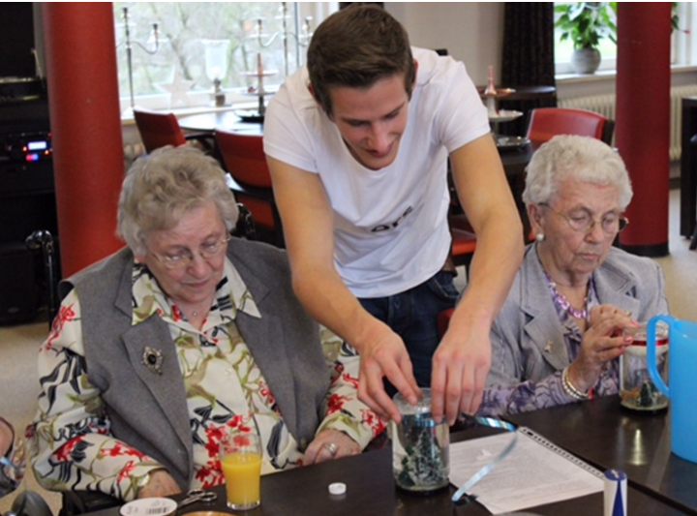
Free Housing For Students On One Condition
Notes:
A Dutch Nursing Home allows 6 students live on site rent free with the seniors. They are required to spend 30 hours a month with the seniors
http://www.pbs.org/newshour/rundown/dutch-retirement-home-offers-rent-free-housing-students-one-condition/

Slide 7
Uber and Lyft Get Creative
Notes:
Uber – Code the Road – In an effort to recruiter more engineers. Uber sends out a challenge to their passengers thru their app. Uber states they send out challenges based on geo location. They are given 3 challenges and then based on how they do they receive a score. If they do well they are invited to connect with a recruiter thru the Uber app.
http://www.slate.com/blogs/future_tense/2016/03/29/uber_s_code_on_the_road_hacker_challenge_scouts_for_new_employees.html
http://www.businessinsider.com/uber-recruiting-engineers-through-in-app-coding-test-2016-3
Lyft - http://ridesharedashboard.com/2014/09/09/inside-lyft-driver-recruiting-program/ - this is a campaign that turns drivers into recruiters and gives them the opportunity to earn money by mentoring recruits

Slide 8
PepsiCo Personalizes Recruiting

Slide 9
Virtual Reality
Notes:
https://www.cornerstoneondemand.com/rework/latest-recruiting-tool-virtual-reality
http://people-corner.com/virtual-reality-in-recruitment/
http://www.recruitingblogs.com/profiles/blogs/vr-new-possibilities-for-virtual-reality-in-recruiting
http://www.talenteconomy.io/2017/03/13/firm-uses-virtual-reality-recruit-others-follow/
Many companies today like Jet, General Mills and Intuit are using virtual reality to recruit talent. If you can give potential applicants a peak into your world, share your culture you might be able to entice them to interview. General Mills might be showing someone their headquarters, while Deutsche Bahn will let their applicants peer over the shoulder of someone working on the railways. The CommonWealth Bank of Australia will use VR to take their applicants thru challenges in order to change the perception that they are a old fashion place to work. Intuit sent VR glasses to 50 applicants to give them a peak behind the curtain and entice them to interview.

Slide 10
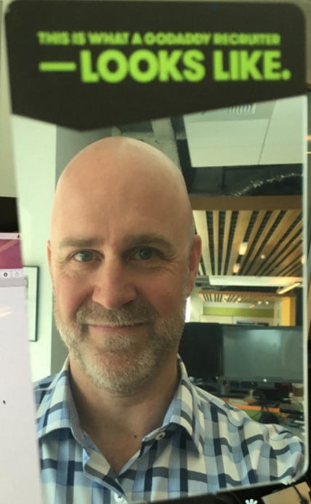
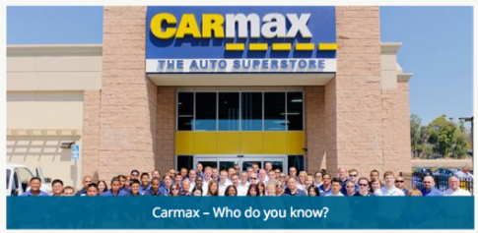
Ramping up the Referrals
Notes:
GoDaddy “Mirror” Employee Referral Program Launch - GoDaddy employees receive a handheld mirror on their desk. It says “This is what a GoDaddy recruiter looks like”
https://business.linkedin.com/talent-solutions/blog/employee-referrals/2016/the-creative-tactic-godaddy-is-using-to-promote-its-employee-referral-program-a-hand-held-mirror. They had another ERP campaign aimed at hiring developers but they asked their employees to refer people using computer code.
CarMax gives employees blue bracelets to wear with the question “Who Do You Know” on them
https://www.linkedin.com/pulse/hiring-creativity-out-box-ritesh-chudasama
Intuit hosts “Newtuit” sessions with new hires to explain how their referral program works and encourages employees to think about who they would like to work with again. Pure – an insurance company does the same thing and has referral hire rates as high as 40%.
https://business.linkedin.com/talent-solutions/blog/employee-referrals/2016/6-creative-ways-companies-keep-their-employee-referral-programs-top-of-mind

Slide 11
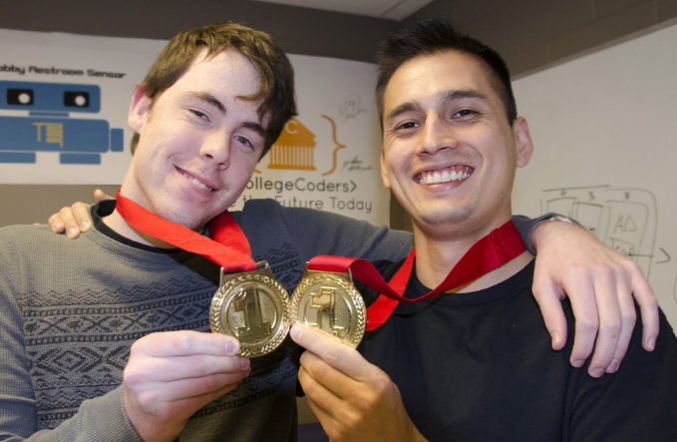
Tools to Make It Competitive
Notes:
http://www.inc.com/salvador-rodriguez/uber-recruiting.html
IronHack – https://www.ironhack.com/en - bootcamps in Web and UX. Provides 100k of scholarships to coding school
CodeFights – https://codefights.com/ - used by programmers to refine their skills against other developers. They go to a website and they compete against each other. Over 500k registered users, Codefight introduces the best of the best to companies. 200 firms are using the platform. Another company called Umbelmania has a similar experience
HackerRank – online assessments designed to determine if a potential applicant has the right coding skills necessary to perform well at your company. Company sets the scores for applicants that move to the next level and they come up with the questions.
Google uses Google Code Jam to invite software engineers to recruit – they have done so over the last 12 years
Formaposte launchec Jeu Facteur Academy due to retention issues – this allowed players (candidates) to “live a week” as a new postal employee – they were able to reduce attrition thru gamifying the experience
Pizza Hut – created the Pizza Mogul game to drive brand awareness but also to recruit
Kaggle – competitive site for data scientist
Hackathons
https://hackernoon.com/forget-the-mba-heres-the-fastest-way-to-become-a-product-manager-b3a230a7c055
http://www.georgiancollege.ca/student-news/college-coders-takes-top-prize-in-2016-georgian-den/
University Tool –
Piazza.com – https://recruiting.piazza.com/ - 1m students, 1500 schools, 90 countries
Karat - https://karat.io/ - tech interviewers,

Slide 12
Intuit Operationalizes their Pipeline
41% of Product Management Hires for FY17 came from our pipeline
Notes:
Don’t have to have fancy tools – excel will work
Change how you interview – interview for both open roles and roles of the future (understand your current employee skill set. For example – what type of Product Managers do you hire – api, data, app store, SaaS, developer tools, identity, etc.). Let candidates know you will be reaching back out and encourage them to follow you career site and continue to apply on line and ping you if they see a need as well.
Create list of “targeted companies” – interview candidates from those company whether you have an open role or not
Capture info on everyone you talk to within a particular skill set
Be sure to include skills as one of your elements
Rank your interview – high, medium and low
Learn to use filters
Prior to any hiring plan – filter your data
Take 3-5 “pipeline candidates” to the hiring plan with you
Validate if you are on track – if so, reach out to pipeline candidate to see if they are still interested
Each month, evaluate your hires.
Track company they came from
Level
Compensation
Source – the original source stays the same so you can determine quality of source
Separate field for if they were a “pipeline hire”

Slide 13
The Puzzle Challenges Continue
https://www.google.com/foobar/
Notes:
https://www.entrepreneur.com/article/250032
https://www.google.com/foobar/
British Intelligence – CGHQ (like NSA) uses encrypted messages on a website called CanYouCrackIt.com.uk to find candidates

Slide 14
Netflix Gets Real
Notes:
https://business.linkedin.com/talent-solutions/blog/recruiting-strategy/2016/here-is-how-netflix-recruiters-find-stunning-colleagues
They have created a culture powerpoint with over 14 m views.
Netflix gives honest feedback to candidates. Watches how they respond. They need employees who can take feedback well
Hiring managers ask the “keeper test” – who would they fight hard to keep

Slide 15
Using Humor to Recruit
GE’s What’s The Matter With Owen Ad Campaign
Notes:
http://theundercoverrecruiter.com/candid-job-advert-recruitment/?utm_content=bufferd5fec&utm_medium=social&utm_source=linkedin.com&utm_campaign=buffer
Chef uses humor in his ad on Gumtree - “I have no problem working seven days a week, but on the off-chance I break my foot or get third-degree steam burns on my face I need someone who can work unsupervised and still make quality food … I need a second in command to bang out a ton of semi-fancy food in a kitchen the size of a closet, and you also have to put up with my wife because I do, and she's the real boss.”
SnapChat used geo filters and humor to recruit targeted employees within a geography
Pinterest employees were targeted - “Feeling pinned down?”
Uber employees were targeted - “This place driving you mad?”
Twitter employees were targeted – “Fly higher”
GE launches “Whats the Matter with Owen” on the Stephen Colbert show – their demographic prefers comedians to sports stars – video has been watched over 800k. They created a series of funny videos designed to showcase how GE has changed
http://www.adweek.com/agencyspy/ge-and-bbdo-know-exactly-whats-the-matter-with-owen/92849

Slide 16
Send Recruiting Campaigns Directly to Applicants Homes
Notes:
https://blog.beamery.com/creative-recruitment/
http://www.nbcnews.com/id/21134540/vp/24836769#24836769
Red 5 Studios Channels Willy Wonka
Red 5 Studios is a computer game company so it is only logical that they put “games” into their recruitment efforts. They took a line from Charlie and the Chocolate Factory’s Golden Ticket that was hidden in candy bars. In the movie, the winners got to visit Willy Wonka’s chocolate factory. In Red 5 Studio’s version they sent 100 unmarked packages to game developers that were deemed the brightest in the industry. Each package contained a message from the CEO. 99 of the 100 game developers had clicked on the link within days of receiving the package.

Slide 17
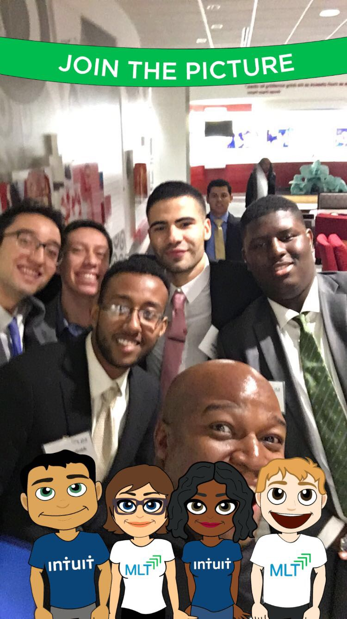
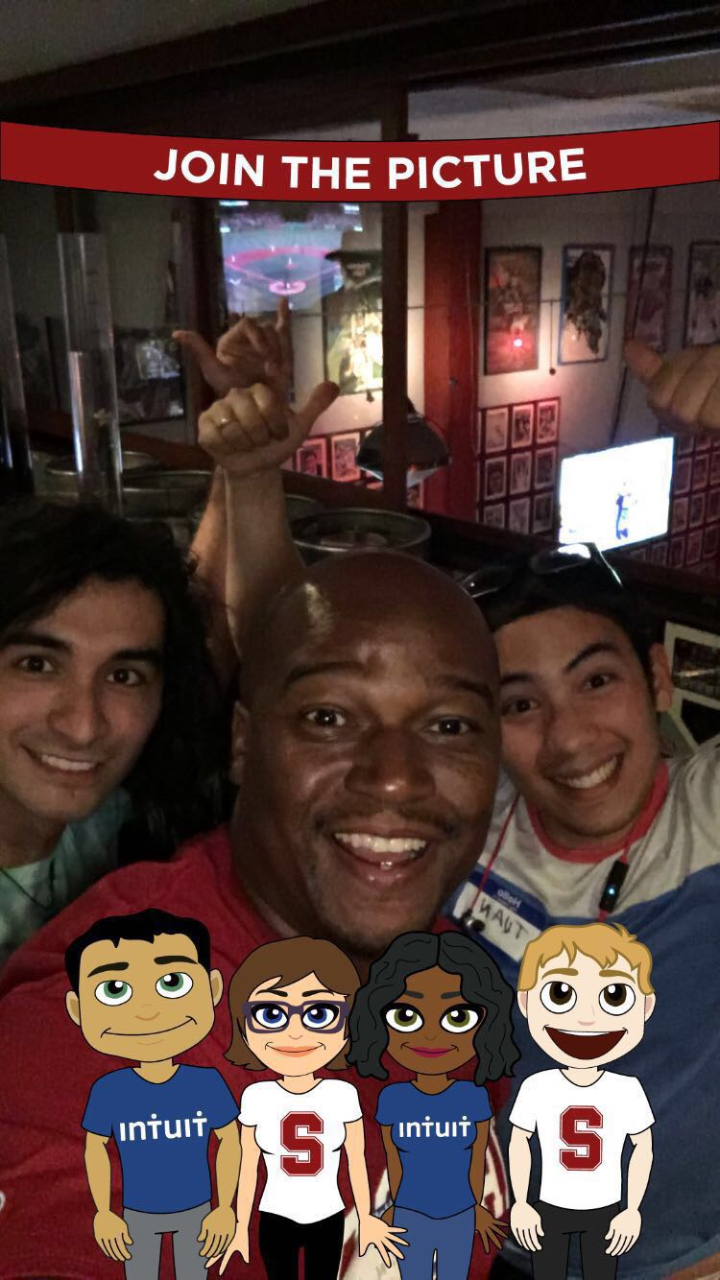
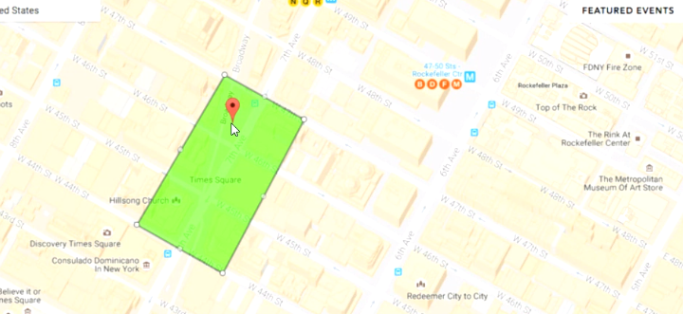
Using Snapchat to Engage Talent @Internguy
On Demand Geo Filters
Notes:
Understanding Snapchat
https://www.wepow.com/4-companies-use-snapchat-recruit-millennials/
https://www.officevibe.com/blog/beginners-guide-snapchat-recruiting
http://www.socialmediaexaminer.com/how-to-create-a-snapchat-geofilter-for-your-event/
https://hbr.org/2016/04/recruiting-strategies-for-a-tight-talent-market
What are geo location filters on snapchat - https://www.snapchat.com/geofilters and On demand geo filters - https://www.snapchat.com/on-demand
Geofilters are special overlays that communicate the “where and when” of a Snap in a fun way, whether you're sending it to a friend or adding it to your Story. An on demand geo filter allows you to use a geo filter for a specific location / specific period of time. (think of the university recruiter being out on an event on campus)
How are companies using Snapchat
Intuit – Charles Martin, known as the internguy on snapchat uses the service to engage students on campus. He creates filters for tips, he snaps that he will be in the café – come grab some coffee and talk. He invites them to career advice discussions. He is friendly, engaging and funny. Students love it. Before he started, he hired 4 students off Stanford campus, today he is hiring 18 a year off a highly competitive campus.
GrubHub used Snapchat to find a social media intern. They posted a slideshow telling candidates how to apply (show them your best doodle thru snapchat).

Slide 18
DRAFT DAY – University Recruiting
Notes:
Companies like National Oil Well Varco and Intuit have both hosted Draft Days in regards to their University Recruiting practices. At Varco, prior to the draft students were able to present their qualifications and highlight their skills. Managers would then come in and select their picks. At Intuit, you could see managers bartering with each other as they traded “picks” based on the problems they were trying to solve within their groups. Students were able to indicate location preferences as well.
https://blog.beamery.com/creative-recruitment/

Slide 19
Creating Competitions to Get The Offer
Notes:
https://www.wsj.com/articles/SB10001424052702303460004579193901642418812
https://blog.beamery.com/creative-recruitment/
Lego loves to hold competitions to find their employees. They host an annual recruitment workshop where they bring in a variety of skill sets from entry level to very experienced to compete for their design jobs. Applicants go thru 3 rounds of competition with the designer hired on the spot.

Slide 20
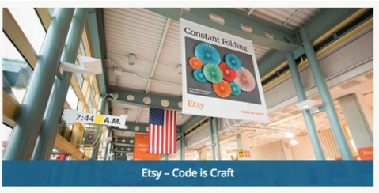
Using Blogs and Videos to Showcase Your Culture
Notes:
Etsy's "Code as Craft" campaign was a targeted recruitment campaign for software engineers. By using engineering jargon to showcase real Etsy goods, the e-commerce company sought out to show that code and craft are one in the same. David Schiff, the chief creative officer of the campaign, described the ads as a recruitment and branding campaign in one. He said, "Lots of people know Etsy is a killer repository of unique, crafted products. But most people have no idea that behind all that craft is a tech powerhouse." This campaign is a great example of an employer applying their brand to a campaign.
Etsy’s has a blog, an video engineering series by the name of “Code as Craft”.
https://www.etsy.com/codeascraft/talks – video series
https://www.slideshare.net/chaddickerson/code-as-craft-building-a-strong-engineering-culture-at-etsy – slideshare presentations - over 108k views
http://avc.com/2010/02/code-as-craft/

Slide 21
Deutsche Bahn Uses Hologram
Notes:
https://www.youtube.com/watch?v=2GlqOuodYrA
http://www.therecruitingnerd.com/

Slide 22
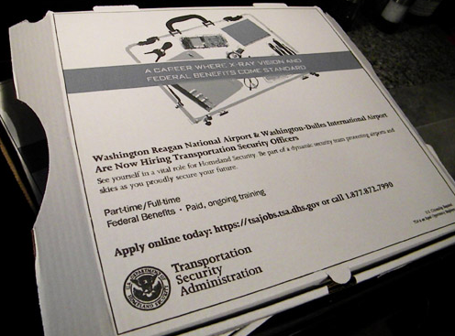
Recruit Your Customers (or someone else’s)
TSA Recruitment Message
On Pizza Boxes
IKEA’s Career Instructions
Notes:
IKEA took advantage of it’s own boxes by including “Career Instructions” in each box. They had 4285 applicants and 280 hires thru this channel when opening up their new Australian Mega Store
http://www.halogensoftware.com/blog/5-reasons-ikeas-australian-recruitment-campaign-is-brilliant.
The TSA took advantage of the pizza companies customers – they bought ad space on a Pizza box that was delivered near the airport - https://jobmob.co.il/blog/creative-recruitment-advertising/

Slide 23
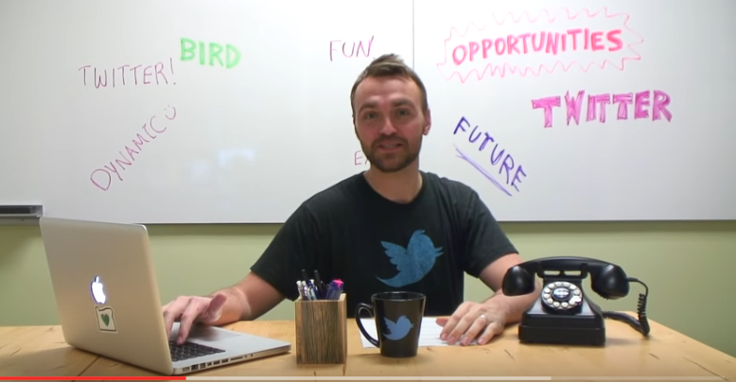
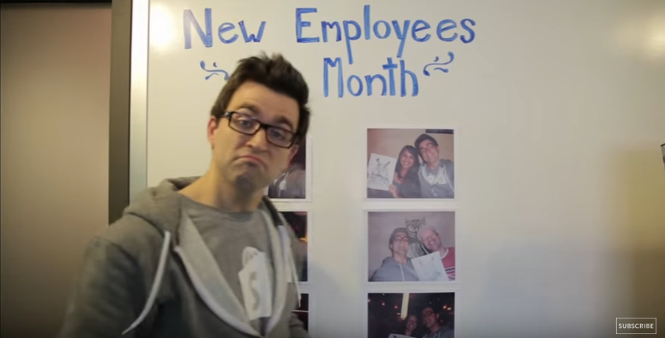
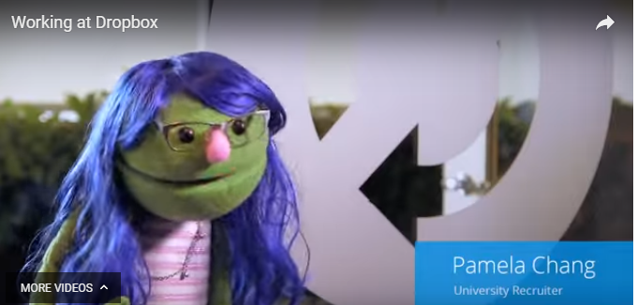
Utilizing Video to Recruit
Twitter “Join the Flock”
Employee Video Campaign
Shopify’s “Draw The Owl”
Recruitment Videos
Why I Love Dropbox Recruiting Campaign
Notes:
Examples of Recruitment Videos
https://good.co/blog/15-best-recruitment-videos/
https://good.co/blog/the-top-15-recruitment-videos-of-2016/
Twitter - https://www.youtube.com/watch?v=vccZkELgEsU&feature=youtu.be
Twitter wanted to have more creativity in their recruitment messages to showcase the company culture. During Hack Week, they challenged employees to create both the best and worst recruiting videos of all time for their “Join the Flock” campaign. The winning video while funny also included hiring information and a snippet from CEO Dick Costello.
Shopify – Draw the Owl - https://www.youtube.com/watch?v=dwSe2imUyvg
Dropbox – Why I love Dropbox campaign done with puppets

Slide 24
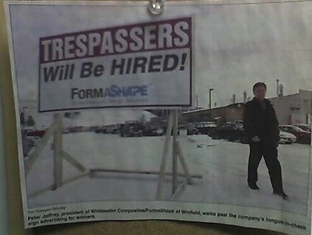
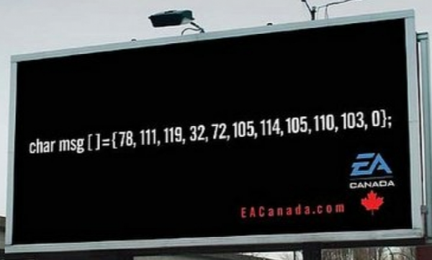
Billboard Recruiting Gets Creative
Notes:
FormaShape – put a billboard outside their plant – “Trespassers Will be Hired” – they received 100’s of applications and a lot of free publicity
EA Canada uses “super secret nerd language” to recruit - http://adland.tv/content/ea-canada-aggressively-recruiting-using-super-secret-nerd-language

Slide 25
Recruiting Where Your Competition Works
Notes:
http://adsoftheworld.com/media/ambient/shield_security_jobcases
https://jobmob.co.il/blog/creative-recruitment-advertising/
Shield Security Needed to hire security personnel so they came up with a unique way to “target” their applicants. They created a briefcase that has it went thru the scanners the security personnel could see the recruitment message. Supreme Security used a similar tactic

Slide 26
Research Your Audience
Notes:
Intuit’s Amanda Hippe changed her pitch as she reached out to UX professionals. She conducted interviews with current UX designers on why they decided to come here. What attracted them, what have they learned since coming here, what would they change. She then interviewed UX applicants from competitors. Asking questions like what would make you consider leaving a job you love? She took this information and she changed her recruiting pitch and has now successfully recruited top talent from Twitter, Google, Facebook, LinkedIn

Slide 27
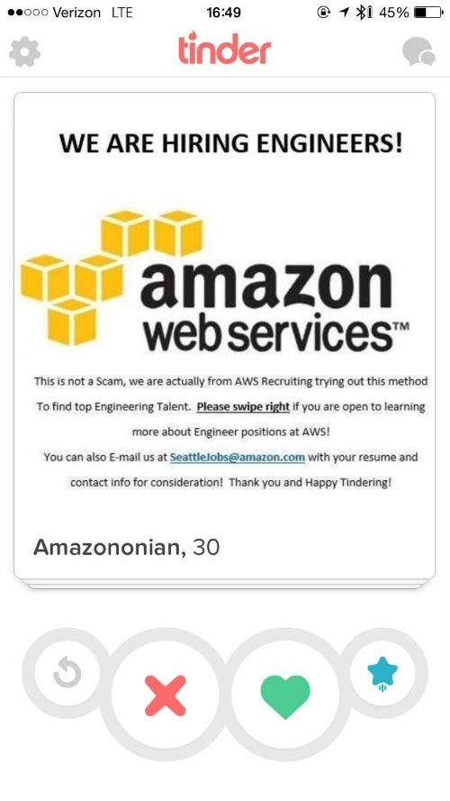
Experimentation Should Be Part of Your DNA
Be Bold – Test Out Different Channels Where Your Targeted Applicants Live
Notes:
Try different recruiting channels to find talent
Amazon put an ad out on Tinder - https://www.jibe.com/blog/recruiting-ideas-5-innovative-talent-acquisition-campaigns-from-2015/
American Airlines Hosted a Speed Dating event – they had a gallery walk on the bottom floor and hiring managers on the 2nd floor. Applicants were able to explore their interest then go upstairs and find hiring managers to introduce themselves to
Quicken Loans armed their employees with the ability to offer interviews to service professionals that stood out in their day to day interactions
http://360.talentegg.ca/2015/10/how-speed-interviews-put-your-gen-y-recruitment-efforts-in-the-fast-lane/

Slide 28
Are you crazy enough to try? Updated Tools and Techniques that will blow your mind Part 3
DFW TRN – April 2017
Jim Schnyder @jimschnyder - PepsiCo Gail Houston @ghouston - Intuit
Notes:
Quick shout out to Gail Houston! Although Jim was a presenter, Gail found 90% of this stuff. Send her a note at gail_houston@intuit.com with the subject line “Thanks for blowing my mind at the DFW-TRN meeting”

