Slide 1
What's Happening in the World of Sourcing?
#GlobalTADay Edition
Shannon Pritchett, SourceCon Editor
Notes:
Title Page: Font is Lato; SourceCon Green color is: Hex: #68ae44 | RGB: R(104) G(174) B(68)

Slide 3
Why do people share?

Slide 7
People Share When They Feel a Connection

Slide 8
When people feel an emotional connection, they often feel compelled to share those emotions with their peers.

Slide 10
Take 5 minutes to share something with your table.

Slide 11
My best advice – Be organized
Establish SLA with your hiring managers
Use a meeting scheduler

Slide 12
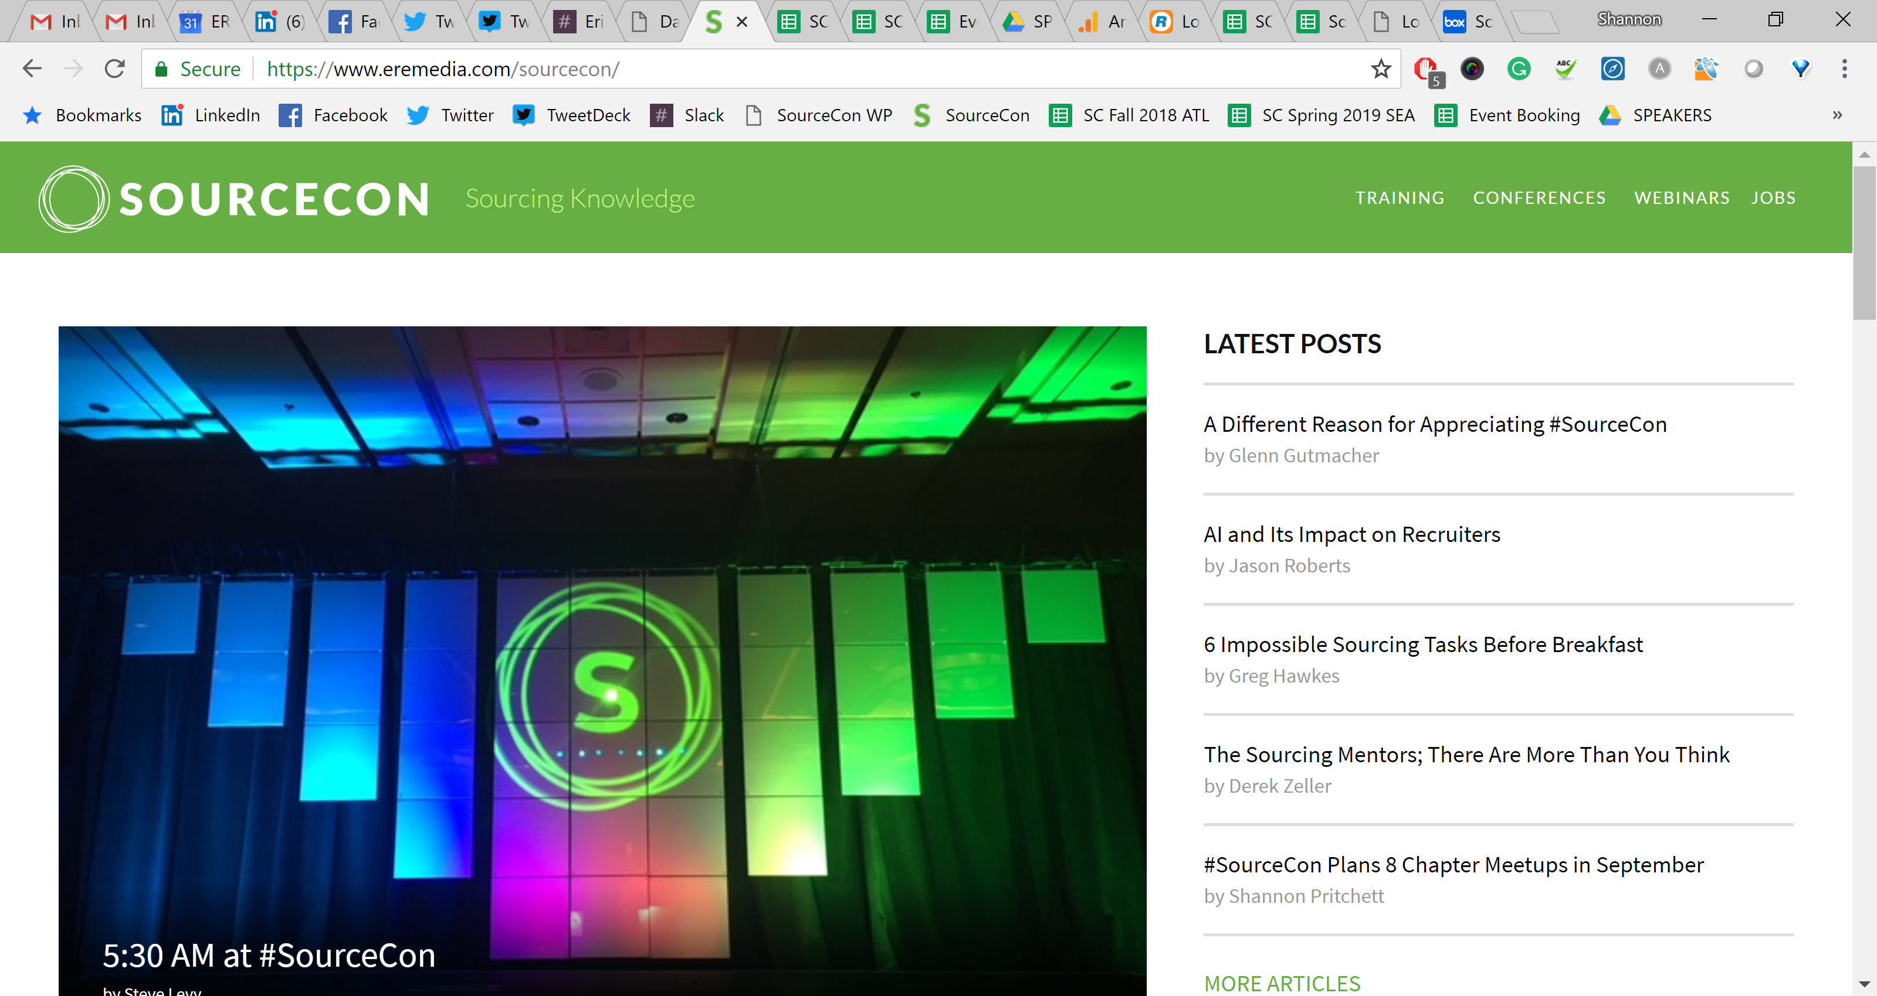

Slide 14
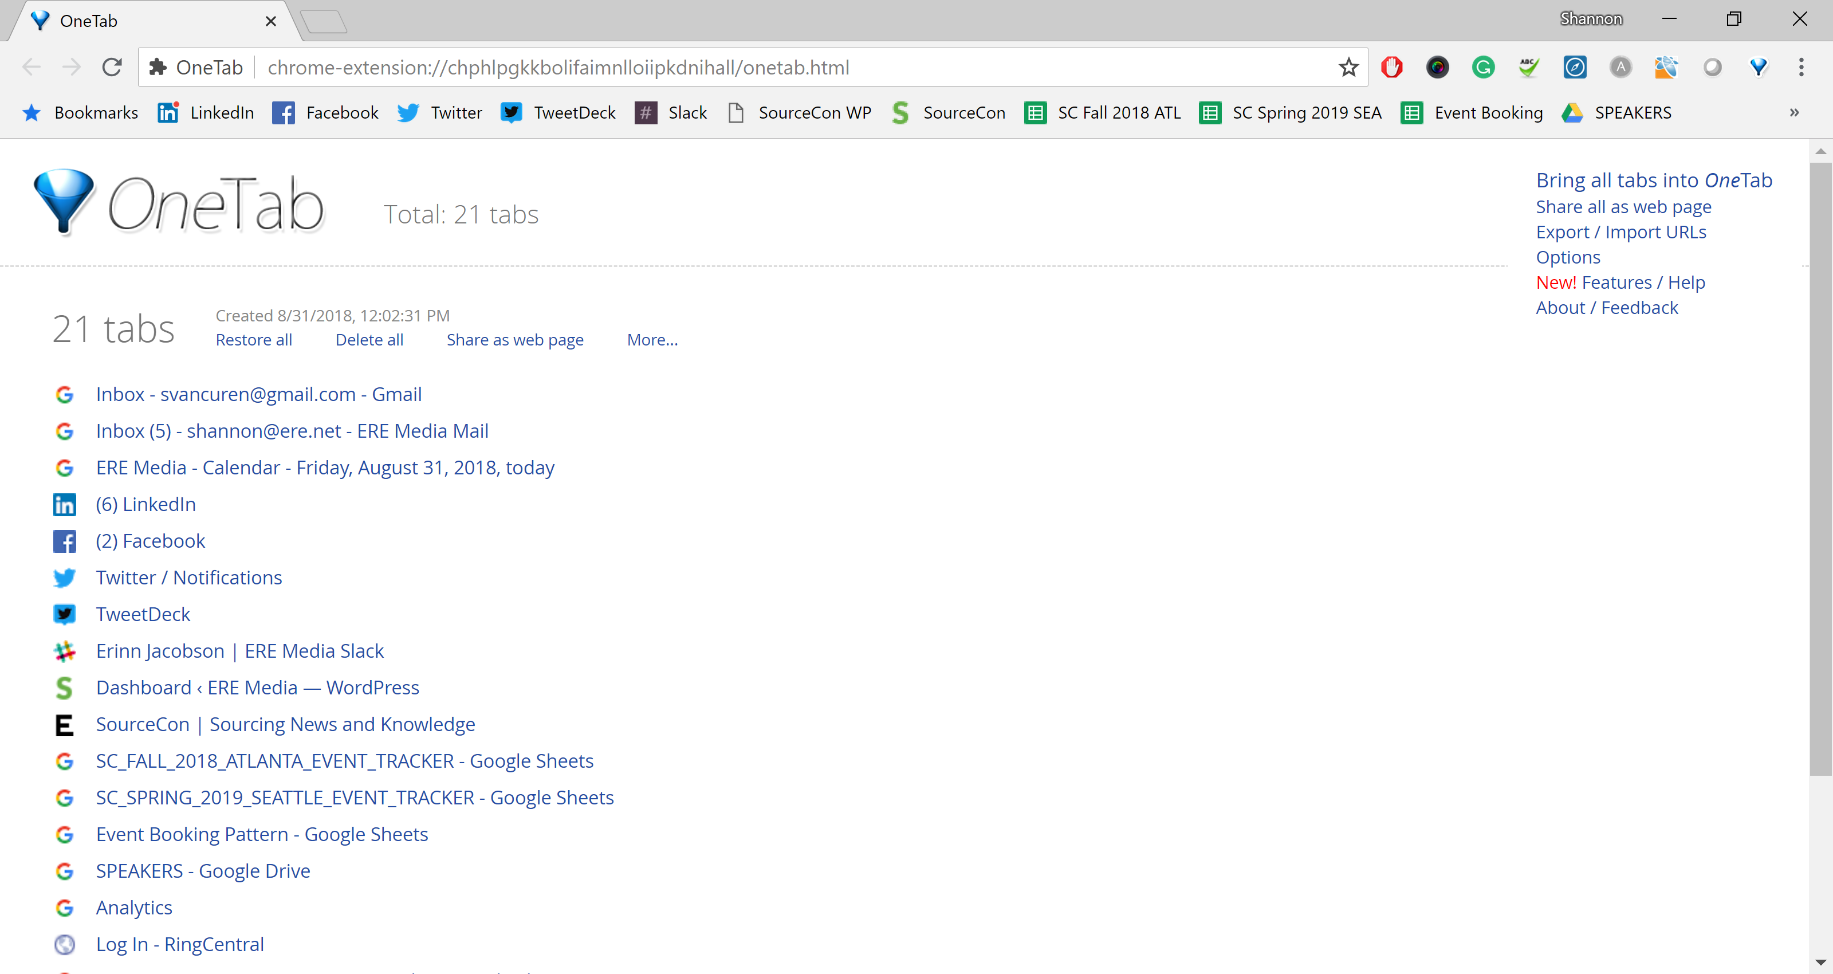

Slide 15
Share Always

Slide 16
People Come First

Slide 17
A community is an engaged and connected group of individuals in pursuit of mutual interests or a shared commonality.

Slide 18
Communities often form amongst those who share a common sense of self. We seek purpose.

Slide 19
SourceCORE Advisory Committee
SourceCon Technology Advisory Committee
European SourceCORE Advisory Council
International Chapter Leaders
Grandmaster Committee
Hackathon Committee

Slide 21
Tips to Build a Better Community
Enable your community
Trust your community
Empower your community
Serve your community
Believe in your community

Slide 22
Challenge

Slide 26
Can you answer these questions from our 2018 SourceCon Hackathon?

Slide 30
Be Creative

Slide 31
Creativity in Searches
Amybeth Quinn
(filetype:doc | filetype:pdf) resume -sample -jobs -careers "software engineer" (214 | 469 | 972 | 682 | 817)
Cyndy Davis
"network (engineer OR architect)" AND (wifi OR wi-fi OR wireless) AND ("email me at" OR "download my" OR "I am a") -apply -submit –job
Mine
"(i OR my) (specialty OR specialties OR specialize OR expertise OR skill) (is OR are OR in) (photoshop OR adobe OR illustrator OR dreamweaver OR html OR css OR php)"

Slide 32
Creativity in Messaging
Things You Should Never Put in Your inMails
“I hope you don’t mind me contacting you”
“I just came across your profile”
“Could you send me on your Resume?”
“Here’s a link to the job ad, apply if you’re interested”
Me, Me, Me
“I can see from your profile that you have X years of experience”
Subject Line: “Career Opportunity”
Blah, Blah, Blah
Vague, Vague, Vague
“Would you like to put yourself forward?”

Slide 35
Share Always
People Come First
Challenge
Be Creative
Never Give Up

