Slide 1
Introductory JavaScript & VBA Coding for Sourcers
Glenn Gutmacher
Director of Talent Sourcing
Huron Consulting Group
glenn@recruiting-online.com
@glenngutmacher
www.facebook.com/ glenn.gutmacher
@gutmach
www.linkedin.com /in/gutmach

Slide 2
Who Is Glenn Gutmacher?
At Huron Consulting Group since 2021 ($1B revenue consulting firm).
At State Street 2015-21 (world’s #2 custody bank, $10B+ revenue), first built out a NA-focused diversity sourcing team, and centralizing sourcing globally since, plus some recruitment marketing
At Avanade 2010-15, managing offshore sourcing team supporting North America, lead strategic online sourcing strategies and global training
VP of Arbita’s Recruiter Consulting & Education Services (2008-2010) training many companies on sourcing with Shally Steckerl
Senior Sourcer at Microsoft (2005-2008) & Getronics (2003-2005)
Pioneering Sourcing trainer and methods since 1997 (Founder of Recruiting-Online.com)
Founded JobSmart in 1996, greater Boston's 1st regional career portal (owned by a major newspaper chain)
Co-founder, Boston Area Talent Sourcing Association www.batsa.us
Yale University graduate, started out in Broadcasting
Wife + 3 sons ages 22, 19 and 15 living near Boston USA

Slide 3
VBA (in Excel)
One overlooked but powerful area:
The programming language built into Microsoft Office since 1993! It’s used most often with Excel, but it can do cool stuff in other apps & on the Web, too.
See slides 9-13 of Gutmacher-Swinton...pptx in my SourceCon Extras repo covering setup (the example there is geared to Outlook).
To start, you need a file that contains your macros, like the one I showed in the DFWTRN recording. Ideally store in your XLSTART folder so it opens when you launch Excel (e.g., mine being shared with you is at C:\Users\ggutmacher\AppData\Roaming\Microsoft\Excel\XLSTART
DFWTRNmacros.XLSB ) and when you save it on your computer, make sure to keep the Excel Binary Workbook (*.xlsb) file format.
Much of what’s called Robotic Process Automation (RPA) began with Excel macros.
See AutomateTheWeb.net which covers this in detail (e.g., start with “speed-write VBA code by recording a macro”).
Nowadays, you can use other software such as Microsoft Power Automate (free), Blue Prism, UI Path, Automation Anywhere, etc., too.

Slide 4
What are bookmarklets, anyway?
Bookmarklets are browser favorites/bookmarks on steroids because they have JavaScript embedded in them: They don’t just take you to a website – they *do* something.
Some starter sets of free bookmarklets you can have:
Functional bookmarklets NOT related to search
BATSA bookmarklets (contact info finders)
SOSU searchers (other search examples)

Slide 5
Bookmarklets vs. Extensions
Bookmarklets can do almost anything you can do in JavaScript, such as:
Generate a popup prompt and run your search
Extract emails or scrape other content from a webpage
Send an article you’re viewing to a read-later tool
Highlight text, (de-)select checkboxes on webforms, etc.
Bookmarklets | Extensions
Work in any browser, no Google login needed | Work in Chrome or Microsoft Edge only
Only run when clicked, lightweight and no impact on computer performance | Keep running in the background, using up memory/slowing performance
Safer than extensions; only reads data that you send to websites you visit | May contain malware, has access to more information stored in your browser including browser settings
Portable: can store in any of your favorites / bookmarks folders or (most conveniently) in top bar subfolders | All are stored in extensions bar (or install Custom Chrome or Extensity to toggle some to hide/display)
Many pre-made free ones you can copy | Same
Need to know some JavaScript to customize | Can’t customize but greater range of functionality (e.g., multi-page)
Partial source for above

Slide 6
Example: Find All Emails on Page
Here’s a typical webpage with a lot of email addresses on it. Let’s say you wanted just the Brussels and London office staff emails. Can you grab them all quickly?
Drag the FindAllEmailsOnPage hyperlink in the 3rd paragraph of www.recruiting-online.com/bookmarklets.html into your browser’s favorites / bookmarks bar. That page also explains how to pull Glenn’s bonus sets of free bookmarklets into your browser (very useful to sourcers) but won’t teach you how to code them. Actual code for FindAllEmailsOnPage is here, and is explained line-by-line here.
Whatever JavaScript bookmarklet you create, the main steps are the same:
1. create a javascript function to wrap around your code (ensures no conflict with same-name variables used on your target webpage):
javascript:(function(){
code will go here –end code lines with a ;
)})()
2. start with declaring variables that you will use (you can add more later) – e.g.,
var loc, h, q, p;
3. If you know what you want a variable to be initially, you can do that here instead (e.g., var loc = location.href, h = ‘’, p = []; )
If you do things to variables later, omit the var part.
4. When your code is done, test it in the browser console.
5. Use a free tool like MrColes Bookmarklet Creator to condense it into a bookmarklet

Slide 7
Where can you customize bookmarklets & code JavaScript on your computer?
To edit any code or scripts, from simple one-liners to very complex ones, you need a source code editor, ranging from text editors to graphical IDEs.
Perfectly good ones are free, but make sure they support all languages you plan to code in (e.g., PyCharm is just for Python).
Coding environment | Pros & Cons
Wordpad or Notepad | Simple and basic, nothing to install
Your browser Console | Run directly on target webpage while watching webpage; nothing to install; some error support
Text Editor (e.g., Sublime Text 3) | Free, auto-highlights and indents once you save file with proper filetype (e.g., .js for JavaScript), integrates with GitHub, can run partial code blocks
Graphical IDEs (e.g., Atom) | More bells and whistles (e.g., drag and drop code blocks and see results)
See comparisons of many editors and IDEs here.

Slide 8
Coding in the browser console
Right click anywhere in your browser and select Inspect (or Inspect Element), then click Console tab (shortcut is Ctrl + Shift + i)
Type or copy/paste one or more lines at a time. When you hit Enter key, the snippet of code since your last Enter will be invoked, but will be able to take advantage of previously-entered code (e.g., values of pre-existing variables remain)
If you run out of space, press Ctrl+L to clear console (or click circle icon with diagonal line through it)
Getting started with the console (Chrome developer tools section)
If your code works well, you’ll want to save it as a .js file to make it easy to create variations later (e.g., use Sublime Text 4) and/or as a bookmarklet in your browser (for running it easily).
To share 1 or a set of bookmarklets with others (ideal if they just want to run and not code them), use a free tool like Bookmarklet Combiner

Slide 9
Convert your favorite search into a bookmarklet
You know how to find CVs, but these are great to find people, too:
bio, profile, about, us, our, team, staff, people, alumni, roster, list, directory, members, attendees, board, speakers, panel, agenda, officers, minutes
Let’s say you wanted to find hospital staff. Similar to a refinement on a Google custom search engine, the bookmarklet can include all this: (intitle:alumni OR intitle:people OR intitle:staff OR intitle:about OR intitle:bio OR intitle:profile OR intitle:team OR intitle:our OR inurl:about OR inurl:bio OR inurl:profile OR inurl:our OR inurl:team OR inurl:alumni OR inurl:people OR inurl:staff) -site:linkedin.com -intitle:vacancies -intitle:jobs
Then you want it to prompt you to enter a location and/or job title like ("county cork" OR "county galway") neurologist oncologist

Slide 10
Convert your favorite search into a bookmarklet
Here’s the relevant part copied from the Google search result URL (minus the prompt part): https://www.google.com/search?newwindow=1&num=100&filter=0&q=%28intitle%3Aalumni+OR+intitle%3Apeople+OR+intitle%3Astaff+OR+intitle%3Aabout+OR+intitle%3Abio+OR+intitle%3Aprofile+OR+intitle%3Ateam+OR+intitle%3Aour+OR+inurl%3Aabout+OR+inurl%3Abio+OR+inurl%3Aprofile+OR+inurl%3Aour+OR+inurl%3Ateam+OR+inurl%3Aalumni+OR+inurl%3Apeople+OR+inurl%3Astaff%29+-site%3Alinkedin.com+-intitle%3Avacancies+-intitle%3Ajobs
https://www.google.com/search?newwindow=1&num=100&filter=0&q=% this is where we will insert your extra prompt keywords %28intitle%3Aalumni+OR+intitle%3Apeople+OR+intitle%3Astaff+OR+intitle%3Aabout+OR+intitle%3Abio+OR+intitle%3Aprofile+OR+intitle%3Ateam+OR+intitle%3Aour+OR+inurl%3Aabout+OR+inurl%3Abio+OR+inurl%3Aprofile+OR+inurl%3Aour+OR+inurl%3Ateam+OR+inurl%3Aalumni+OR+inurl%3Apeople+OR+inurl%3Astaff%29+-site%3Alinkedin.com+-intitle%3Avacancies+-intitle%3Ajobs

Slide 11
Convert your favorite search (cont.)
1. Check if any text is already highlighted in user’s browser, assuming they want to use that – but it’s optional. User will be able to replace that text in the prompt with other keywords (see more about getSelection syntax). Then convert it to a text string:
var s;
if (window.getSelection) {
s = window.getSelection().toString();
} else {
s = document.selection.createRange().text;
}
2. Create a popup prompt to let user enter any additional keywords:
var t = prompt('Enter additional keywords for location, job title, etc.', s);
3. If something was input in prompt, trim spaces, insert it in location, and go to URL:
if (t) {
t = t.trim();
location = 'https://www.google.com/search?newwindow=1&num=100&filter=0&q=' + t + '+%28intitle%3Aalumni+OR+intitle%3Apeople+OR+intitle%3Astaff+OR+intitle%3Aabout+OR+intitle%3Abio+OR+intitle%3Aprofile+OR+intitle%3Ateam+OR+intitle%3Aour+OR+inurl%3Aabout+OR+inurl%3Abio+OR+inurl%3Aprofile+OR+inurl%3Aour+OR+inurl%3Ateam+OR+inurl%3Aalumni+OR+inurl%3Apeople+OR+inurl%3Astaff%29+-site%3Alinkedin.com+-intitle%3Avacancies+-intitle%3Ajobs'
}

Slide 12
Convert your favorite search (cont.)
The whole thing to copy:
var s; if (window.getSelection) {
s = window.getSelection().toString(); } else {
s = document.selection.createRange().text;}
var t = prompt('Enter additional keywords for location, job title, etc.', s);
if (t) { t = t.trim();
location = 'https://www.google.com/search?newwindow=1&num=100&filter=0&q=' + t + '+%28intitle%3Aalumni+OR+intitle%3Apeople+OR+intitle%3Astaff+OR+intitle%3Aabout+OR+intitle%3Abio+OR+intitle%3Aprofile+OR+intitle%3Ateam+OR+intitle%3Aour+OR+inurl%3Aabout+OR+inurl%3Abio+OR+inurl%3Aprofile+OR+inurl%3Aour+OR+inurl%3Ateam+OR+inurl%3Aalumni+OR+inurl%3Apeople+OR+inurl%3Astaff%29+-site%3Alinkedin.com+-intitle%3Avacancies+-intitle%3Ajobs'
}
You should put this into bookmarklet format at MrColes (see final slide) & then drag that into your bookmarks bar or add the code as a row in a Bookmarklet Combiner
Remember to wrap a function around all this code, unless you’re using MrColes which does it for you!

Slide 13
Where do you want your output to go?
Sometimes, a bookmarklet is perfectly useful if it runs your output directly on the webpage you’re viewing (e.g., a bookmarklet that changes the appearance of a page, highlights certain text, etc.) but other options exist. The main ones are:
Output to | Pros & Cons
Same browser tab | Useful when you’re running a page display-altering or search-related bookmarklet. The page will change based on the input and search results.
Browser Console log | The command console.log() will output to the bottom of your console. You can copy it from there and paste elsewhere
Pop-up window | The document.write() command will output your results to a new browser window
Download file | Your output can automatically save (unless blocked) to a text file – typically .tsv which is Microsoft Excel/Google Sheets compatible. Great for Webscraping output.

Slide 14
Example: Editor and Counter popup
Popular sourcing speaker/blogger Sjamilla van der Tooren once posted a handy bookmarklet that she uses as a text editor for writing Boolean strings, candidate texts, etc.
data:text/html,<html><textarea rows="40" style="width: 100%;height: 100wh;"></textarea></html>
To make it even more useful, here’s how to add character and word counters:
1. Note this doesn’t start with javascript: but can be saved as a bookmarklet to your browser. We need a JavaScript function, but to ensure the script doesn’t display on the page, we add it between <head> code here </head> tags, before the <body>
2. The function countChars will count how many words are typed in the textbox, using something called Regular Expressions (RegEx):
<script>function countChars(obj){ var wrds
= obj.value.match(/\S+/g).length;
In short, the variable wrds will contain the length (number) of matching instances of a word (continuous string of non-space characters), symbolized \S+ in RegEx, globally across the whole textbox (symbolized by /g in RegEx).
RegEx takes a while to learn but many free tutorials and a RegEx tester exist. It’s versatile and used in every programming language.

Slide 15
Editor and Counter popup (cont.)
3. Then tell it to count how many characters, followed by on-screen text clarifying that the real-time changing numbers refer to character and word counts. The id charNum is specific, so this code line acts upon the same-named paragraph in the body later:
document.getElementById("charNum").innerHTML = obj.value.length+‘ characters and '+wrds+' words'; }</script>
4. Now in the window body, we initially display 0 characters and words above the form/text area, but charNum will change as the user types in the box:
<body><p id="charNum">0 characters and 0 words</p>
5. Every time a key is not being pressed (onkeyup), it will re-run the countChars function and re-calculate the number of words and characters:
<form><textarea rows="30“ style="width: 800px;height: 500px;" wrap="soft"
onkeyup="countChars(this);"> </textarea> </form></body>;
Full result (copy code below):
data:text/html,<html><head><script>function countChars(obj){ var words= obj.value.match(/\S+/g).length;document.getElementById("charNum").innerHTML = obj.value.length+' characters and '+words+' words'; }</script></head><body><p id="charNum">0 characters and 0 words</p><form><textarea rows="30" style="width: 800px;height: 500px;" wrap="soft" onkeyup="countChars(this);"> </textarea> </form></body></html>

Slide 16
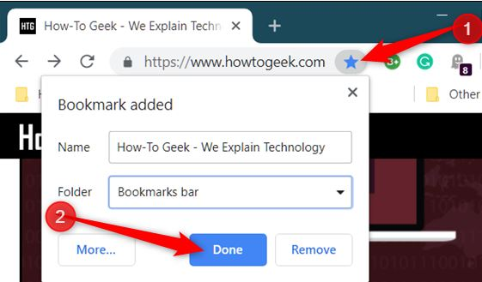
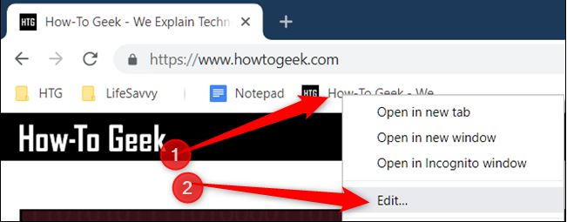
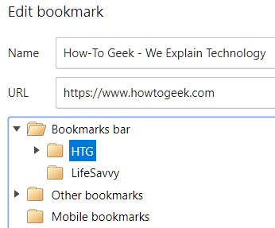
Editor popup (cont.)
This won’t run in the Console but you can just make it a favorite/bookmark in your browser:
Copy the full code from bottom right of previous slide
Do a random Google search or go to any URL you haven’t bookmarked yet
Make a favorite for it, but be sure to select Bookmarks bar (or Favorites bar in Microsoft Edge browser) before clicking Done (see screenshot upper right)
Right click the bookmark and select Edit
In the Name field, use your backspace or delete key to remove what’s there and type something like TextBox Counter instead
In the URL field, backspace to remove URL and then paste (Ctrl+v) which will insert all the code from step 1
Click Save (or Done) at bottom of Edit bookmark popup.
Now click TextBox Counter in your bookmarks bar and watch the magic!

Slide 17
How deep would you like to go?
Some ways to implement bookmarklets, jump off the train when you arrive at your preferred destination:
Copy someone else’s bookmarklet into your browser as is
Get a bunch at a time (& share yours) using Bookmarklet combiner
Learn a little JavaScript so you can customize or create your own (maximum flexibility, but takes more time & tech skill to master)

Slide 18
Custom sets of bookmarklets from Bookmarklet Combiner
Advantages: 1) full flexibility on content (you will enter custom JavaScript), 2) the set of bookmarks can be private or shareable, 3) no one can edit your original code, and 4) easy for anyone to add the set to their own browser (Chrome, Edge, Firefox, etc.)
Go to Bookmarklet Combiner (or see next slide for screenshot)
In the first section (“1. Enter bookmarklets”), type a logical bookmarklet name in the Name field and paste the full JavaScript code in the URL field (see next slide for a few basic but useful examples of JS-formatted bookmarklets to use)
Repeat previous steps with additional bookmarklets (click gray “Add another” button if you want to save a larger set)
Section 2 determines how you want to display/run them.
Section 3 is where you name this *set* of bookmarklets
In the “Result” section at the bottom, click Save button, then mouse-drag the bookmarklet set button onto your browser’s bookmarks/favorites bar to make it accessible there (you can move it later to a subfolder if desired).
If you share the URL of your bookmarklet set, others can drag your set into their browsers, too!

Slide 19
To the right is displayed the starting page for a new set of bookmarklets created in the free tool Bookmarklet Combiner (hat tip Aaron Lintz). See this or this for usage tips.
Get some pre-made sets. Just hold & drag the bottom button on page (below Result) to a convenient location in your bookmarks bar & release.
When you click the new bookmark, it expands into a menu of each selectable bookmarklet in the group. Ask friends for others!
Get many other sets (unrelated to the Combiner tool) by Googling "list|set of bookmarklets"

Slide 20
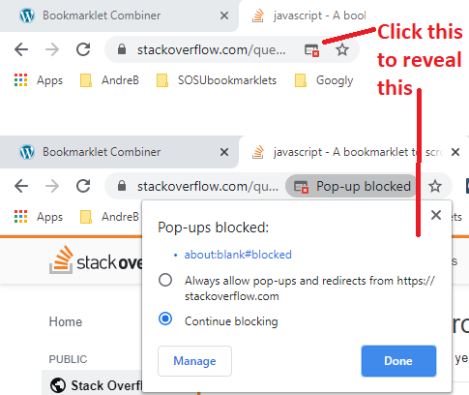
Simple common problems you can avoid
Learning to code can be hard. But don’t give up at the first obstacle. The rewards are great. Here are some things that may frustrate you and how to remedy:
If your bookmarklet doesn’t appear to run, it’s usually due to some small syntax error in your code. Run it in your Console instead and it will tell you what line the error occurred on.
For more specific error checking, you can also enter it in a free JavaScript code checker like JSHint.
Extra spaces and line returns don't matter - insert more if it helps you read code easier
If you know the code is good, watch for a popup blocker icon to the right of your browser’s address bar (see screenshot). Click “Always allow” to unblock, then try running it again.

Slide 21
Scraper software is good
Some of the best ones are free and can be added to Google Chrome (or Microsoft Edge), but there are many others besides these popular ones:
Instant Data Scraper easiest – also see DFWTRN early 2022 webinar by Bret Feig and Greg Hawkes
Webscraper.io
greater learning curve, but almost unlimited flexibility – Bret is also great with this tool. You can export saved scraping scripts (this app calls it sitemaps) for others to import free
DataMiner
Happy middle ground: slight cost if you scrape over 500 pages/month, but bigger free library of recipes (what they call scraping scripts). The vendor holds weekly online office hours where you can ask questions, too, if someone like Bret or Greg lacks time to help.
All these tools have a number of free video tutorials that are helpful, but you can ask specific questions on active sourcing Facebook groups like SourceCon, Secret Sourcing Group or Sourcers Who Code.

Slide 22
When is it not worth creating your own?
If you are trying to complete a discrete task where there is no customization involved, then you’re better off using something off-the-shelf instead. For example:
Scrolling to the bottom of a page (useful for infinite pages like Facebook). You could probably adapt this code, but getting the Scroll it! free Chrome extension is better.
You could create a script to bypass the paywalls on some news sites, but wouldn’t it be better to install this free Chrome extension (via Github) that works with a hundred top sites or this one that’s arguably even better? (Scroll to bottom of Github page for installation instructions.)
However:
If you want functionality that takes results from one page and uses it somewhere else, or you need to click a Next page button to continue grabbing results beyond what can be done from where you are, then you might be outside of bookmarklets’ capabilities and will need to create a custom Chrome extension or get software like Outwit Hub.

Slide 23
More complex script: Winmo results
Winmo.com is an interesting site to x-ray because they reveal more than they intend, e.g.:
“decision makers”
People at Intel
Note the asterisk (wildcard) placeholders in the partially-hidden email addresses of the result pages. Unlike most websites that hide data, if you combine the length of all characters (including wildcards) the length of the actual email exactly matches the length shown in Winmo. This gives us a way to automatically determine the full correct email!
This script will generate a popup when on any individual Winmo page with the (almost 100%) correct email address revealed (along with company address & phone).
This introduces a few new-to-you JS concepts, namely isolating desired portions of an HTML page by splitting into parts, creating a map array, using regex (regular expressions) to identify certain portions of a string that match our criteria, if/else loops that test which of the most popular email address formats used by companies will match the revealed + hidden parts shown on Winmo, and document.write() statements that populate desired data in a popup.
With this code as a base, it wouldn’t be hard for a novice JS coder to generate the revealed data for *all* Winmo page results in a Google x-ray search.

Slide 24
Before we go to Q&A and share some final bonuses, enjoy this (switch to PPT slideshow mode & turn on your computer audio):
“The Coding Man” by Glenn Gutmacher
(sorry, I can’t sing well)
Who can take a code block
Run-it-in the console
Wrap it in a function and a for loop or two
The Coding Man
Oh, the Coding Man can
Who can take a request
Add some more scope creep
Deliver it next day with yet more functionality
The Coding Man

Slide 25
Before Q&A + bonuses, enjoy this (world premiere was at SOSU 2020)
“The Coding Man” by Glenn Gutmacher
(sorry, I can’t sing well)
Who can take a forecast, with every talent need Generate each pipeline in a giant JSON feed The Coding Man The Coding Man (The Coding Man can) The Coding Man can 'cause he knows enough JS to make your sourcing fun
All that data is free ‘cause the Coding Man thinks it should be!
The Coding Man makes Everything he scrapes Satisfying and delicious Talk about your sourcing wishes Big thanks, hugs and some cheek kisses
Who can take a request
Add some more scope creep
Deliver it next day with yet more functionality
The Coding Man
(Disclaimer)
The Coding Man can
'Cause he knows enough JS
To parse the whole web page

Slide 26
Questions? (Appendix follows with how-to-learn coding resources & more)

Slide 27
Basic useful example bookmarklets
Find WhoIs for any domain
(this explains the getSelection syntax)
var s;
if (window.getSelection) {
s = window.getSelection().toString();
} else {
s = document.selection.createRange().text;
}
var t = prompt('Enter root domain', s);
if (t) {
t = t.trim();
location = 'https://whois.sc/' + escape(t);
}
You need to put this into bookmarklet format at MrColes and then drag that into your bookmarks bar or add the code as a row in a Bookmarklet Combiner
PRO TIP
If you ever receive a bookmarklet and you want to know how it was coded, you can use a free JavaScript beautifier to revert it back to readable line-by-line JS code like Dan’s Tools, Beautifier.io, etc.
Remember to wrap a function around all this code, unless you’re using MrColes which does it for you!

Slide 28
Basic useful example bookmarklets
Find WhoIs for domain you’re at
javascript:c=window.location.hostname;c=c.replace('www.','');location='http://who.is/whois/'+c;
Find contact emails by domain:
javascript:var s;if(window.getSelection){s=window.getSelection();}else{s=document.selection.createRange().text;}var t=prompt('Enter rootdomain after @',s);if(t){void(location='http://www.google.com/search?num=100&hl=en&newwindow=1&q=(contact+OR+email)+*%40'+t);}else{void(s);}
Preferably surround by starting with javascript:function(){
and end with })()
Github C# profiles by location (you can substitute desired skill term)
javascript:var s;if(window.getSelection){s=window.getSelection();}else{s=document.selection.createRange().text;}var t=prompt('Enter location name for C%23 Github profiles',s);if(t){void(location='https://github.com/search?q=location%3A'+escape(t)+'&type=Users&ref=advsearch&l=C%2523');}else{void(s);}
Email-Format.com (enter domain)
javascript:var s;if(window.getSelection){s=window.getSelection();}else{s=document.selection.createRange().text;}var t=prompt('Enter root domain after @',s);if(t){void(location='http://www.email-format.com/d/'+escape(t)+'/');}else{void(s);}

Slide 29
Basic useful example bookmarklets (cont.)
Find WhoIs domain records associated with an email address you know:
javascript:(function(){
var Xs;if(window.getSelection){Xs=window.getSelection();}
else{Xs=document.selection.createRange().text;}
var Xt=prompt('Enter full email address you want to find WhoIs domain records for',Xs);var Em=Xt.trim();
Pattern = /^[a-zA-Z][a-zA-Z_0-9\.\-]+@[a-zA-Z_0-9\.\-]+\.[a-zA-Z]{2,6}$/;
bValid = Pattern.test(Em);
var WN=open('http://www.whoismind.com/email/'+Em+'.html','z7','height=500,outerheight=800,width=500,outerwidth=700,left=200,top=0,resizable=1,scrollbars=1,status=0,menubar=1,toolbar=1');
if(bValid==true){void(WN);}else{alert('invalid email address');}})();
Use the MrColes bookmarklet maker to automatically remove the line breaks

Slide 30
More complex example bookmarklets (copy/paste as is to use)
Convert Bing search result into an RSS feed
javascript:Q=[]; c=location.search.slice(1).split('&'); for (i in c) { f=c[i].split('='); if (f[0]=='q' || f[0]=='as_q' || f[0]=='p' || f[0]=='query') if (f[1]) Q.push(f[1]) } R=unescape(Q.join('; ').replace(/\+/g,' ')); location = 'http://www.bing.com/search?q='+escape(R)+'&format=rss';
Show all links on page
javascript:WN7z=open('','Z6','width=800,height=400,scrollbars,resizable,menubar');DL5e=document.links;with(WN7z.document){write('<base target=_blank>');for(lKi=0;lKi<DL5e.length;lKi++){write(DL5e[lKi].toString().link(DL5e[lKi])+'<br><br>')};void(close())}
Find all emails (mailto: links) on page – try the bookmarklet here
javascript:eMlA='';for(iB2M=0;iB2M<document.links.length;iB2M++){if(document.links[iB2M].protocol=='mailto:'){Ju59=document.links[iB2M].toString();eMlA+=Ju59.substring(7,Ju59.length)+'\n'}};if(eMlA!=''){alert(eMlA)}else{alert('No mailto links on page!')}

Slide 31
2-value prompt search example 1
1. Start with base bookmarklet for a 2-value prompt (yellow text has 2nd variable prompt):
javascript:var s;if(window.getSelection){s=window.getSelection();}else{s=document.selection.createRange().text;}var one=prompt('Enter first value',s);var two=prompt('Enter second value',s);if(one){void(location='http://www.URLtoVisit.com/RestOfPath/'+one+'/'+two+'/');}else{void(s);}
2. Change wording above value prompts as appropriate for site (see yellow highlight):
javascript:var s;if(window.getSelection){s=window.getSelection();}else{s=document.selection.createRange().text;}var one=prompt('Enter LASTname only',s);var two=prompt('Enter FIRSTname only',s);if(one){void(location='http://www.URLtoVisit.com/RestOfPath/'+one+'/'+two+'/');}else{void(s);}
3. Change URL pattern to match the site (in this case, http://www.peoplebyname.com/people/gutmacher/glenn):
javascript:var s;if(window.getSelection){s=window.getSelection();}else{s=document.selection.createRange().text;}var one=prompt('Enter LASTname only',s);var two=prompt('Enter FIRSTname only',s);if(one){void(location='http://www.peoplebyname.com/people/'+one+'/'+two);}else{void(s);}
4. Copy new bookmarklet into your bookmarks/favorites!

Slide 32
Bookmarklet & other coding resources
Wikipedia’s entry for bookmarklet
Good how-to and resources from Casey Watts
Bookmarklets – Subsimple Browser Power guide
This Dutch guy has a how-to guide and a tool
Other lists of bookmarklets
An editing tool to manage bookmarklets
Some of the better free resources (best way to start before you commit) are in this great categorized annotated list at LearnToCodeWithMe which includes popular online class environments sites Codecademy (bite-size chunks in interactive coding environment), Coursera, and video-skewing ones like Khan Academy, etc., vs. blogs (good if you like reading step-by-step).
But there’s nothing wrong with googling JavaScript Tutorial or searching just within YouTube if you prefer video format only.

Slide 33
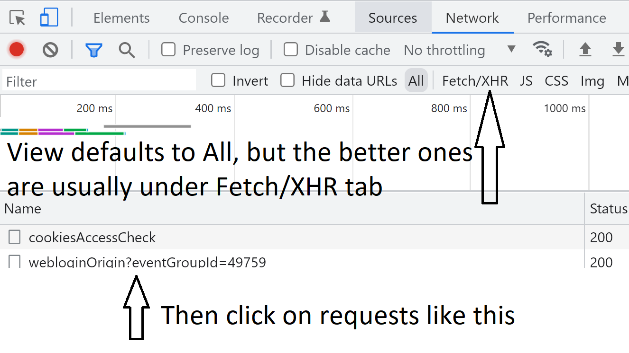
If you want to take it further…
You will inevitably discover target talent-relevant online events like https://cultivate.eightfold.ai/ but pick one you can pre-register for & access *while* it’s happening live & you can get all the attendees’ basic contact details *if* you know how to use:
The network tab on your console (from your browser tab, press Ctrl+Shift+i then click Network tab) will reveal activity going on behind the scenes.
A free tool like Postman (download or Web-based) to simulate network requests from the browser and reveal the resulting data.
View my YouTube playlist of Postman beginner tutorial videos & this video on how to find the hidden API when webscraping
And here’s an example of how to use Google Apps Script (which is based on JavaScript).

Slide 34
Bonus (breaking my free rule slightly)
One of the unique things you might want to pay for is Quickli, created by Andre Bradshaw). This mega Chrome extension lets you do amazing things with LinkedIn data. I can’t do it justice to explain it all, but his videos give you a clue. Buy it for a month; you’re highly likely to renew.
But here’s a free part that ties into our previous bookmarklets explanation: His tool generates (for many results) more than one personal email address per profile. The excel-compatible output combines all those emails into one column. So he created a JavaScript to place each email in its own column. He suggests converting it into a bookmarket for ease of use.
While his script is more complex, bookmarklet creation is the same as the examples shown earlier in this deck:
ONE-TIME steps:
Copy his script (currently 245 lines) from here.
Go to MrColes, erase alert(“test”) in the textbox and paste code from step 1 there.
In the Name: field, replace this link with a logical name (e.g., Quickli split emails)
Click gray Convert to bookmarklet button
Hold & drag the new Quickli split emails blue button to a convenient location on your top bookmarks bar & release.
ONGOING usage steps:
Once you export LI profile data from Quickli, select the bookmarklet. It generates a popup where you can paste the data from your Quickli emails column (copy/paste just BELOW the header row). Optionally, toggle “Remove Corporate Emails” on if you only want personal emails.
Click “Split Emails and Sort” button at bottom.

