Slide 1
Get Creative Using Social To Recruit
Meeting Applicants Where they Hang out

Slide 2
Why Use Social Media To Recruit?
25% of all job seekers use social media to do more than just find and connect with friends—they use it to pinpoint their next career opportunities as well.
73% of 18-34 year-olds found their last job through social media. (Capterra)
59% of recruiters rated candidates sourced through social media as “highest quality.” (Jobvite)
21% of candidates said they found their dream job through social media (Jobvite)
83% of job seekers prefer Facebook over any other social network.
56.3 % of Worlds Population uses Social Media (4.66 b)
Diversify Your Recruiting Efforts
New Pew Research data shows that minority groups tend to over-index in their use of many social media platforms
Notes:
https://sproutsocial.com/insights/social-recruiting-guide/
https://www.smartinsights.com/social-media-marketing/social-media-strategy/new-global-social-media-research/
https://khoros.com/resources/social-media-demographics-guide
https://www.omnicoreagency.com/social-media-statistics/
https://blog.hootsuite.com/social-media-demographics/
https://www.pewresearch.org/internet/2021/04/07/social-media-use-in-2021/

Slide 3
Let’s Chat with Recruiters Who use Social Successfully
Charles Martin - theinternguy
University Recruiter
Gabrielle Woody – careerconfidant
University Relations and Diversity Lead

Slide 4
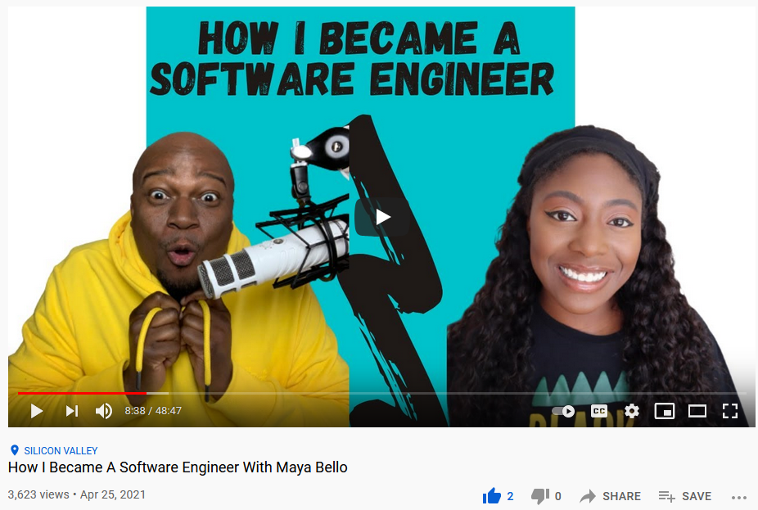
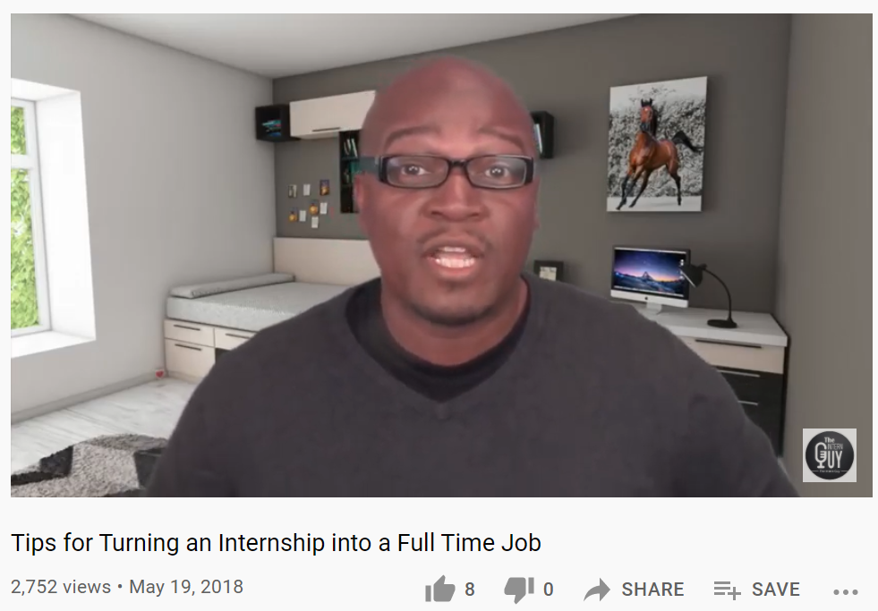
Recruiting and Career Advice on Youtube
https://www.youtube.com/watch?v=esvlT5tHjPg
https://www.youtube.com/watch?v=QblACYPQ464
2b monthly users | 44% female 56% male | 84% of African Americans & 85% of Hispanics Use | 2nd most visited
Notes:
Emily.the.recruiter on YouTube – also known as the TheStraightShooterRecruiter
On YouTube – follow her channel here: https://www.youtube.com/channel/UCUApm5FZ_Z523Tr45rWZxog
https://anchor.fm/tssr
YouTube Stats
https://blog.hootsuite.com/youtube-stats-marketers/
https://www.omnicoreagency.com/youtube-statistics/

Slide 5
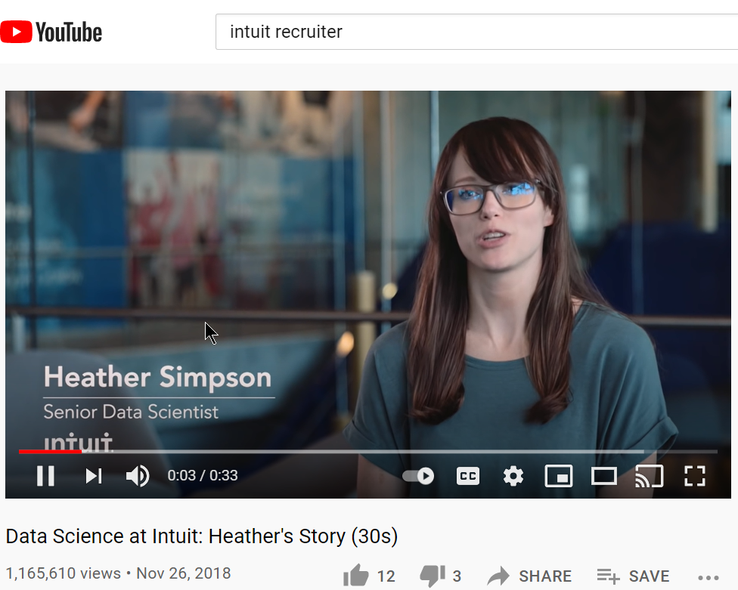
Corporate YouTube Video Examples
Over 1.16m views
Over 27k views
Position | Skill Related Videos Do Really Well
Information on Recruiting Process is Helpful

Slide 6
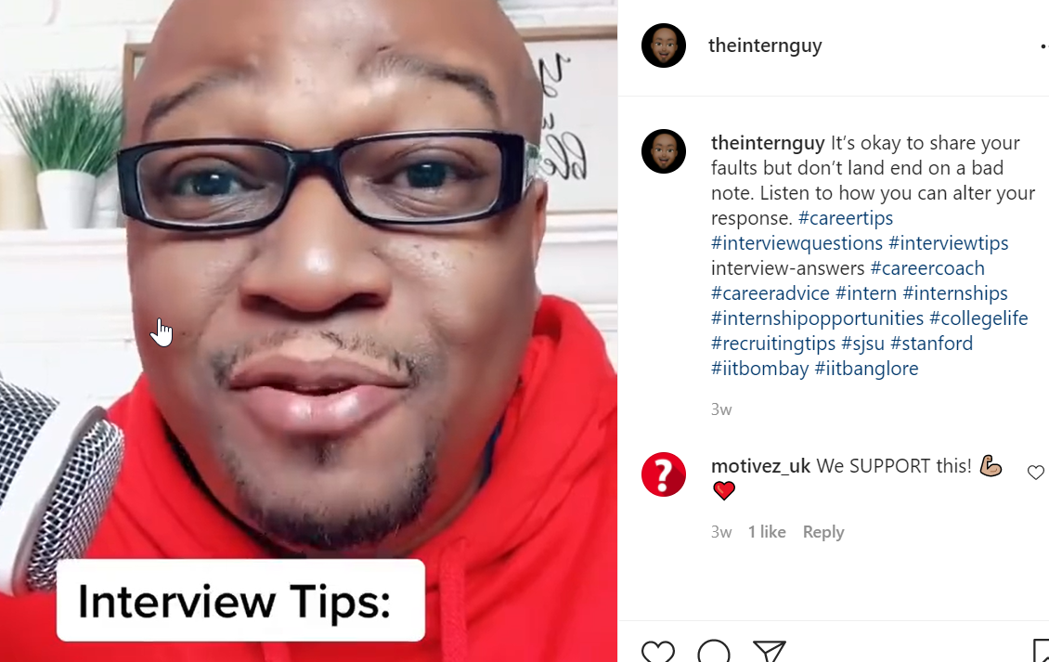
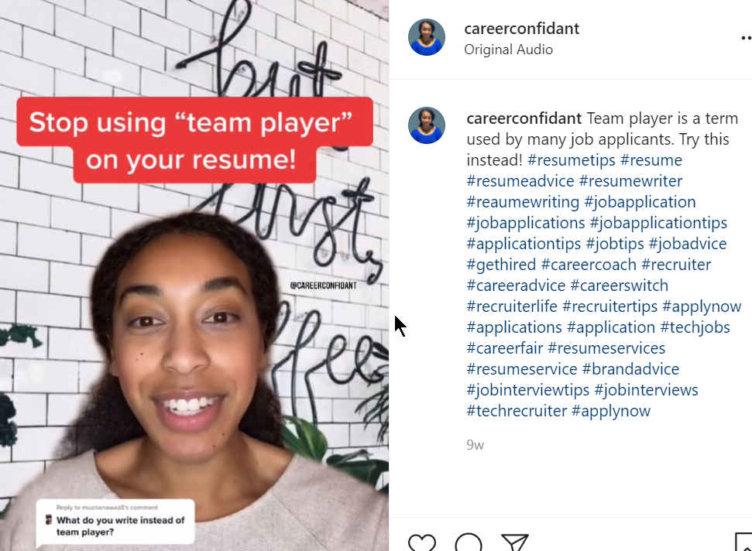
Recruiting and Career Advice on InstAGram
1b Monthly Users | 51% female, 49% male | Largest age group: 25-34 (33.1%) | 6th most visited
| 43% African American ; 38% Hispanic; 32% White User Base
Notes:
https://www.instagram.com/theinternguy/?hl=en - Charles Martin
Instagram Stats
https://blog.hootsuite.com/instagram-statistics/ - Instagram stats
https://sproutsocial.com/insights/new-social-media-demographics/
How To Recruit Using Instagram
https://theundercoverrecruiter.com/how-to-recruit-using-instagram-in-5-simple-steps/
https://beamery.com/resources/blogs/recruiting-on-instagram-the-ultimate-playbook
https://recruiterbox.com/blog/recruiting-on-instagram-4-companies-crushing-it
https://www.talentlyft.com/en/blog/article/260/how-to-find-candidates-using-instagram
How to Job Search Using Instagram
https://www.flexjobs.com/blog/post/using-instagram-for-job-searching-v2/

Slide 7
Recruiting & Career Advice on Snapchat
381m active monthly users | 58% female 40% male | Largest age group: 13-34 (75%)
| 26% Black & 31% Hispanics Use

Slide 8
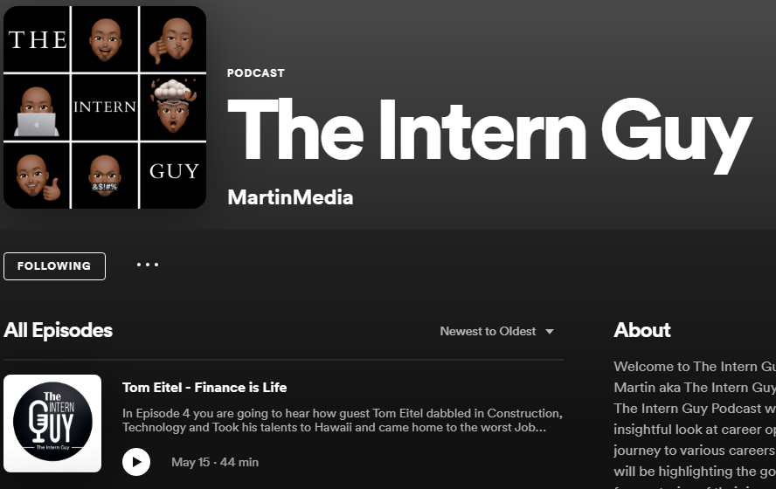
Recruiting and Career Advice on Spotify
345m subscribers | 56% female, 44% male | 55% of US Spotify users under age of 35
Notes:
Stats
https://www.businessofapps.com/data/spotify-statistics/#5
Link to Spotify:
https://open.spotify.com/show/4nojpZBEv29NgUBZ4v3MKZ?si=9d5b316b487940c9

Slide 9
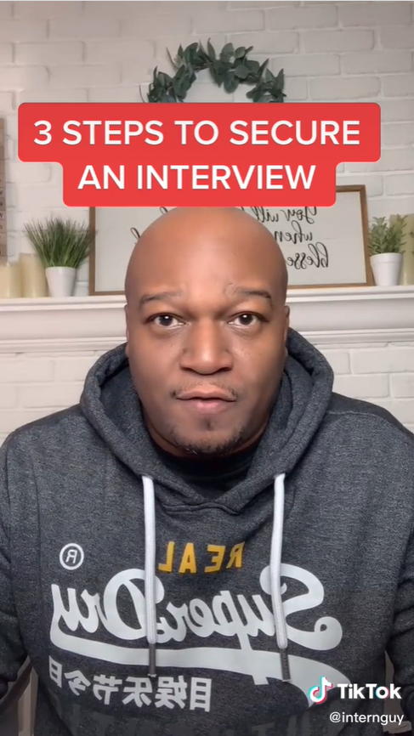
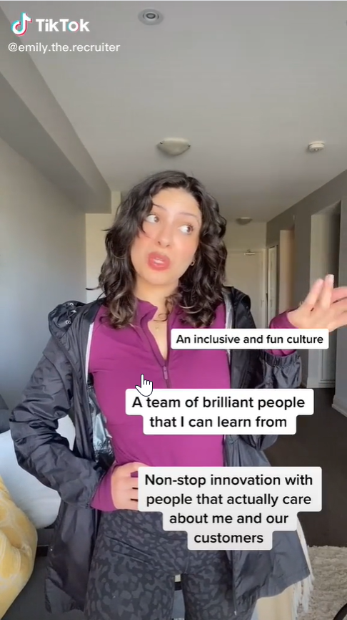
Recruiting & Career Advice on TikTok
careerconfidant
Emily.the.recruiter
theinternguy
100m monthly | 59% female 41% male | Largest age group: 18-24 | 30% of Blacks & 31% of Hispanics Use
Notes:
https://www.tiktok.com/@careerconfidant? – Gabby Wood
https://www.tiktok.com/@internguy? – Charles Martin
https://www.tiktok.com/@emily.the.recruiter?lang=en – Emily Durham
Article‘s
https://www.narcity.com/how-to-get-a-job-on-tiktok-instagram-was-revealed-by-recruiter#toggle-gdpr Emily Durham
https://www.washingtonpost.com/business/2021/03/26/tiktok-career-advice-job-interview-tips/ Gabrielle Woody, a recruiter for financial software company Intuit (whom Sorto follows), said she started posting videos in June — after she had more spare time during the pandemic and was no longer traveling for work. Topics include skills not to list on résumés, what questions are legally okay for an interviewer to ask and a four-part series on getting recruiters’ attention.
Stats
https://sproutsocial.com/insights/new-social-media-demographics/

Slide 10
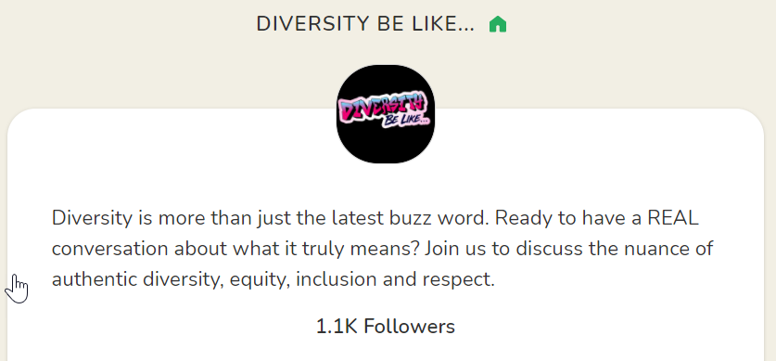
Recruiting with ClubHouse
Examples of Clubhouse content includes: Job search strategies; Networking; Interview prep; (Reverse) Career Fairs
10m downloads | App is in Beta | Supported by Celebrities and Tech Leaders
Notes:
https://www.clubhouse.com/@careerconfidant
https://www.clubhouse.com/
What is Clubhouse - https://www.nytimes.com/2021/02/20/at-home/clubhouse-app-explainer.html
A social networking app that lets people gather in audio chat rooms to discuss various topics, whether it’s sports, wellness, art or why Bitcoin is headed to $87,000. Rooms are usually divided into two groups: those who are talking and those who are listening (participants can see a list of everyone who is in a conversation, and the numbers sometimes run into the thousands). Unlike Twitter, Clubhouse is a closed, hierarchical platform: A moderator oversees discussions and has the ability to let someone chime in or to kick out the unruly. In addition to the “clubs” sorted by topic, two or more users can join together and start their own chat room.
https://www.cnbc.com/2021/01/10/black-users-turned-social-app-clubhouse-from-drab-to-fun.html

Slide 11
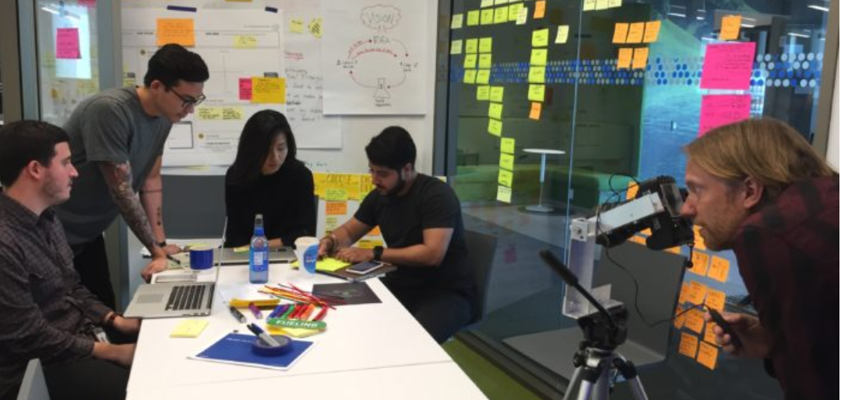
Recruiting using VR
“We heard from many students that they wanted to know more about our design culture” says Gabrielle Woody, one of our university recruiters. “We saw this as a way to show the type of technology we work on while delivering a unique candidate experience at our booth.”
https://www.ere.net/how-we-at-intuit-changed-our-recruiting-game-in-10-days/

Slide 12
Recruiting and Career Advice using Blogs
https://blog.powertofly.com/advice-from-an-intuit-recruiter
You Can Create Your Own Blog or Participate as a Guest

Slide 13
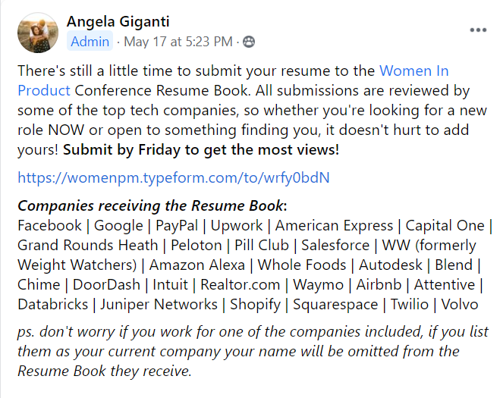
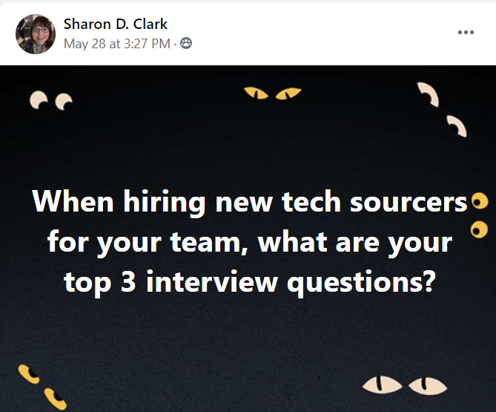
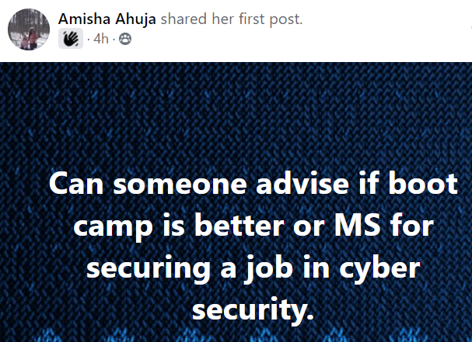
Recruiting & Career Advice on Facebook
2.7b monthly users | 44% female, 56% male | Largest age group: 25-34 (26.3%) | 74% Black and 72% Hispanics USE
Notes:
Stats
https://sproutsocial.com/insights/new-social-media-demographics/

Slide 14
Recruiting and Career Advice Using Slideshare.net
1415 views
1405 views
Notes:
https://www.slideshare.net/ghouston/

Slide 15
Follow Charles and Gabby
Site | Follow Charles Martin | Follow Gabrielle Woody
YouTube | https://www.youtube.com/channel/UC8t2h9N1IJ3DAKM92CF3nYw | https://youtube.com/channel/UCClWYUZTrBi4d9cJNDnDRnw
Instagram | https://www.instagram.com/theinternguy/?hl=en | https://www.instagram.com/careerconfidant/
TikTok | https://www.tiktok.com/@internguy?lang=en | https://www.tiktok.com/@careerconfidant?
SnapChat | https://www.snapchat.com/add/internguy | n/a
Spotify | https://open.spotify.com/show/4nojpZBEv29NgUBZ4v3MKZ?si=FGenHll-SVueTJW6k8w4wA&nd=1 | n/a
Clubhouse | https://clubhousedb.com/user/theinternguy | https://www.clubhouse.com/@careerconfidant

Slide 16
Questions?

