Slide 1
The Future of Work
Today’s Professionals working with/for/among
Millennials

Slide 2
Today’s Topics
Millennials ~ are the Largest Generation of today’s Work Force
How do they define Success? It’s different today
Future of Work Trends for Business Leaders
Work Places and Organizations are evolving…Are you?
Mobile Worker
Freelancing is the new NORM
The Future of Work in a Global Economy
Are you ready to be Boss? Maybe…Maybe Not?
When you Run the Show
The Future is Yours!
Notes:
This slide provides an opportunity to talk about market disruption – that is happening across every industry. It provides a way to transition into a discussion of our original research around digital disrupters (key findings and an explanation of the research are on slides to follow).

Slide 3
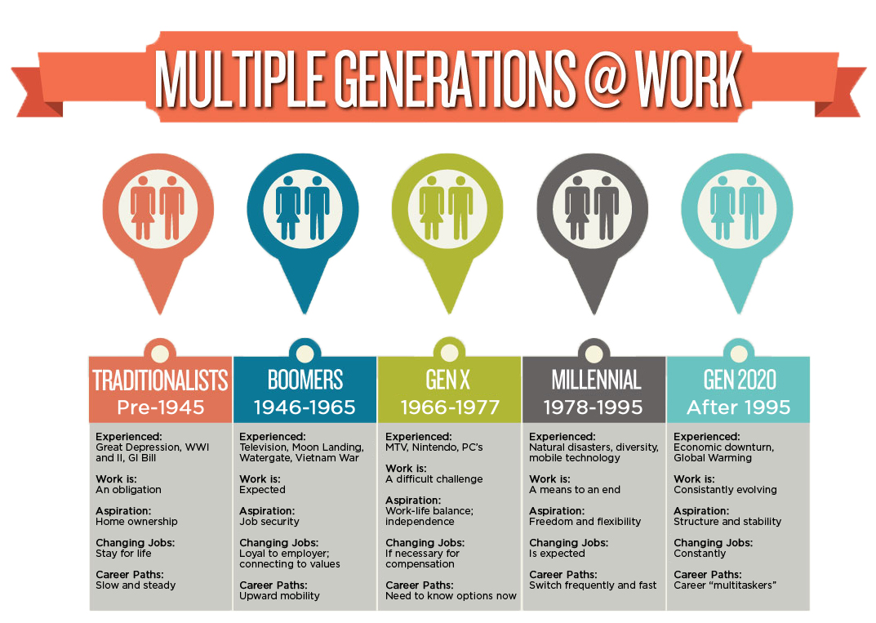

Slide 4
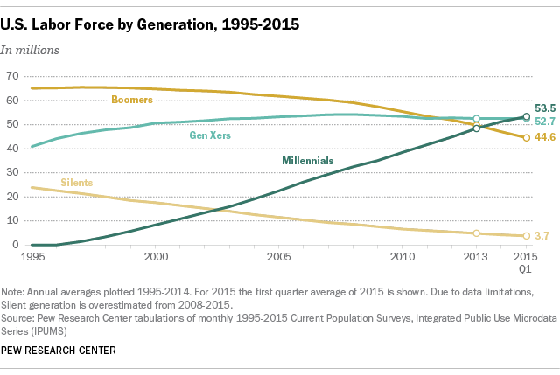
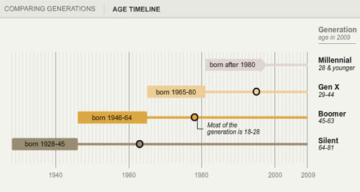
Who are the Millennials?
American Generation Age Timeline | Pew Research

Slide 5
How do you Define Success?
"Paying your dues, moving up slowly and getting the corner office — that's going away. In 5 years, it will be gone!"
"Instead, success will be defined not by rank or seniority but by getting what matters to you personally,"
Whether that's the chance to lead a new-product launch or being able to take winters off for snowboarding.
"Companies already want more short-term independent contractors and consultants and fewer traditional employees.
Seniority matters less and less as time goes on, because it's about the past, not the future."
Notes:
"Paying your dues, moving up slowly and getting the corner office — that's going away. In 10 years, it will be gone," says Bruce Tulgan, head of the consulting firm Rainmaker Thinking, based in New Haven, Conn., and author of a new book about managing Gen Y called Not Everyone Gets a Trophy.

Slide 6
Future Trends Are
Changing behaviors which are being shaped by social media entering the enterprise.
New collaborative techniques and technologies
Flexible Workplaces
Support your Personal Mission
A shift to the “cloud” for your work effort
Mobility and “connecting to work.”

Slide 7
Workplaces Must Empower Collaboration and Innovation
The millennial generation essentially demands a corporate culture anchored in collaboration.
Recent studies show 82 percent of millennials believe collaboration is the key to innovation and aspire to work in companies that agree.
This means organizations should invest in technology and spaces that encourage and drive collaboration while also enabling the type of work their people need to get done.

Slide 8
New collaborative technologies
New collaborative technologies are dramatically impacting the way we work.
These technologies give us the freedom and flexibility to work from anywhere, anytime.
Being able to find subject matter experts and connect with colleagues (known or unknown) across the globe is now a possibility that didn’t exist.
Hierarchies are being flattened regardless of seniority and information is being opened up instead of being locked down.
Systems are being connected and opportunities for business process improvement, customer experience, and overall efficiency improvement abound.

Slide 9
Companies Must Support Their Mission
The millennial generation believes business should do more than generate profit, it should also change the world.
The 2015 Millennial Impact survey indicates that 97 percent of millennials want to use their skills to help a cause.
This means organizations must do more than simply draft new values and mission statements, they should also consider aligning their workspace around their mission.

Slide 10
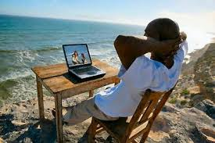
Mobility and “Connecting to work”
Mobility is not just about being able to work and get access to people and information from a mobile device.
It’s also about being a mobile worker which means you can work from anywhere, anytime, and on any device.
The idea of “connecting to work” is become more prevalent within organizations as they are starting to allow for more flexible work environments.
The notion of having to work 9-5 and commuting to an office is dead.

Slide 11
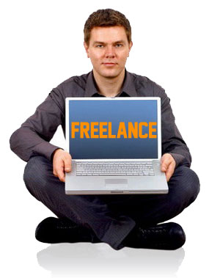
Traditional Work is Dying… FREELANCING is here
We’ve seen glimpses of the looming changes already: freelancers now make up 34%—that's 53 million people—of the U.S. workforce, according to a 2015 survey by Edelman Berland.
In the next 10 years, this shift will accelerate in a major way towards entrepreneurship, independent contracting, and "peer-to-peer" work on platforms like TaskRabbit or TopTechJobs.
There will be major diversification of entrepreneurship as new platforms like crowdfunding and relocalized production become increasingly popular.

Slide 12
Work Will Consist Of Many "Short-Term" Assignments
A career will be hundreds of short-term assignments spread out over a lifetime.
By 2025, the majority of the job market will consist of part-time assignments, portfolio careers, and entrepreneurialism.
Instead of day-in, day-out work consisting of much of the same responsibilities, a "career, then, will be composed of hundreds of [short-term] assignments spread out over a lifetime".
In other words, workers will work on short-term assignments ranging from several days to multiple years, and will become employees for their own firms.
As this becomes the norm, the vast majority of job growth in 2030 will come from small businesses.

Slide 13
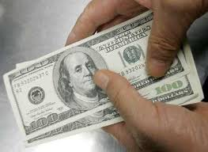
Small-Business Growth Will Lead To A Boost In Wages
The rise in self-employment will inevitably increase wages.
Additionally, as the aging population retires and with a birthrate below replacement, the labor supply will decrease, which will also play a role in boosting wages.
Just remember, now you are paying for your own insurance, benefits, PTO, 401k, training, etc.

Slide 14
Everyone Is Responsible For Their Own Success
Your career success relies solely on you.
Workers will be forced to think constantly about their next assignment, the skills required for that assignment, and the education and credentials required to gain those skills.
To be successful, individuals will have to be more entrepreneurial in thinking and planning their lives, meaning constantly selling themselves, defining one’s own work, and educating themselves for future assignments.

Slide 15
MILLENIAL PANEL
INTRODUCTIONS

Slide 16
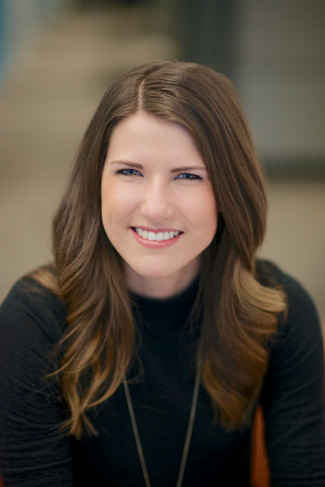
KATT ANDERSON
Network Manager | Public Relations
Catalyst Health Network
Employed by:
Catalyst Health, StratiFi Health, Village Health Partners, Dr. Kevin Conner, MD, Starbucks
University:
Dallas Baptist University
Bachelor of Arts, Political Science

Slide 17
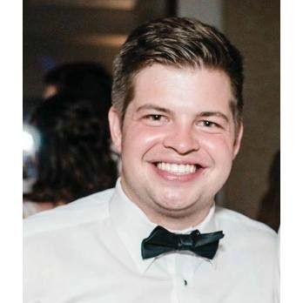
MITCH
MILLER
Senior Tax Analyst
ClubCorp
Employed by:
ClubCorp, Deloitte Tax, and Southern Methodist University
University:
Southern Methodist University
Masters & Bachelor’s - Accounting

Slide 18
JAMES YODER
Partner
Start-up
Employed by:
Simpli.fi; Ro5.ai; Charles Thames
University:
Harvard University
Bachelor of Arts, Statistics

Slide 19
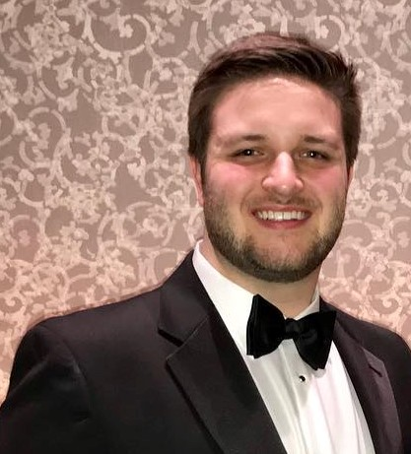
BRADY KREITMAN
Business Insight Analyst II
Conifer Health Solutions
Employed by:
Conifer Health, Fluor Corporation
University:
The University of Texas at Austin
Bachelor’s Degree in Physics

Slide 20
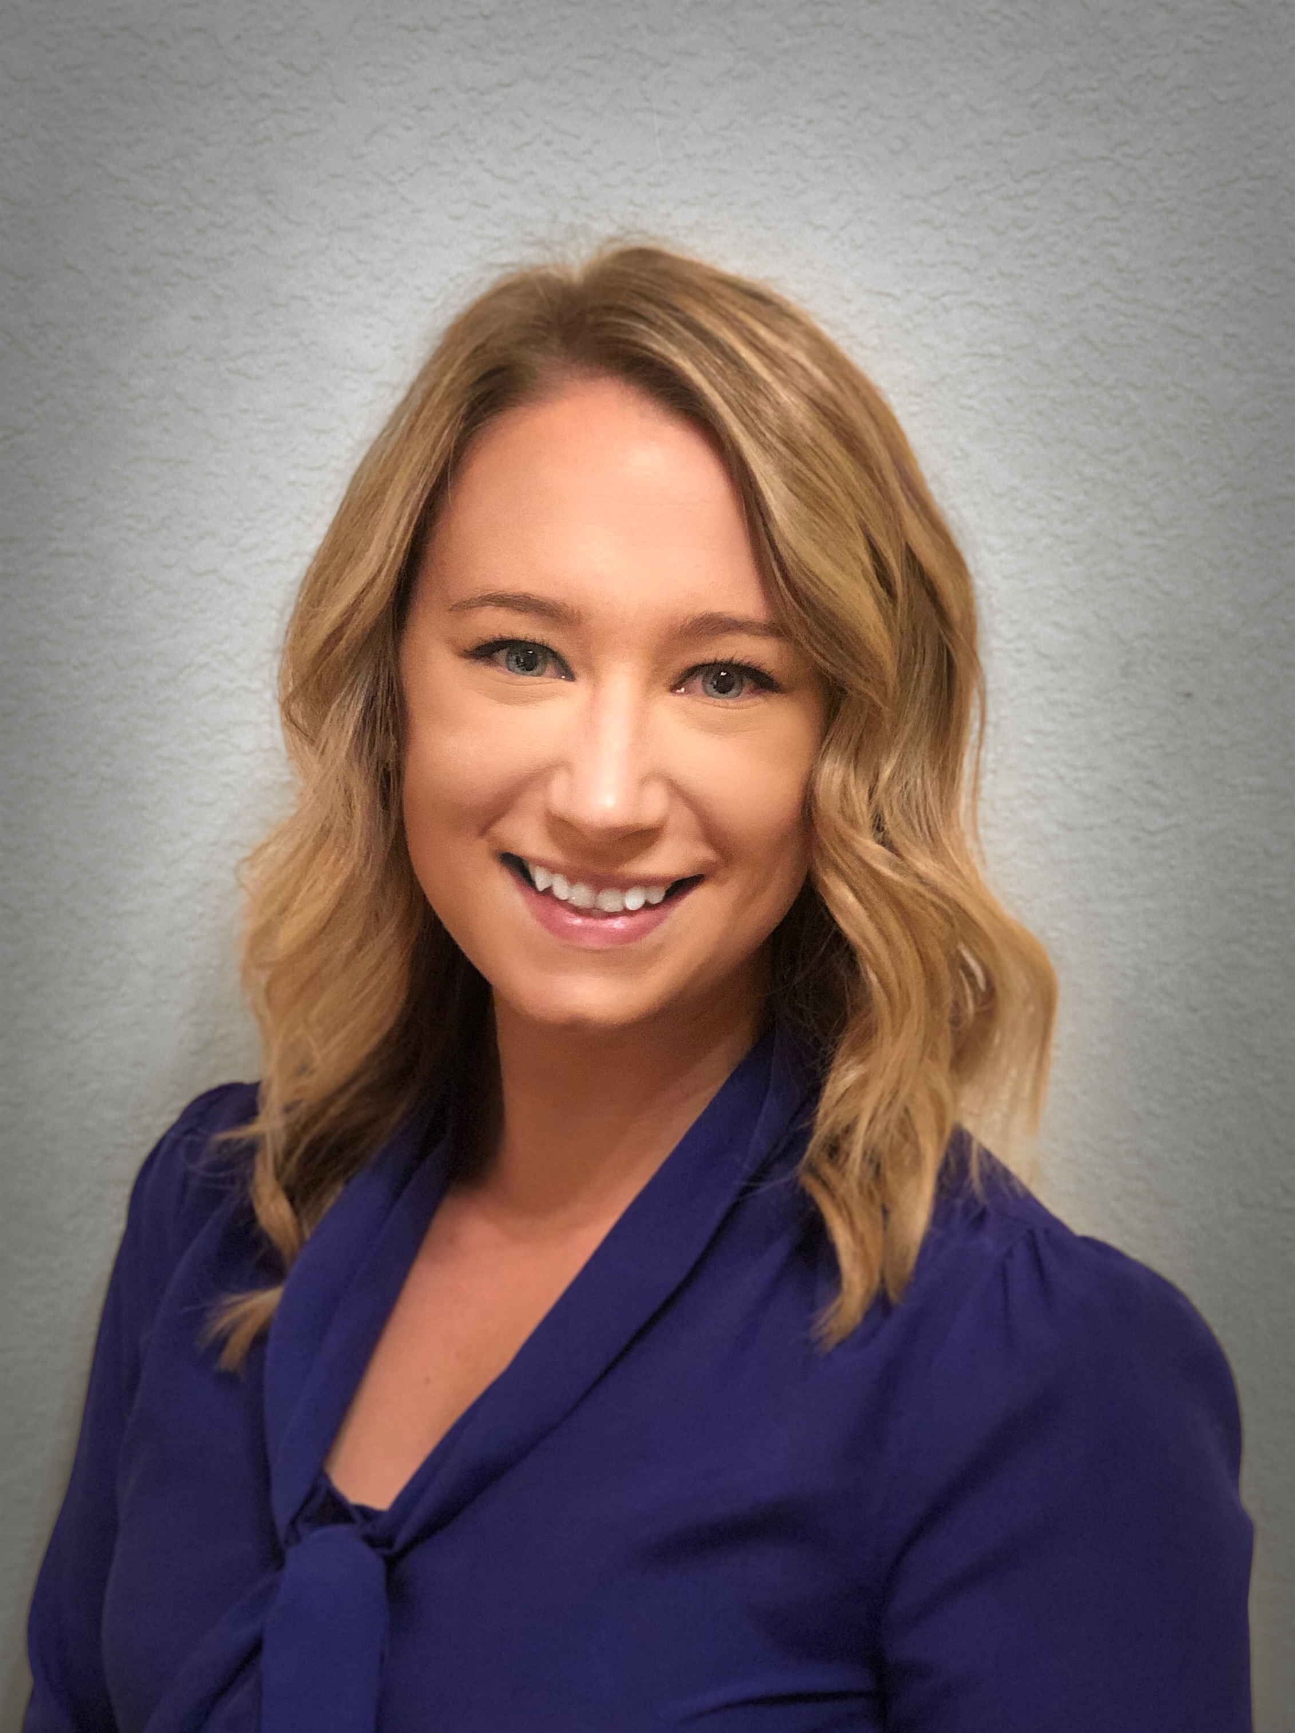
KIM
MALIN
Product Development Manager
Research & Development
Borden Dairy Company
Employed by:
Borden Dairy, Keurig, Dr. Pepper Snapple
University:
Masters of Food Science
Kansas State
Bachelor’s of Science – Chemistry
University of Illinois

Slide 21
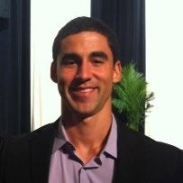
NICK
ECHEVARRIA
Data Visualization Architect
American Airlines
Employed by:
American Airlines, Ericsson, Novation
University
Arizona State University
B.S. Logistics, Materials, and Supply Chain
B.S. Finance

Slide 22
JENNIFER
GOEBEL
Operations Supervisor
Uber
Employed by:
Uber, ADP, Sour Wired Café, NetApp,
All-American Dance Company
University
Millsaps College
BBA, Business Administration, Communications, and International Business

Slide 23
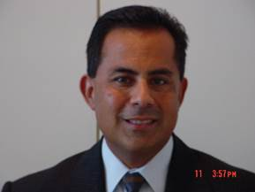
@rickmartinez
Rick Martinez
rick@r2now.com
www.linkedin.com/in/rickmartinez
214-382-3992
www.r2now.com

