Slide 1
Wednesday August 7th 2019
DFWTRN is the place to Network!

Slide 2
Welcome Guest
Become a member to receive discounted luncheons, member directories and more!
Network with talented Recruiters
Promote your company brand
Learn from experts
Stay informed on industry topics

Slide 3
DFWTRN = Great Lunches and Networking!

Slide 4
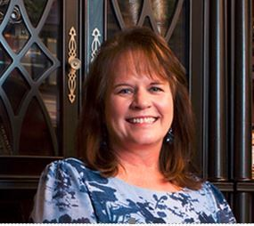
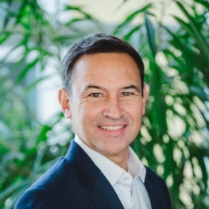
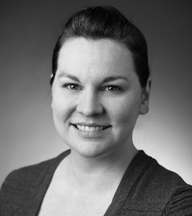
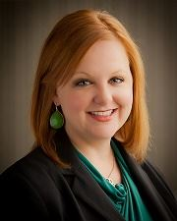
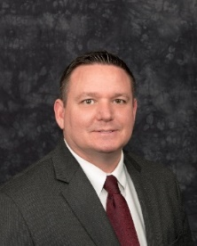
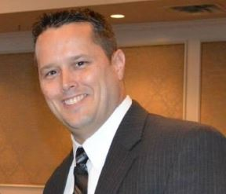
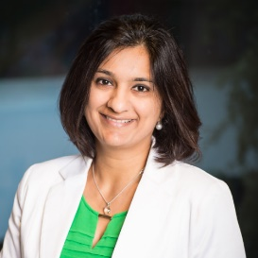
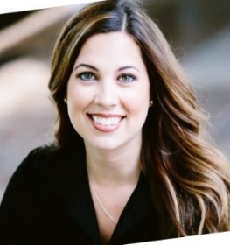
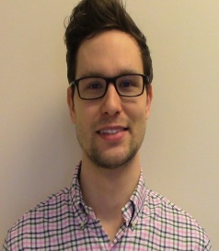
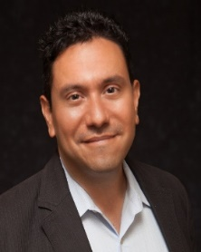
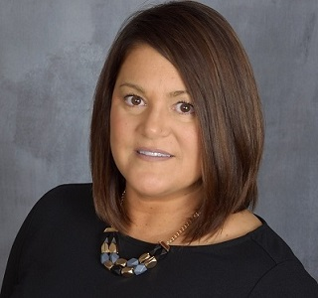
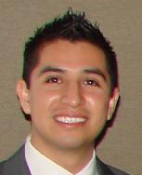
DFWTRN Board Members
Gail Houston
Education Director
Jim Schnyder
Education Director
Heather Matthews
Membership Director
Sara Stoub
Secretary
Douglas Roark
President
Jim Brown
Treasurer
Alishaa Chhabra
Marketing Director
Amanda Thompson
Sponsorship Director
Travis Russell
Treasurer Assistant
David Jaramillo
Vice President
Jen Idrizi
Social Media Director
Jose Jaramillo
Registration Volunteer

Slide 5
DallasHR Stars Gala Awards Ceremony
HRSTARS Award Gala
Date: February 8th, 2020
Location: Westin Galleria
Register: DallasHR.org
Ten Awards will be presented including the industry’s best HR Executive of the Year and a Lifetime Achievement Award.
Nominate and Register Today!
Nominate your team for “Recruiting Team of the Year” on the RTOY page of DFWTRN

Slide 6
Meeting Sponsor
Quarterly Sponsors
Annual Sponsors

Slide 7
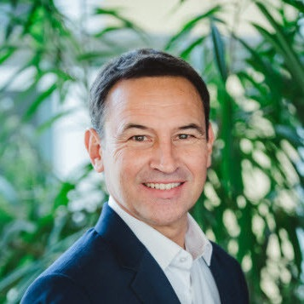
DFWTRN Welcomes Jim Schnyder
Topic: Rapid Fire Recruiting Tips and Tricks!
SPEAKER

Slide 8
Recruiting Humor

Slide 9
Artificial Intelligence

Slide 10
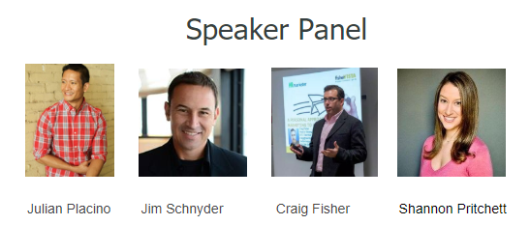
Global Talent Acquisition Appreciation Day
Global Talent Acquisition Appreciation Day is a worldwide day to celebrate the recruiters, hiring managers, staffers, sourcers, employer brand managers, and everyone in between! DFWTRN host the largest event in the USA! Come join your peers for this free event!
Brought to you by:
9/4/2019
Register
at
DFWTRN.org
Free Admission to the first 200 Talent Acquisition Professionals, so be sure to invite your team!
RSVP Required - No Walkins

Slide 11
Global Talent Acquisition Appreciation Day
Brought to you by:
TA DAY SPONSORS!

Slide 12
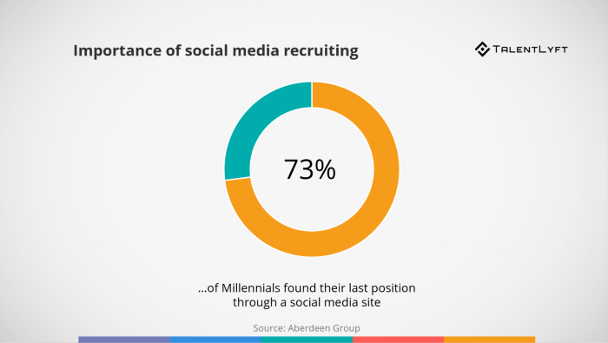
Social Media Recruiting

Slide 13
SOURCECON ACADEMY

Slide 14
Qjumpers ATS Software

Slide 15
HIGH PROFILE

Slide 16
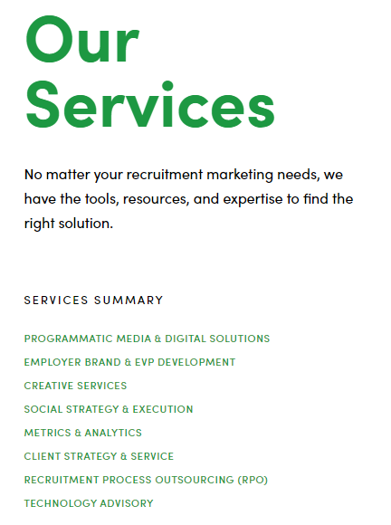
BAYARD ADVERTISING

Slide 17
MM Goldberg & Associates

Slide 18
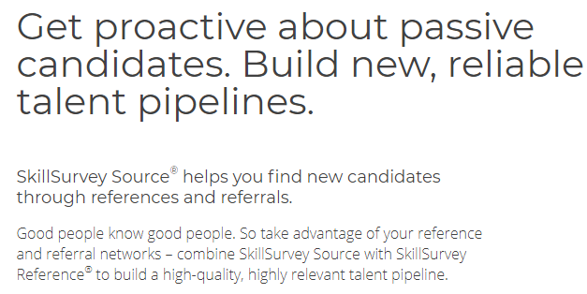
SkillSurvey is a Talent Acquisition Day and Annual DFWTRN Sponsor

Slide 19
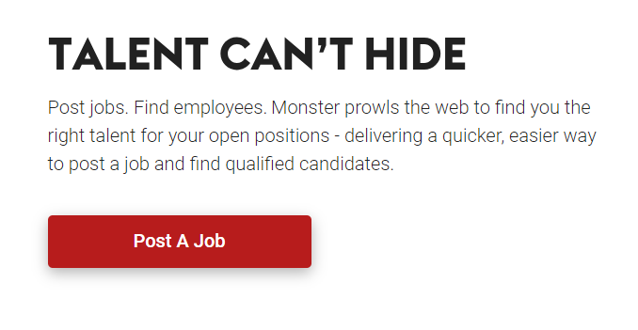
Monster.Com

Slide 20
HIRETUAL

Slide 21
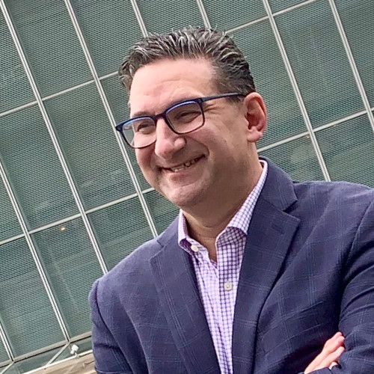
Hiretual Webinar Series
Tuesday August 13th at 8:00 a.m. Central
Making a Difference with a Recruiting Roadmap
https://www.hiretual.com/making-a-difference-with-a-recruiting-roadmap
Speaker
Host
Michael Goldberg
Ninh Tran
Partner at Strong Tower Partners
LinkedIn: in/michaelgoldberg/
Twitter: @SuperRecruiter
Email: michaelmogoldberg@gmail.com
Founding Member, Hiretual
LinkedIn: in/ninhtran08/
Twitter: @ninhtran09
Email: ninhtran@hiretual.com

Slide 22
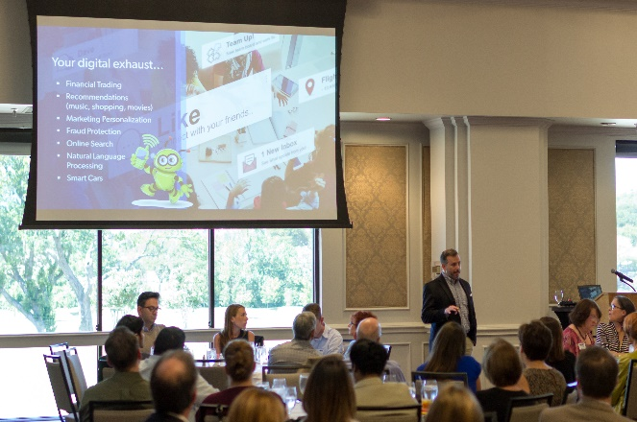
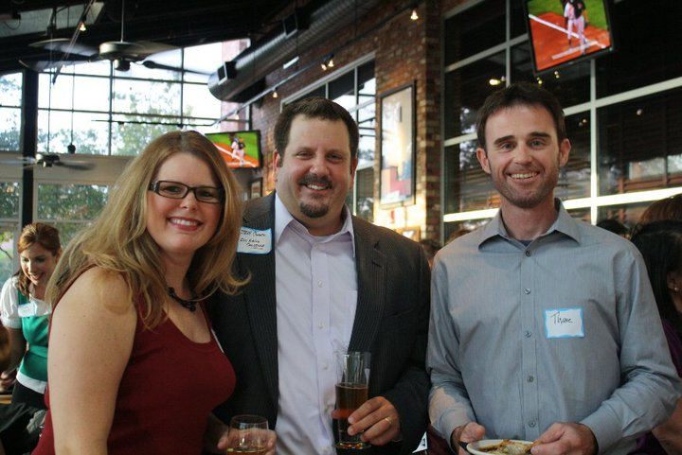
Networking is FUN at DFWTRN

Slide 23
DFWTRN Happy Hour!

Slide 24
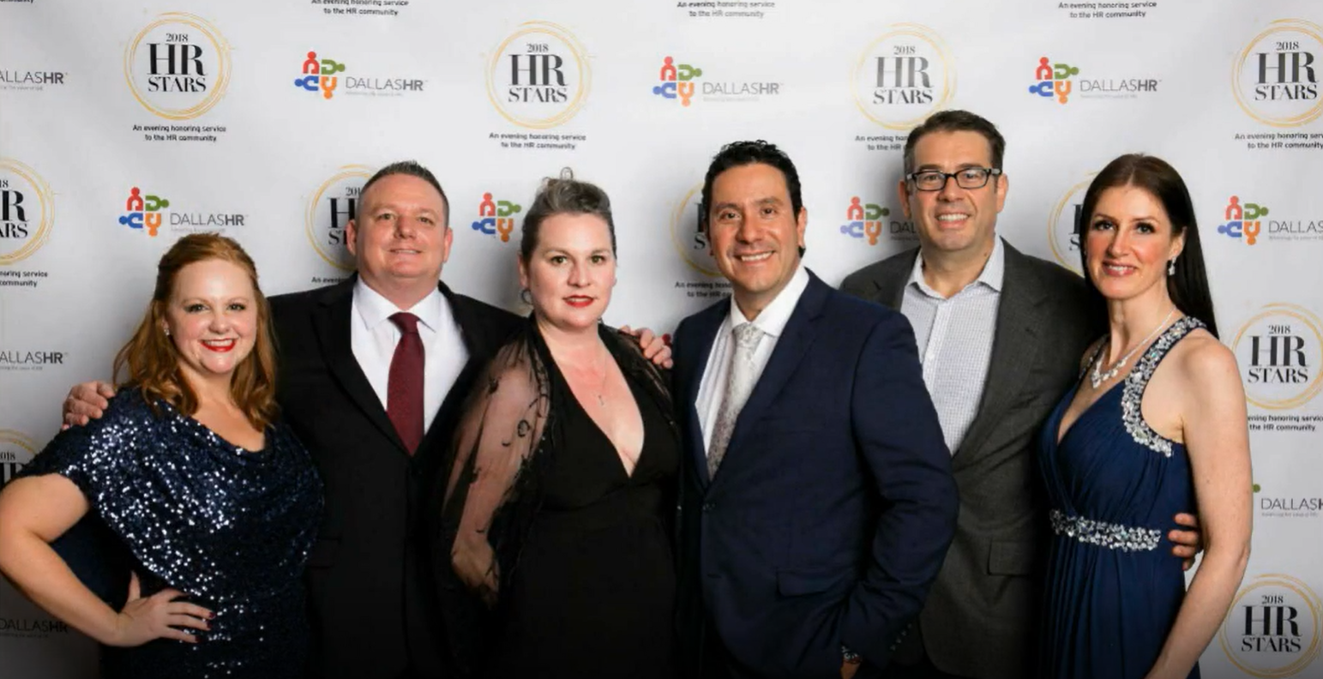
DFWTRN – HR Stars Gala

Slide 25
Diversity is Talent
Enables you to attract the best human talent
Enables you to reach and serve diverse markets
Higher creativity and innovation
Better problem solving & Organizational flexibility

Slide 26
Write great job descriptions
Use well-known titles for your job description.
Identify what makes your company a great place to work.
Many great candidates will avoid positions without clear, concise goals. Prioritize into four to six bullets.
Don’t format responsibilities and qualifications in paragraphs. Bullets help make requirements easy to scan and digest quickly.

Slide 27
Global Talent Acquisition Appreciation Day
Global Talent Acquisition Appreciation Day is a worldwide day to celebrate the recruiters, hiring managers, staffers, sourcers, employer brand managers, and everyone in between! DFWTRN host the largest event in the USA! Come join your peers for this free event!
Brought to you by:
9/4/2019
Register
at
DFWTRN.org
Free Admission to the first 200 Talent Acquisition Professionals, so be sure to invite your team!
RSVP Required - No Walkins

Slide 28
Global Talent Acquisition Appreciation Day
Brought to you by:
TA DAY SPONSORS!

Slide 29
DallasHR Stars Gala Awards Ceremony
HRSTARS Award Gala
Date: February 8th, 2020
Location: Westin Galleria
Register: DallasHR.org
Ten Awards will be presented including the industry’s best HR Executive of the Year and a Lifetime Achievement Award.
Nominate and Register Today!
Nominate your team for “Recruiting Team of the Year” on the RTOY page of DFWTRN

Slide 30
Searching the globe for candidates?
Register each month for DFWTRN lunch and learns! Learn the best practices that you can use to make your job easier!

Slide 31
Suggestions? Comments?
Email us at: info@dfwtrn.org
We are happy to help you!

