Slide 1

Forget ChatGPT & AI - Beating the Bots While Sourcing
Trish Wyderka * DFWTRN * August 10, 2023

Slide 2

Takeaways…
Introduction to AI versus Humans
Learn how to use AI such as ChatGPT to make your life easier!
Creative ways to identify candidates.
Low-cost ways to find emails and/or phone numbers.

Slide 3
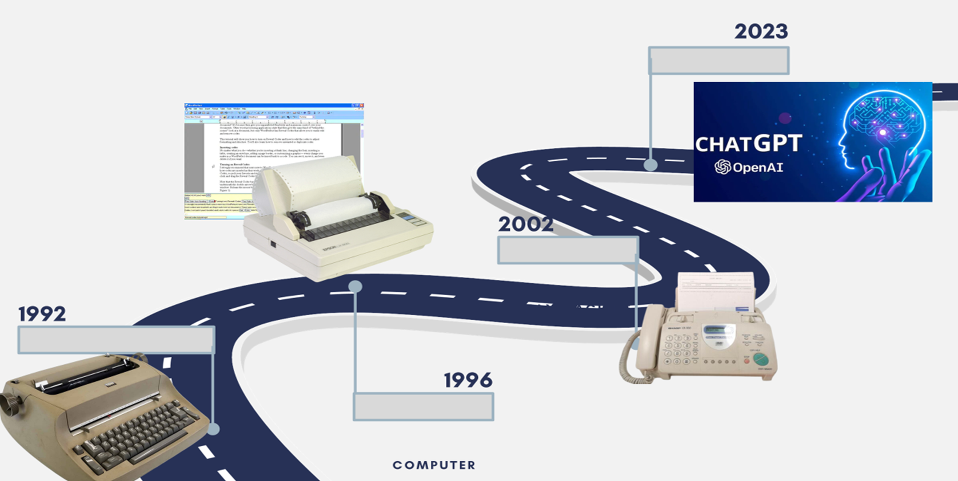
1. Introduction

Slide 4
Ever since the commencement of the industrial revolution, concerns have arisen about the potential replacement of human jobs by new machines, spanning from automated looms to microchips. In most cases, humans have managed to maintain their dominance
  60% of workers today are employed in occupations that didn’t exist in 1940.
  We will not be replaced by technology but will be replaced by those who know how to harness its power
  AI is not capable of doing tasks that involve human qualities such as emotional intelligence and “thinking outside of the box”
  AI can help make your job easier!

Slide 5

2. Learn how to use AI such as ChatGPT to make your life easier!

Slide 6
Create keyword lists
Example: "Act like a researcher. Give me a list of keywords for a job description I will provide you with that I can use to find a candidate for the position. Act like an expert in this field, include additional keywords that may not be in the job description."

Slide 7
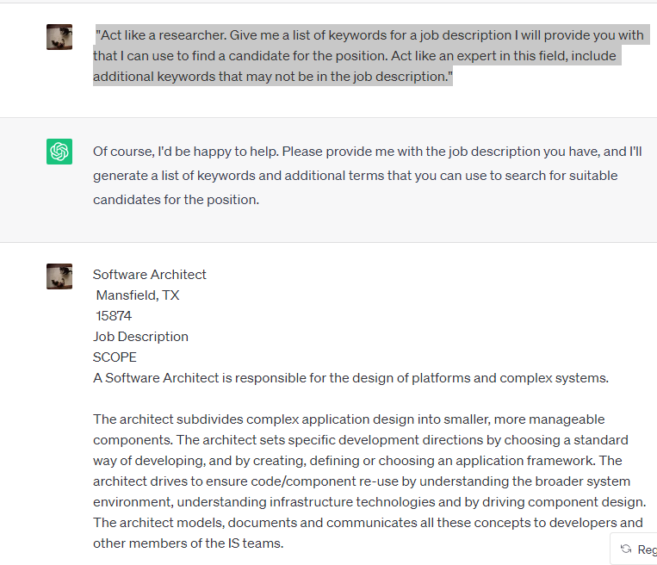

Slide 8
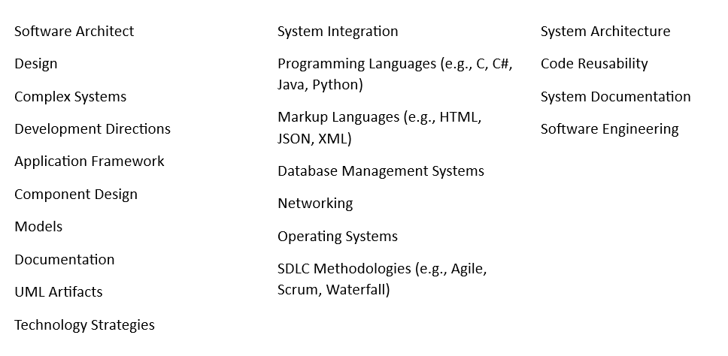

Humans are needed to determine which keywords are relevant for finding potential leads.

Slide 9
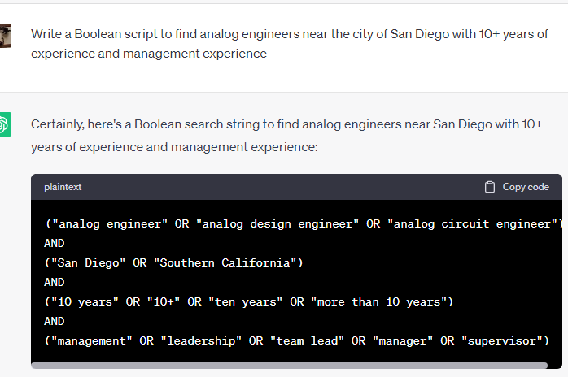
Write Boolean strings
Example: Write a Boolean script to find analog engineers near the city of San Diego with 10+ years of experience and management experience

Slide 10
site:linkedin.com/in ("analog engineer" OR "analog design engineer" OR "analog circuit engineer") ("San Diego" OR "Southern California") ("10 years" OR "10+" OR "ten years" OR "more than 10 years") ("management" OR "leadership" OR "team lead" OR "manager" OR "supervisor")
inurl:resume OR intitle:resume ("analog engineer" OR "analog design engineer" OR "analog circuit engineer") -example –sample
site:linkedin.com/in ("analog engineer" OR "analog design engineer" OR "analog circuit engineer") "San Diego" gmail.com
TIP OF THE DAY: SAVE PROMPTS IN AN EXCEL SPREADSHEET OR ON START.ME FOR THE FUTURE

Slide 11
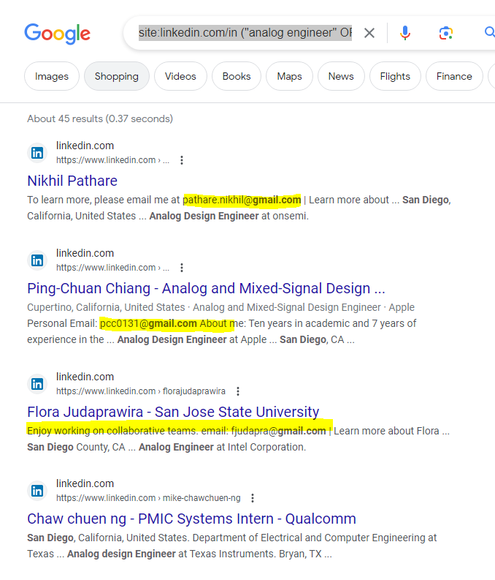

Slide 12
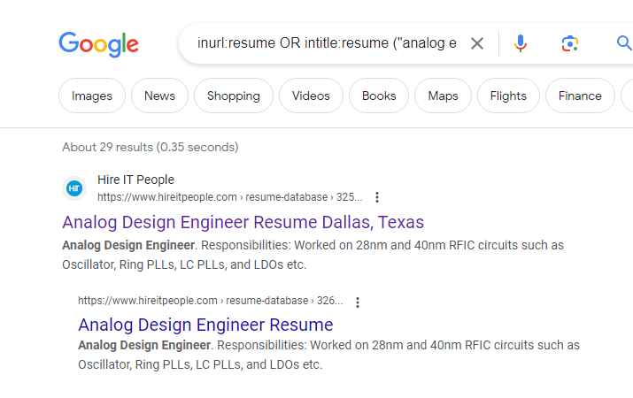

Slide 13
Example: Suggest a Boolean string to find candidates with Oracle Cloud experience
("Oracle Cloud" OR "Oracle Cloud Infrastructure" OR "OCI") AND ("experience" OR "expertise" OR "knowledge" OR "proficiency")
Example: Suggest a Boolean string to find candidates with Oracle Cloud experience x-raying into LinkedIn
site:linkedin.com ("Oracle Cloud" OR "Oracle Cloud Infrastructure" OR "OCI") AND ("experience" OR "expertise" OR "knowledge" OR "proficiency")
site:www.linkedin.com ("Oracle Cloud" OR "Oracle Cloud Infrastructure" OR "OCI") (contractor OR consultant) -jobs

Slide 14
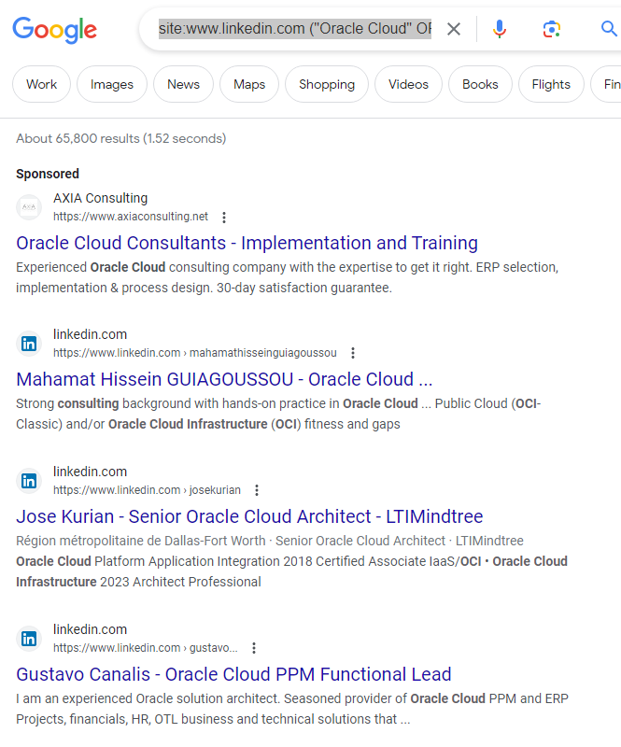

Slide 15
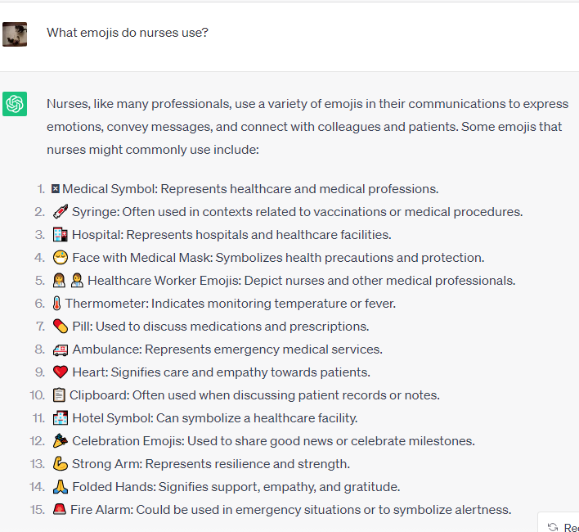

Slide 16
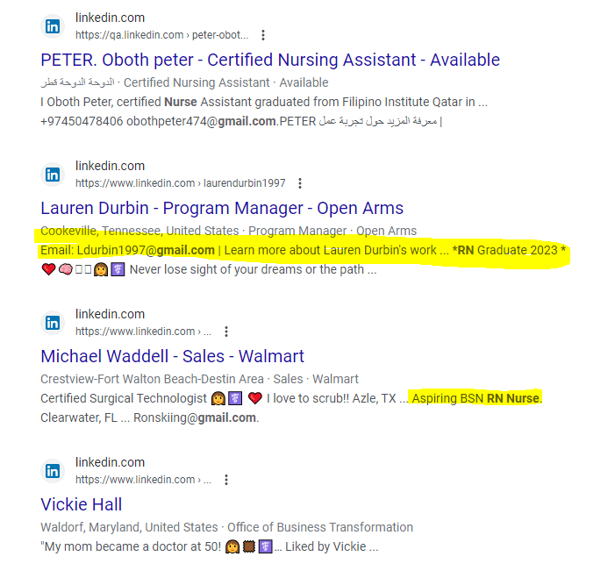
site:linkedin.com/in (💉 OR 🏥 OR 😷OR 👩‍⚕️ OR 👨‍⚕️ 🌡️ OR 💊 OR 🚑 OR ❤️ OR 📋 OR 🏨 OR 🎉OR 💪 OR 🙏 OR 🚨) (nurse OR LVN OR RN)
site:linkedin.com/in (💉 OR 🏥 OR 😷OR 👩‍⚕️ OR 👨‍⚕️ 🌡️ OR 💊 OR 🚑 OR ❤️ OR 📋 OR 🏨 OR 🎉OR 💪 OR 🙏 OR 🚨) (nurse OR LVN OR RN) gmail.com

Slide 17
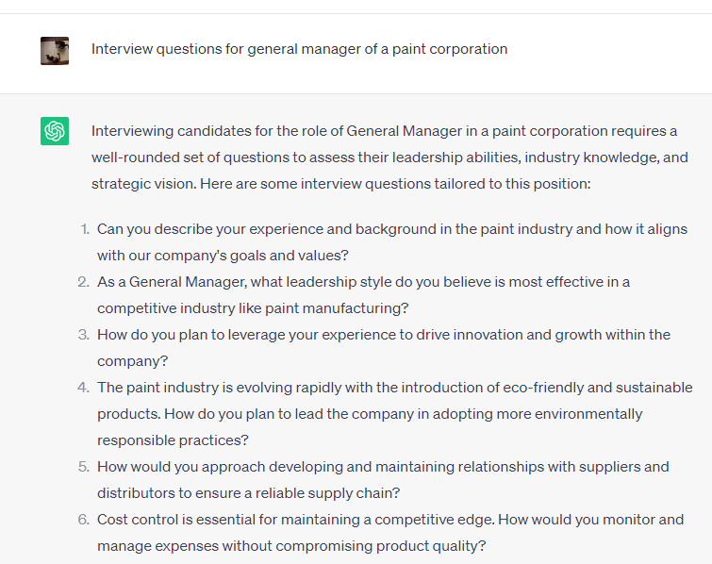
Create interview questions by role

Slide 18

3. Creative ways to identify candidates

Slide 19
peoplegpt
PeopleGPT used for recruiting, discovery research and more (Free trial and various priced packaged to meet your needs) https://chat.juicebox.work/
  Almost everyone in search results has a LinkedIn profile
  Streamlined email outreach process
  Limitations: Will not uncover every potential lead; a great add-on to your “bag of sourcing tricks”

Slide 22
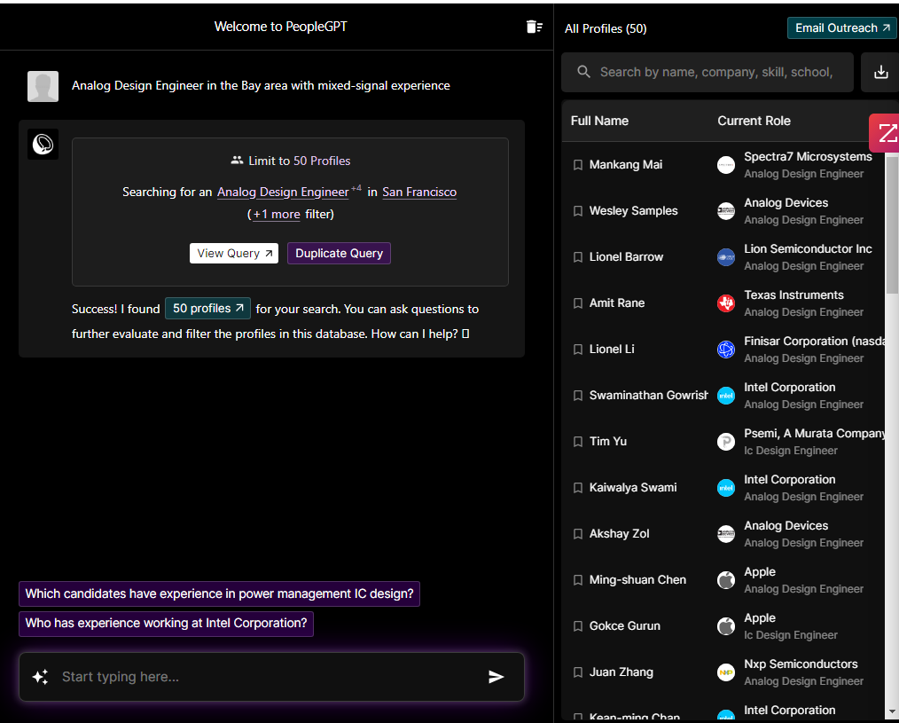

Slide 23
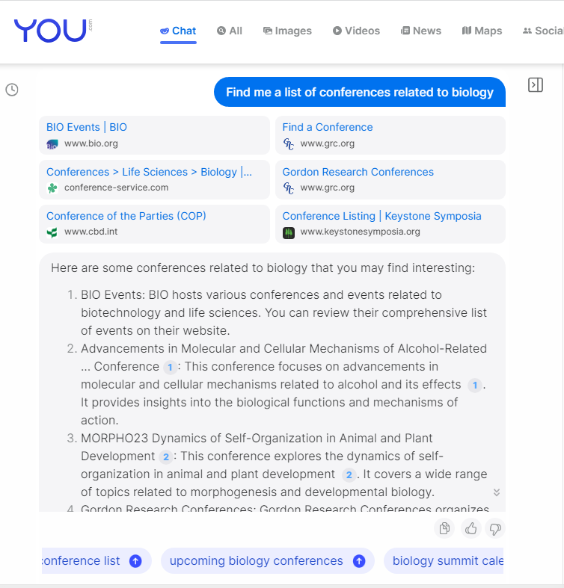
You.com
You.com is a search engine that offers a personalized search by letting its users upvote, downvote, or block apps.

Slide 24
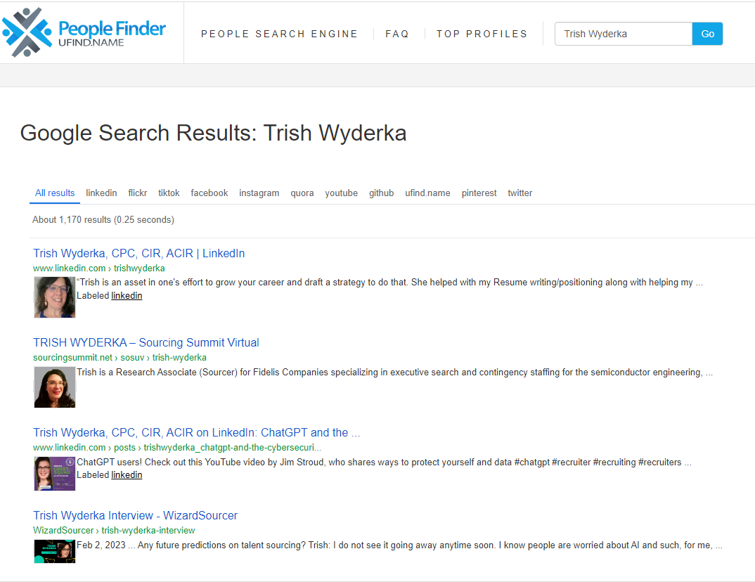
PEOPLEFINDER UFINDNAME

Slide 25

4. Low-cost ways to find emails and/or phone numbers

Slide 26
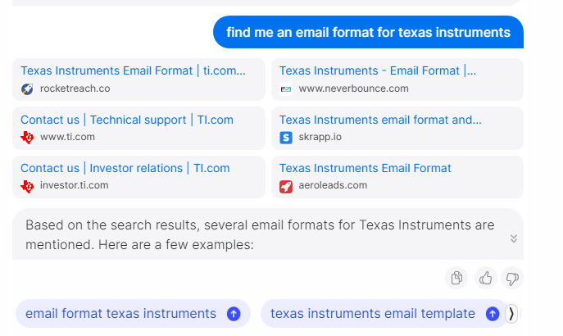

Slide 27
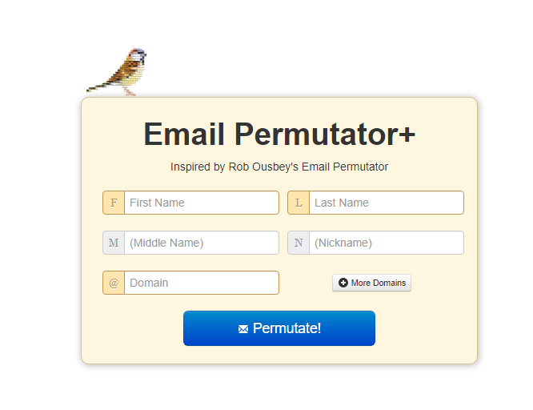
http://metricsparrow.com/toolkit/email-permutator/

Slide 28
Prompt in chatgpt
Example: Build me a Boolean string using gmail.com and yahoo.com and outlook.com
  ("gmail.com" OR "yahoo.com" OR "outlook.com") AND "nurse“
  ("gmail.com" OR "yahoo.com" OR "outlook.com") AND “Java developer“

Slide 29
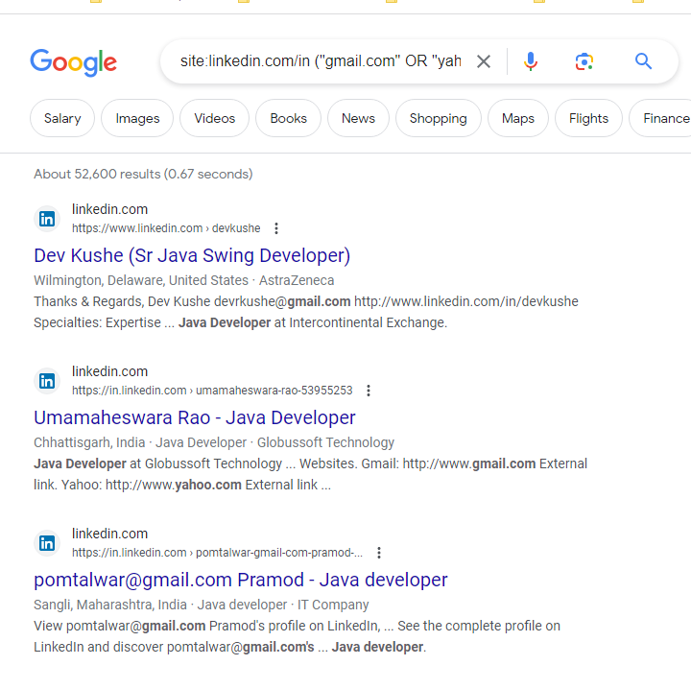

Slide 30
BONUS SECTION
AI Talent Sourcing – Jonathan Kidder (WizardSourcer) - https://www.amazon.com/AI-Talent-Sourcing-ChatGPT-Automate-ebook/dp/B0C6R7DQ2J
Udemy - https://www.udemy.com/course/prompt-engineering-for-chatgpt/ (Check for deals, some courses $34.99 and run on sale for $16.99)

Slide 31

THANK YOU!!
Trish Wyderka
https://www.linkedin.com/in/trishwyderka/

