Slide 1
Chat with the Queen of Mystery: Tips & Tricks to Uncover Talent
Trish Wyderka
DFWTRN
November 17, 2022

Slide 2
TAKE AWAYS
Planning Phase
Research
Tools for Success
Bonus

Slide 3
1. HOW DO I EVEN GET STARTED?... PLANNING

Slide 5
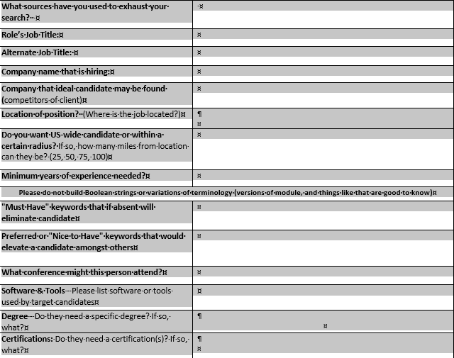

Slide 6
2. Research
GlossaryTech (Chrome Web Store) – Free
Techopedia - https://www.techopedia.com/definition/33515/artificial-intelligence-engineer
Wikipedia - https://www.wikipedia.org/
Boolean – “industry keywords”
Acronym Finder - https://www.acronymfinder.com/
Storage Networking Industry Association - https://www.snia.org/education/dictionary/about-dictionary

Slide 7
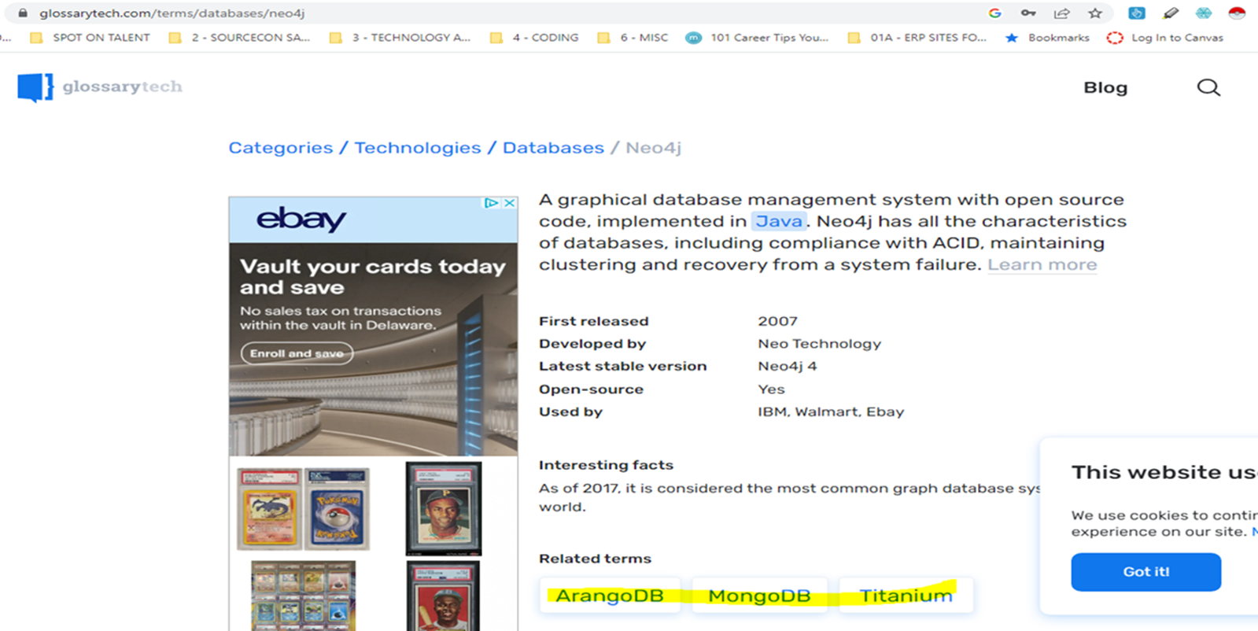

Slide 8
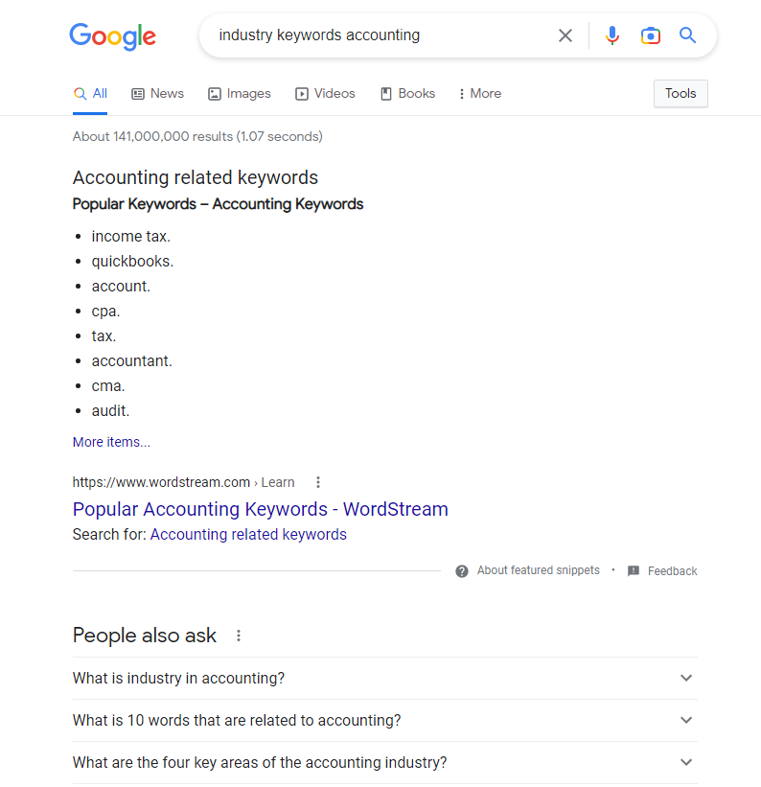

Slide 9
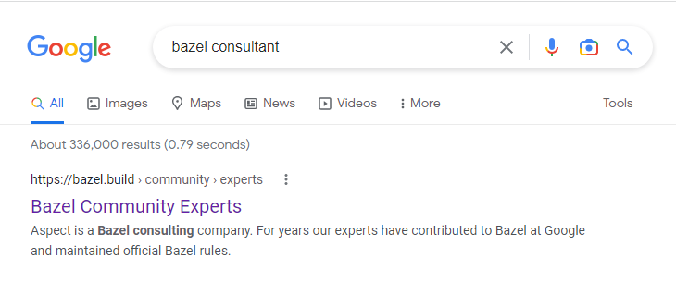

Slide 10
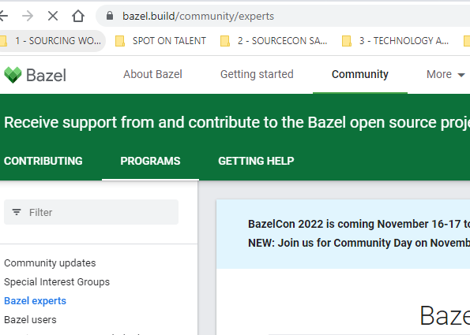

Slide 11
3. TOOLS FOR SUCCESS

Slide 12
A. Candidate Lookup by CODE
Candidate Lookup by CODΞ helps you cross-reference people via a range of social media platforms and search engines
https://chrome.google.com/webstore/detail/candidate-lookup-by-cod%CE%BE/ibfmahfoaohgpmfpklfkppmgpkjomked

Slide 13
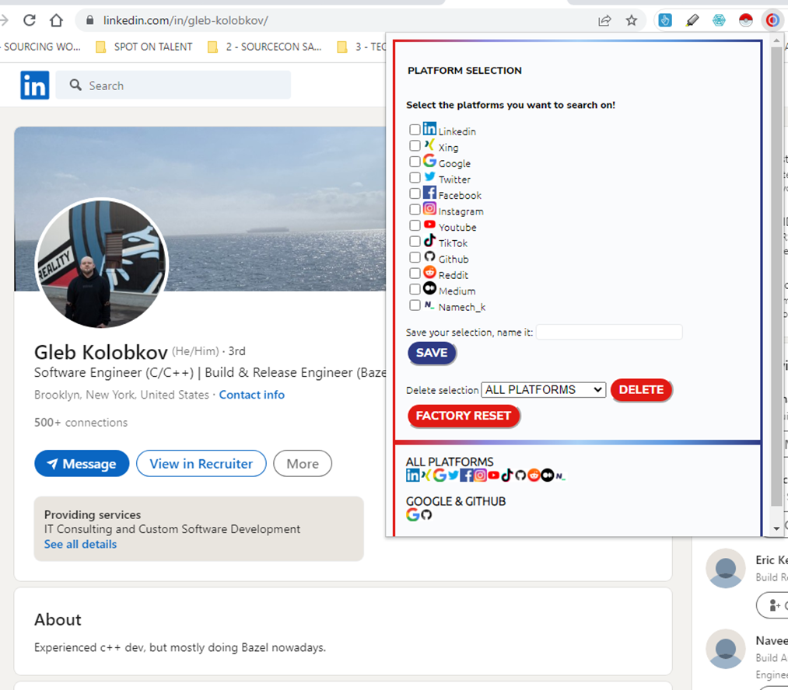

Slide 14
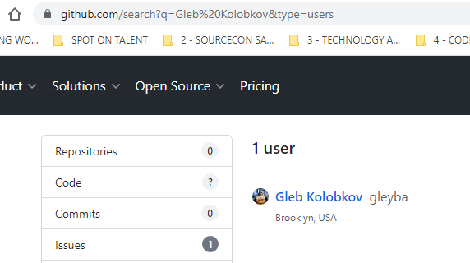
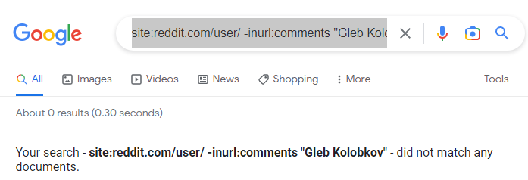
BONUS!!! Boolean string you can add to your “tool bag”
site:reddit.com/user/ -inurl:comments "Gleb Kolobkov"

Slide 15
B. Boolean
Psst.. I heard you are not strong in Boolean…

Slide 16
Boolean Builders
Example: Bioinformatics Software Developer

Slide 17
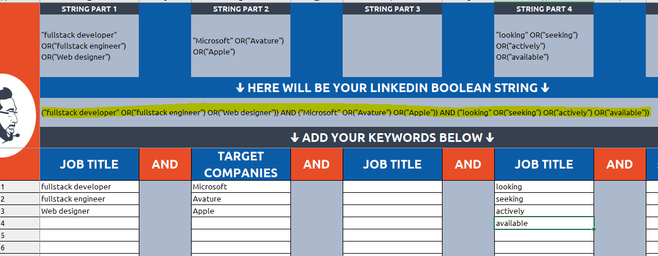
Example: Full Stack Developer from Microsoft, Avature or Apple

Slide 18
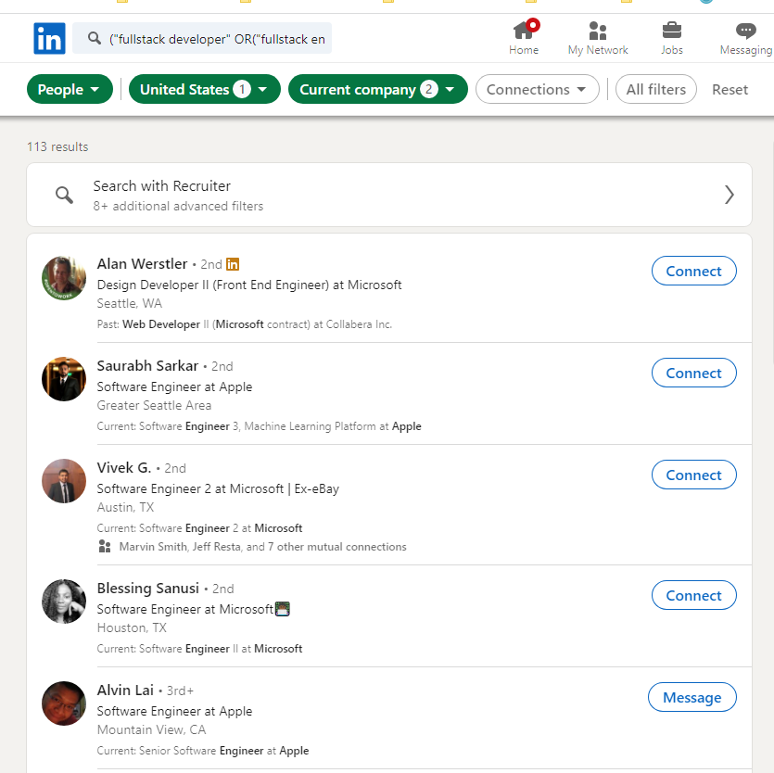

Slide 19
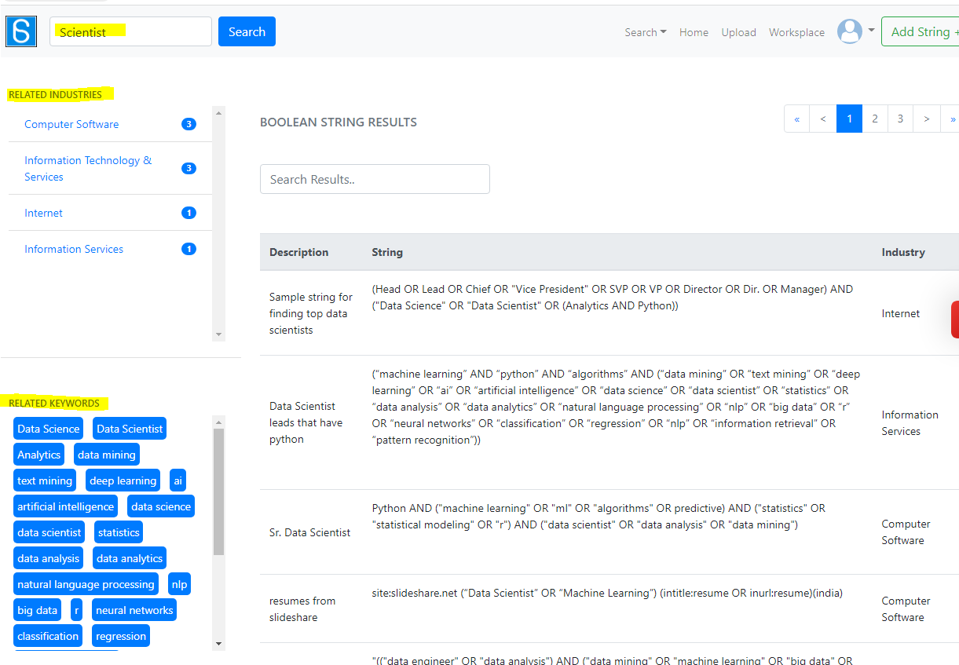
Scoperac.Com – Boolean String Bank
https://scoperac.com/booleanstringbank/

Slide 20
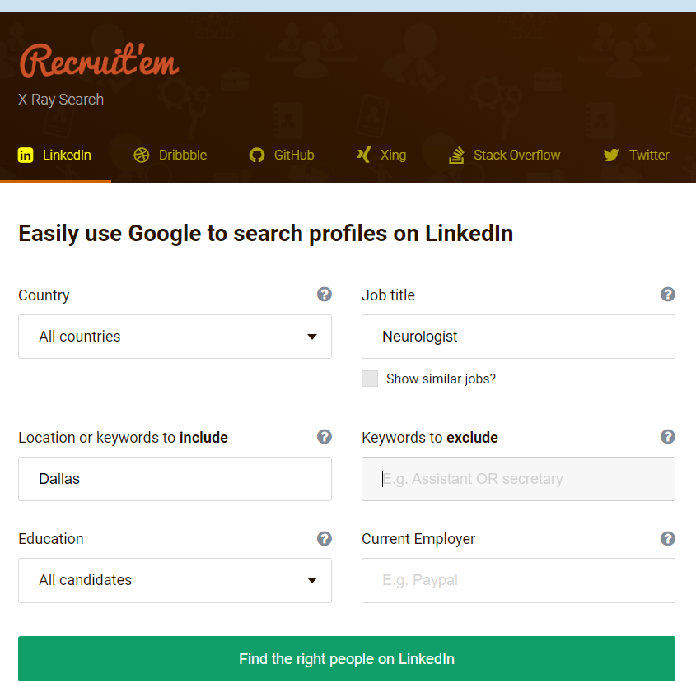
Recruit’em X-Ray Search
https://recruitin.net/

Slide 21
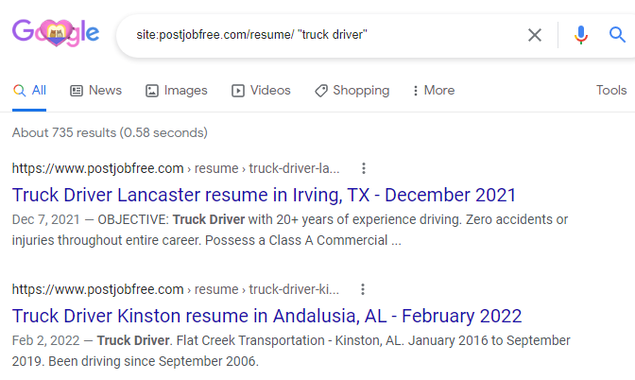

Slide 22
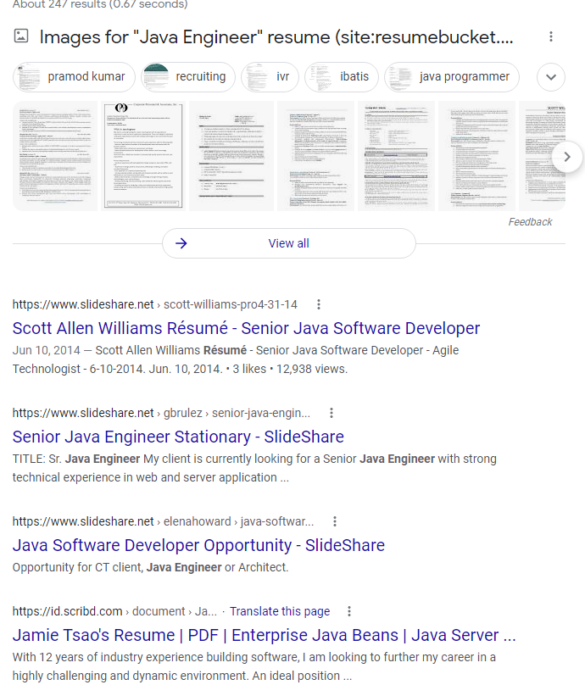
"Java Engineer" resume (site:resumebucket.com | site:visualcv.com | site:jresume.com | site:scribd.com | site:docstoc.com | site:slideshare.net)

Slide 23
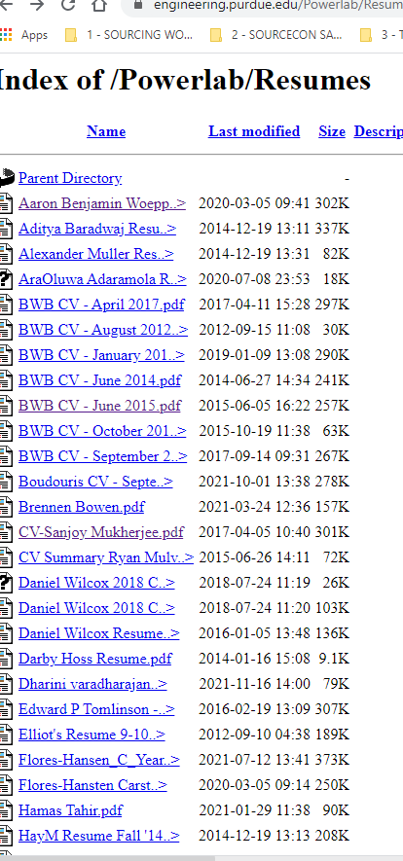

Slide 24
C. Google Dorks
Google Dorks is a search string that leverages advanced search operators to find information that isn’t readily available on a particular website.
https://hackr.io/blog/google-dorks-cheat-sheet

Slide 25
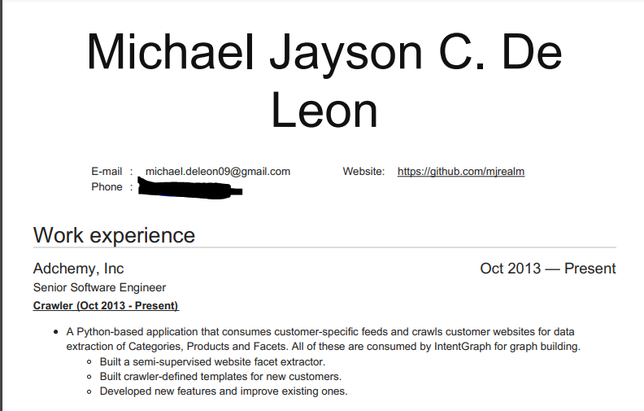

Slide 26
ext:(doc | pdf | xls | txt | ppt) Java developer "*@gmail.com"

Slide 27
Examples of Boolean Strings
(intitle:resume OR inurl:resume OR intitle:cv OR inurl:cv OR intitle:vitae OR inurl:vitae)
(objectives | summary | education | “additional skills” | references) “Title” intitle:resume inurl:resume
(intitle:bio OR inurl:bio OR intitle:profile OR inurl:profile OR intitle:homepage OR inurl:homepage OR intitle:”about me” OR inurl:”about me”)
(intitle:team OR inurl:team OR intitle:staff OR inurl:staff OR intitle:people OR inurl:people OR intitle:employees OR inurl:employees)
(intitle:associates OR inurl:associates OR intitle:members OR inurl:members)
(intitle:alumni OR inurl:alumni OR intitle:graduates OR inurl:graduates OR intitle:alum OR inurl:alum OR intitle:grads OR inurl:grads)
(intitle:”staff directory” OR intitle:”employee directory” OR intitle:”member directory” OR intitle:”alumni directory”)
(intitle:attendees OR inurl:attendees OR intitle:participants OR inurl:participants OR intitle:roster OR inurl:roster OR intitle:registrants OR inurl:registrants)
(intitle:”resume book” OR inurl:resumebook OR inurl:”resume book” OR inurl:resume_book)
(intitle:resume OR intitle:cv OR intitle:vitae)
(intitle:bio OR intitle:profile OR intitle:homepage OR intitle:”about me”)
(intitle:team OR intitle:staff OR intitle:people OR intitle:employees)
(intitle:attendees OR intitle:members OR intitle:participants OR intitle:registrants OR intitle:roster)
(intitle:alumni OR intitle:graduates OR intitle:alum OR intitle:grads)
(intitle:”staff directory” OR intitle:”employee directory” OR intitle:”member directory” OR intitle:”alumni directory”)

Slide 28
Craigslist site:*.craigslist.org/*/res account “Title”
Craigslist site:craigslist.org inurl:res “Title
Docfoc.com site:docfoc.com (resume OR cv OR vitae) “TITLE”
Docstoc.com site:docstoc.com (resume OR cv OR vitae) “TITLE”
DoYouBuzz.com site:doyoubuzz.com “TITLE”
Facebook site:facebook.com “TITLE” inurl:about
Google Docs site:docs.google.com (resume OR cv OR vitae) “TITLE”
LinkedIn Profiles site:linkedin.com/pub | site:linkedin.com/in -inurl:dir -inurl:title “TITLE”
Meetup.com site:meetup.com “member since” ‘TITLE”
Pastebin site:pastebin.com (“gmail.com” OR “yahoo.com” OR “hotmail.com”) “TITLE”
Resumup.com site:resumup.com “TITLE”
Twitter site:twitter.com “TITLE”
VisualCV.com site:visualcv.com “TITLE”
Visualize.me site:vizualize.me “TITLE”
WordPress.com/cv site:wordpress.com/cv “TITLE”
WordPress.com/r site:wordpress.com/resume “TITLE”
ZoomInfo site:zoominfo.com “TITLE”

Slide 29
4. BONUS
Save your Boolean strings for the future using Start.me bookmark manager
Option to share with team members
FREE

Slide 30
True People Search https://www.truepeoplesearch.com/ Melissa Data https://www.melissa.com/v2/lookups/home/index Email Permutator http://emailpermutator.com/permutator/
CONTACT INFORMATION FAVORITES

Slide 31
Additional Resources
https://wizardsourcer.com/boolean-strings-list/
https://wizardsourcer.com/top-boolean-strings-to-find-diversity-candidates-online/#.Xjnl9dKWzGi
Google “pre-constructed-Boolean-search”
Dean Da Costa SSAR Pages
https://start.me/p/GE7Ebm/ssar
https://start.me/p/aLAeEp/ssar-2
https://start.me/p/GEOaz8/ssar-3
https://start.me/p/NxRQbG/search-eng-utopia

Slide 32
Thank you!
Trish Wyderka
Fidelis Companies
trish@fideliscompanies.com
https://www.linkedin.com/in/trishwyderka/

