Slide 1
GitHub & Stack Overflow Recruiting
Trish Wyderka
DFWTRN
November 6, 2019

Slide 2
Introduction…
Prior Air Force veteran
Sourcer for 8+ years; cutting-edge electrical engineering technology
LOVE sourcing; addicted to anything Boolean and data mining
Cat mom and sci-fi movie lover

Slide 3
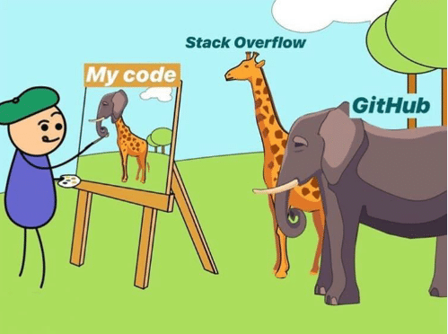
Using GitHub and Stack Overflow to:
Search for users
Assess user profiles
Find user emails
Use Boolean to find users

Slide 4
Website and cloud-based service that helps developers store and manage their code, as well as track & control changes to their code

Slide 5
GitHub Search Bar
location: (location of user)
language: (primary language of user)
followers: (# of followers)
repos: (# of public repositories a user has)

Slide 6
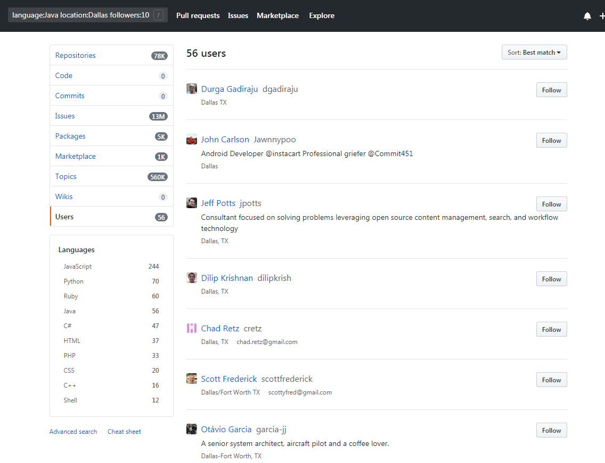
Example: language:java location:Dallas followers:10..* repos:10..*

Slide 7
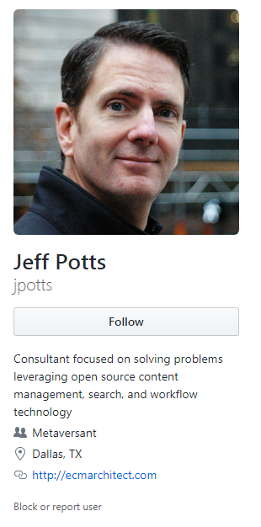
Assessing a GitHubs User
Right click on photo – search for image which can take you to other pages associated with user (Twitter, homepage and more)
Username – run through https://www.namecheckr.com/
Location data
Personal or business websites
Organizations the user is associated with

Slide 8
Dive down deeper in a user’s personal site via GitHub and what do you find…

Slide 9
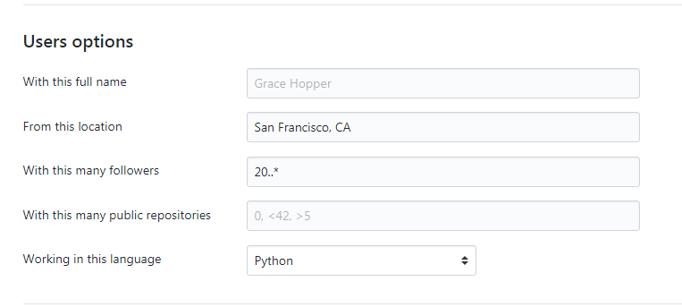
GitHub Advanced Search
https://github.com/search/advanced

Slide 10
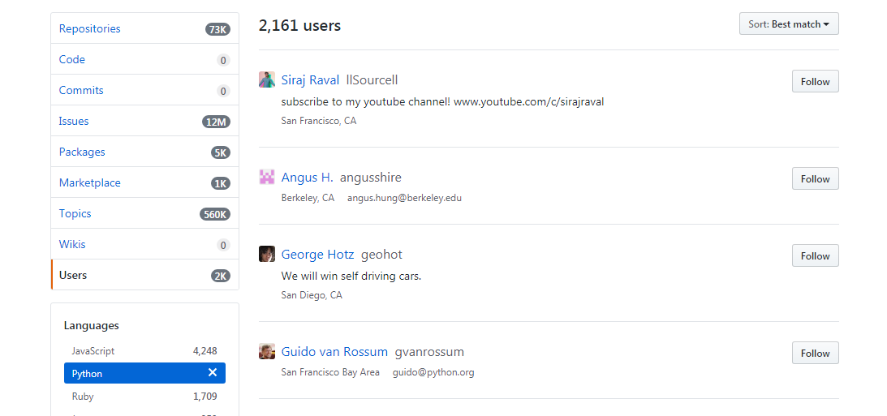

Slide 11
GitHub via Google X-Ray Search
Profiles with location: site:github.com “london” “joined on” “public activity” -tab.activity
Profiles with key terms: site:github.com ios | android “public activity” -tab.activity
Resumes on Github: (Google)
site:github.com (intitle:resume|cv|vitae | inurl:com/resume | inurl:com/cv | inurl:com/vitae) -inurl:https|format
resume.github.io/ Python filetype:pdf

Slide 12
Octohunt - Find Developers on GitHub
Web-based application allows you to search GitHub’s userbase by skill and location
Repositories, followers, link to personal website, contact information
Shows when they are available for hire
https://octohunt.com/?ref=producthunt

Slide 13
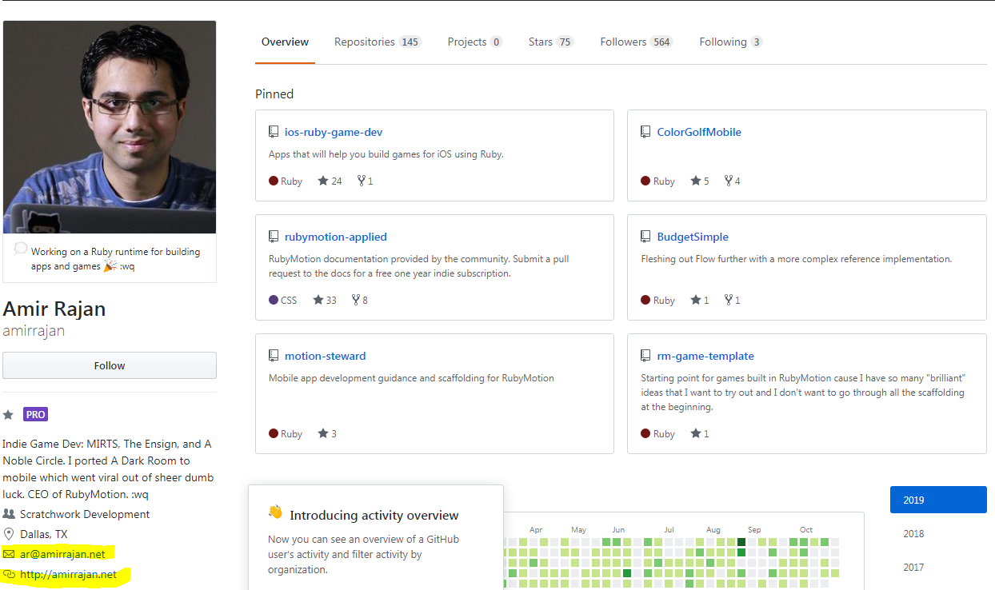

Slide 14
Online community for developers to learn, share their programming knowledge and build their careers

Slide 15
Assessing a Stack Overflow Profile
Stack Overflow profiles have these pieces of information available to other users
Username
Bio
Location
Website
Member since
Link to Twitter profile
Reputation
Question asked
Other profiles
Profile picture
Tags contributed to
Information about their activity (recent activity)

Slide 16
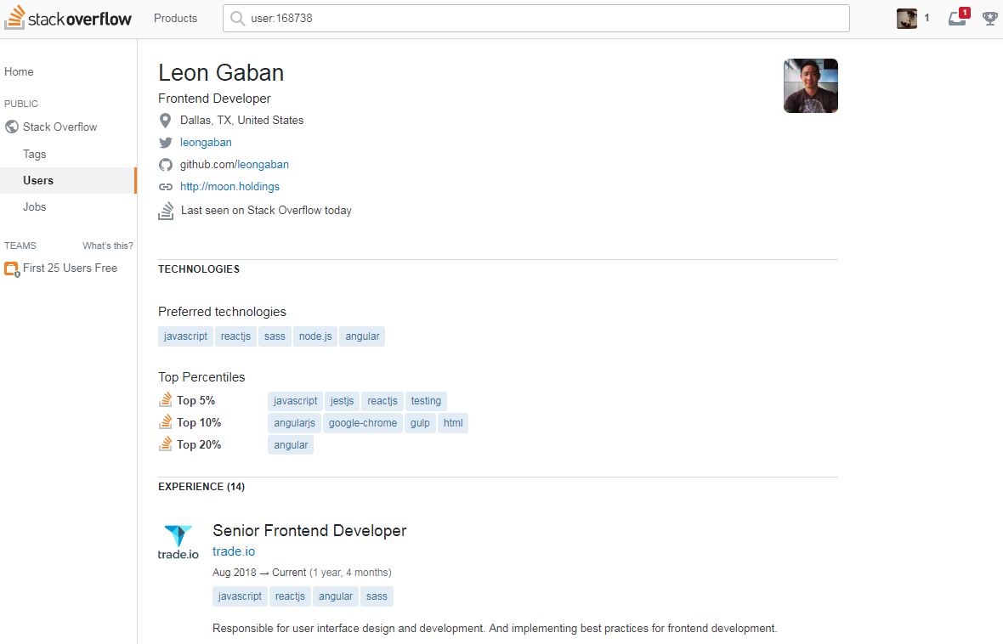

Slide 17
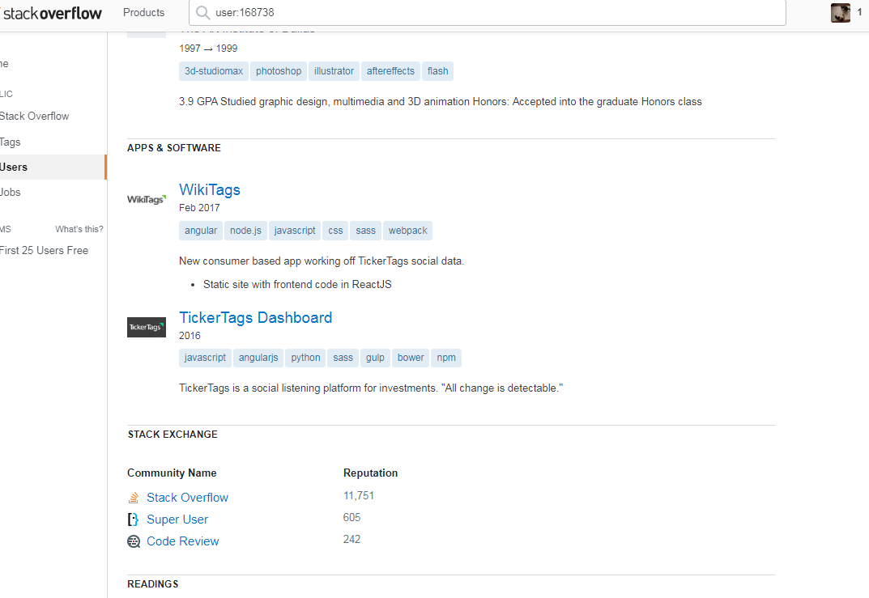

Slide 18
Using Tags & Synonyms to find talent
Locate tag option…
Then enter your term…

Slide 19
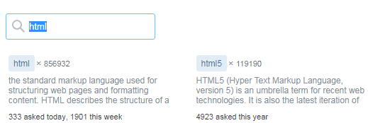
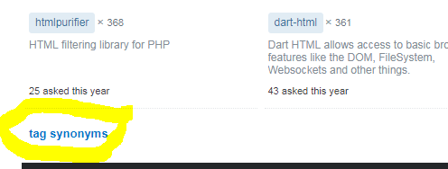
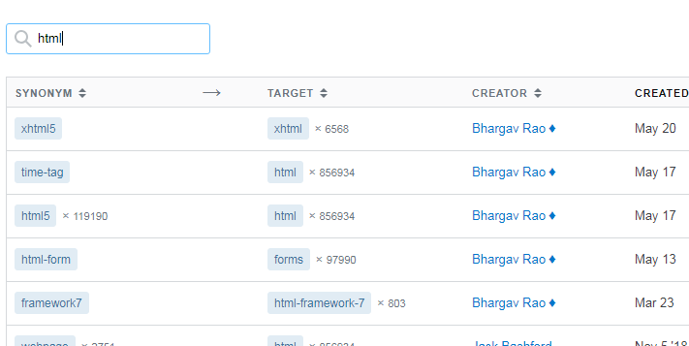
Enter your term and find alternative terms to use as keywords
(Scroll down in results to find synonyms)

Slide 20
GitHub via Google X-Ray Search
Use tag synonyms for X-ray searching
(html | html5 | html-table | xhtml | innerhtml | wkhtmltopdf)
Example: site:linkedin.com/in (html | html5 | html-table | xhtml | innerhtml | wkhtmltopdf) gmail.com Texas

Slide 21
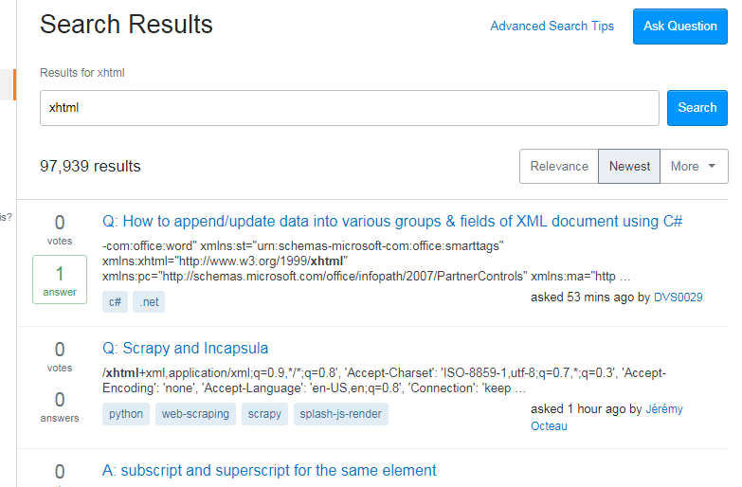

Slide 22
Stack Overflow via X-ray Search
Internal search is limited on Stack Overflow, use Boolean search as alternative

Slide 23
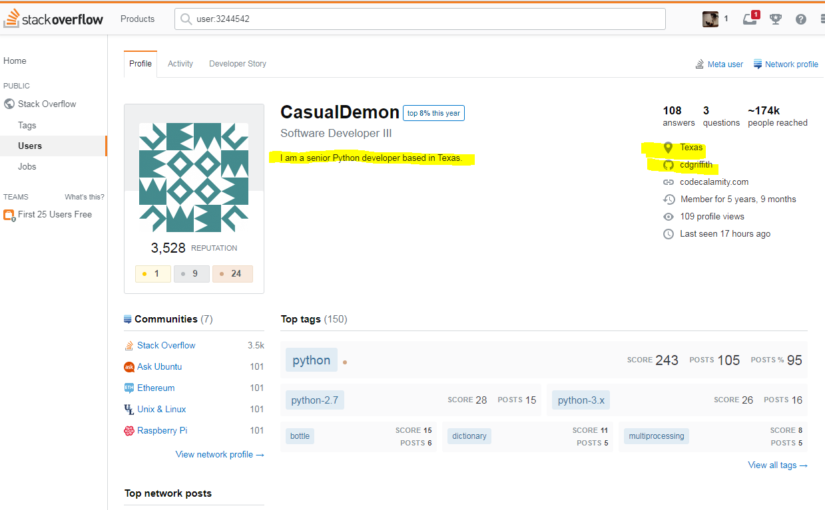
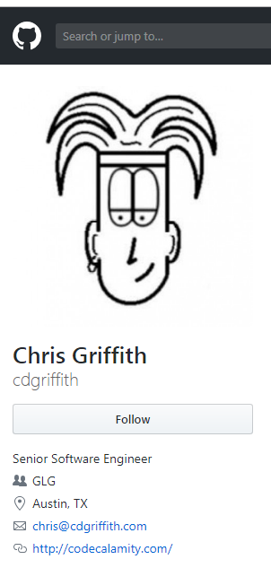
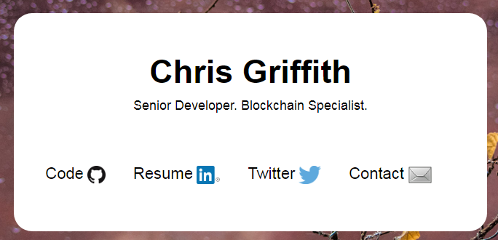

Slide 24
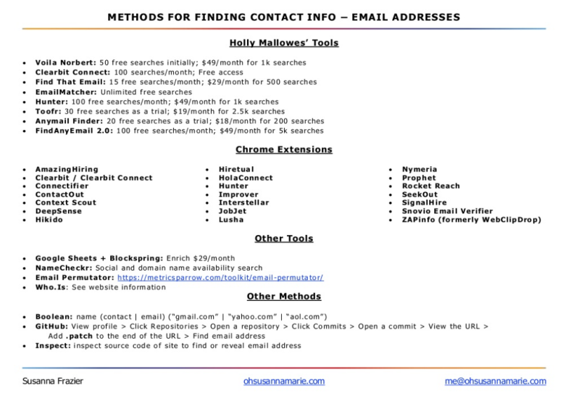
Finding Contact Information for Users
Dean Da Costa SSaR https://start.me/p/GE7Ebm/ssar
Methods for Finding Contact Info (Email & Phone) https://www.slideshare.net/slideshow/embed_code/key/4vhxvQIZIYrYgU

Slide 25
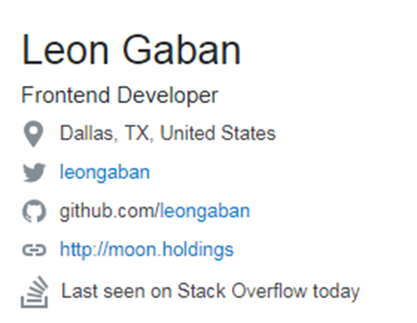
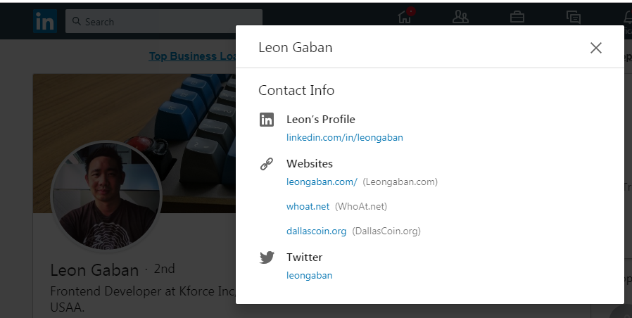
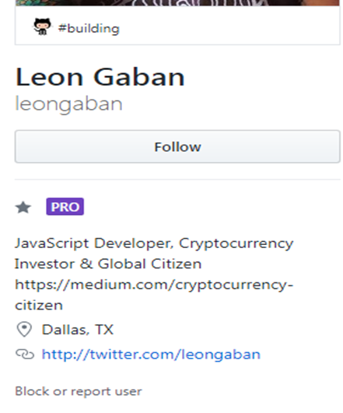
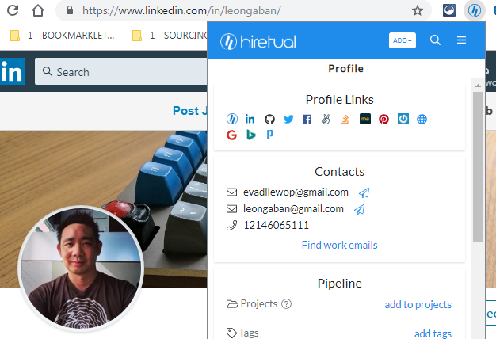

Slide 26
https://start.me/p/EL84Km/cse-utopia
Stack Overflow & More!!
GitHub
** Thank you, Dean Da Costa!!

Slide 27
Questions?
Thank you!
Contact me @
Trish Wyderka
trish@fideliscompanies.com
www.linkedin.com/in/trishwyderka/
Twitter: @trishhasfun

