Slide 1
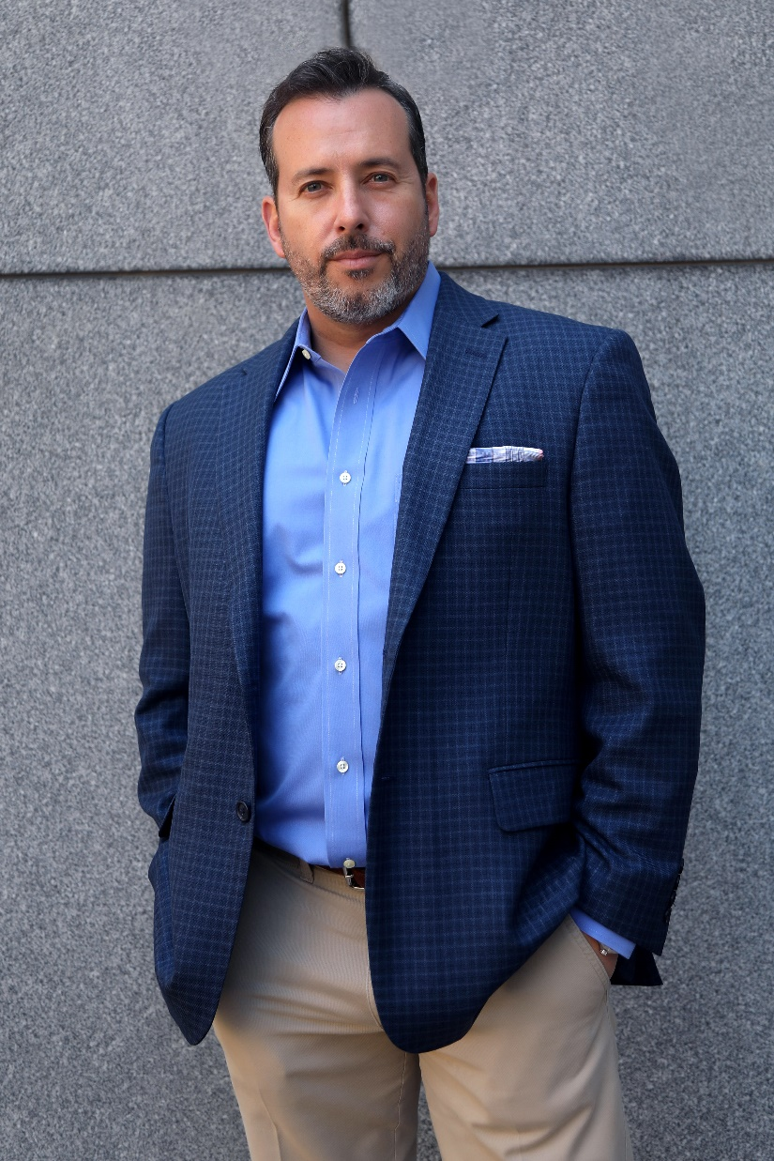
VIDEO FOR RECRUITING
2019
Craig Fisher
Head of Global Marketing, Allegis Global Solutions
@fishdogs

Slide 2
TWITTER
A video tweet is 6x more likely to be retweeted than a photo tweet

Slide 4
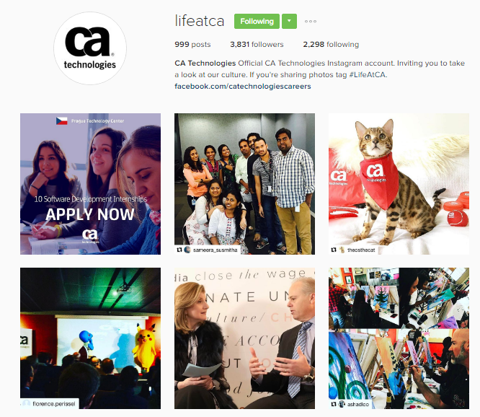
instagram
@FISHDOGS

Slide 5
1. 1 billion people use Instagram 80% of users are outside the U.S. 59% of U.S. users are under 30 72% of teens use Instagram every day

Slide 7
100 MILLION HOURS OF VIDEO ARE WATCHED ON FACEBOOK EVERY DAY
FACEBOOK

Slide 8
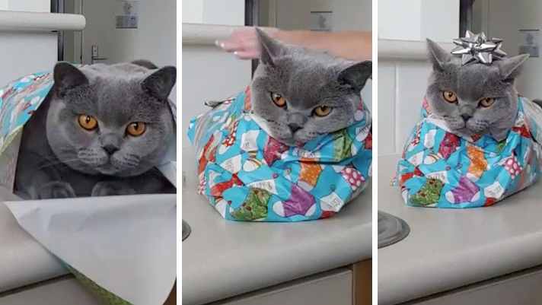
over 100 million views and 1 million shares

Slide 10
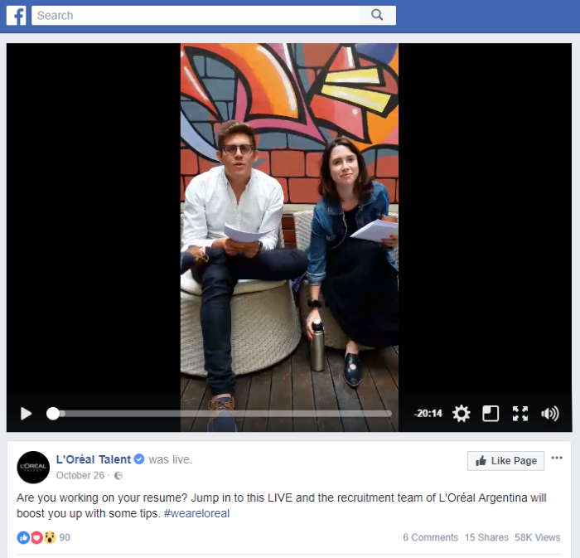
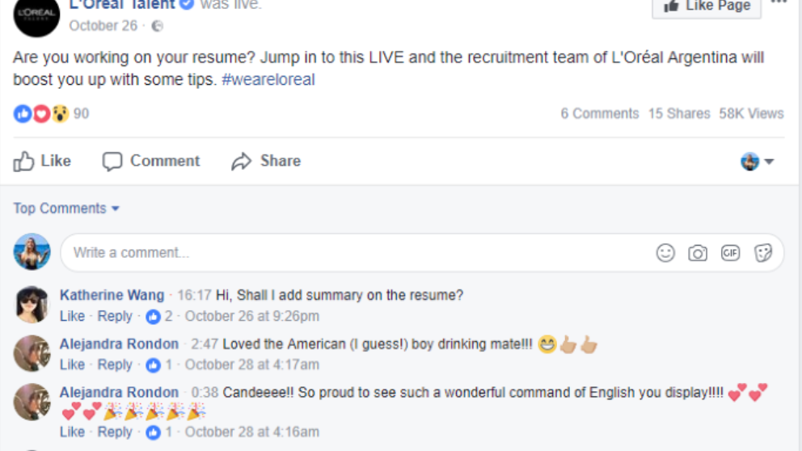

Slide 11
85 percent of Facebook videos are viewed with the volume off
FACEBOOK

Slide 12
FACEBOOK Remember graphics/text: 85 percent of videos are viewed with the volume off, according to Digiday. Upload videos directly to Facebook: Native videos give you analytics and better visibility in the feed. Make sure you have a call to action

Slide 13
Over 1 billion hours of video are consumed on Youtube daily.

Slide 14
youtube more video watch here than any other channel Release new videos on a regular schedule optimize for search ranking - It is the world’s largest search engine after google. Allow embedding to be sharable use extensions to help – tubebuddy and vidiq

Slide 15
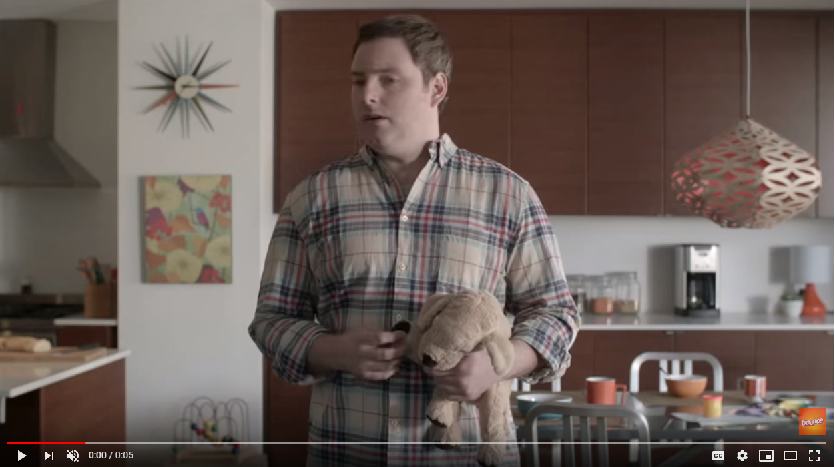

Slide 16
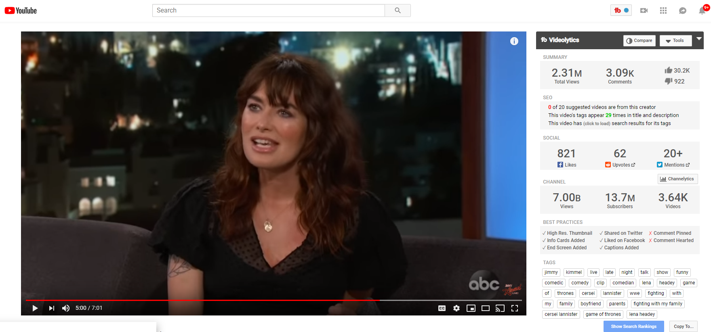

Slide 17
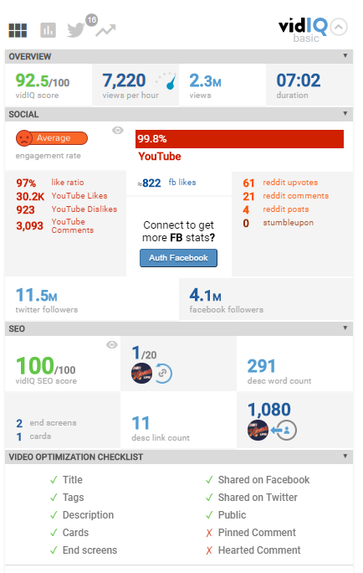
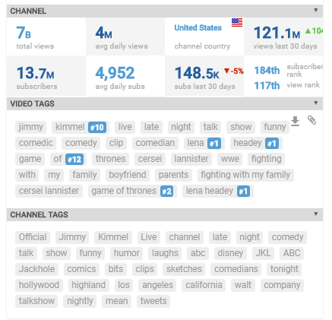

Slide 18
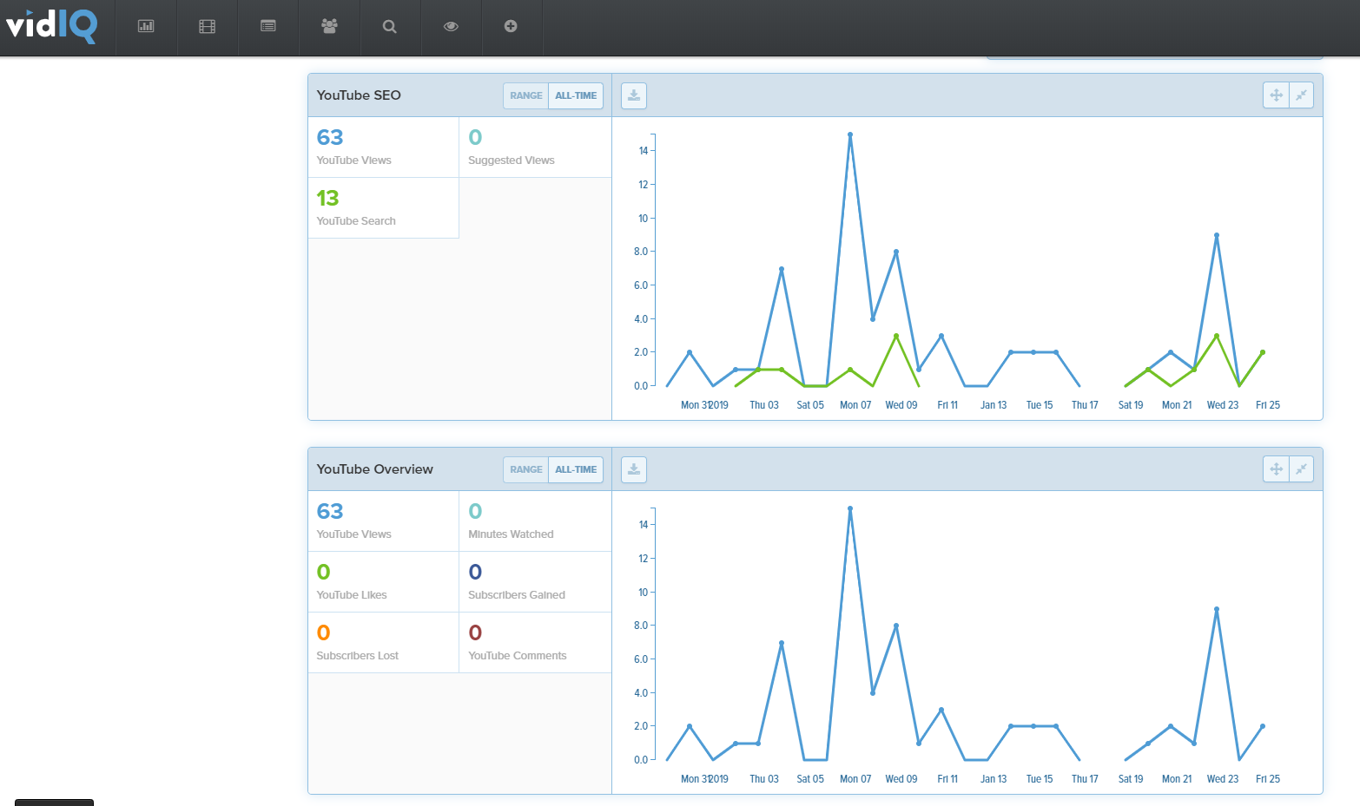

Slide 19
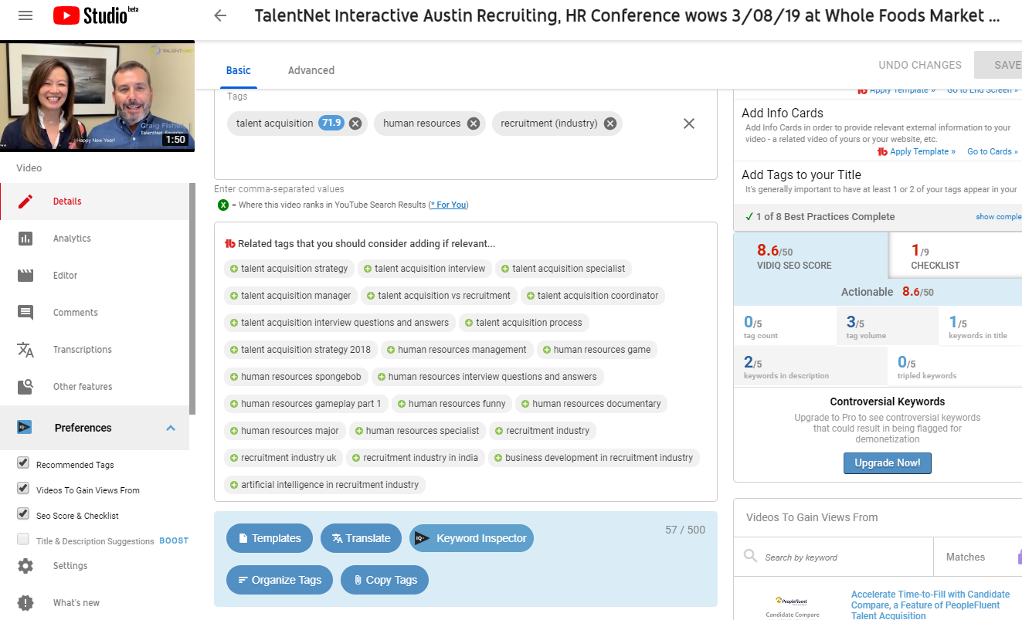

Slide 20
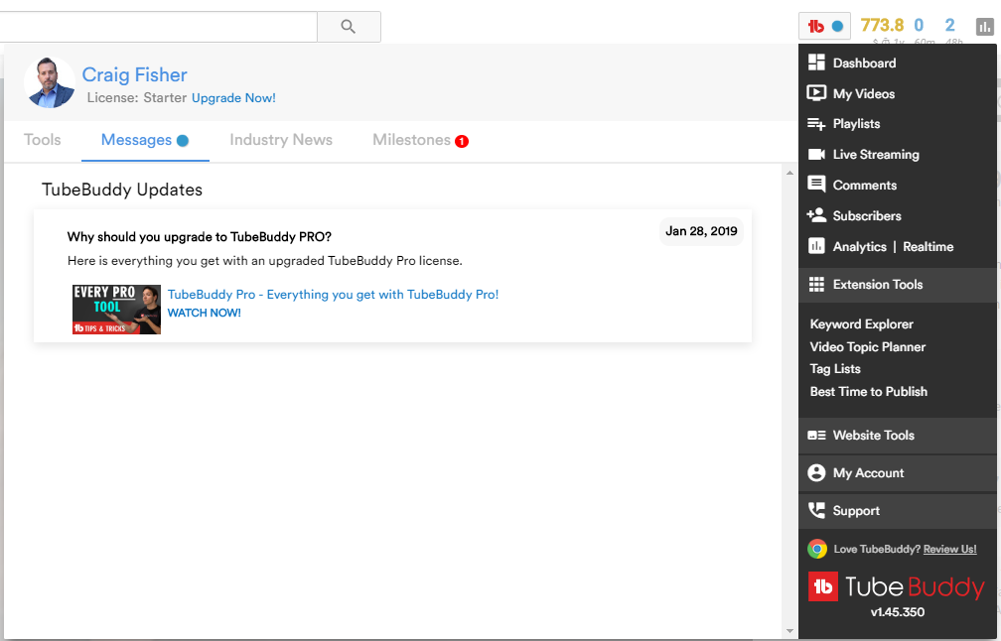
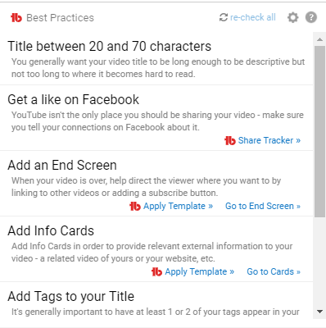

Slide 21
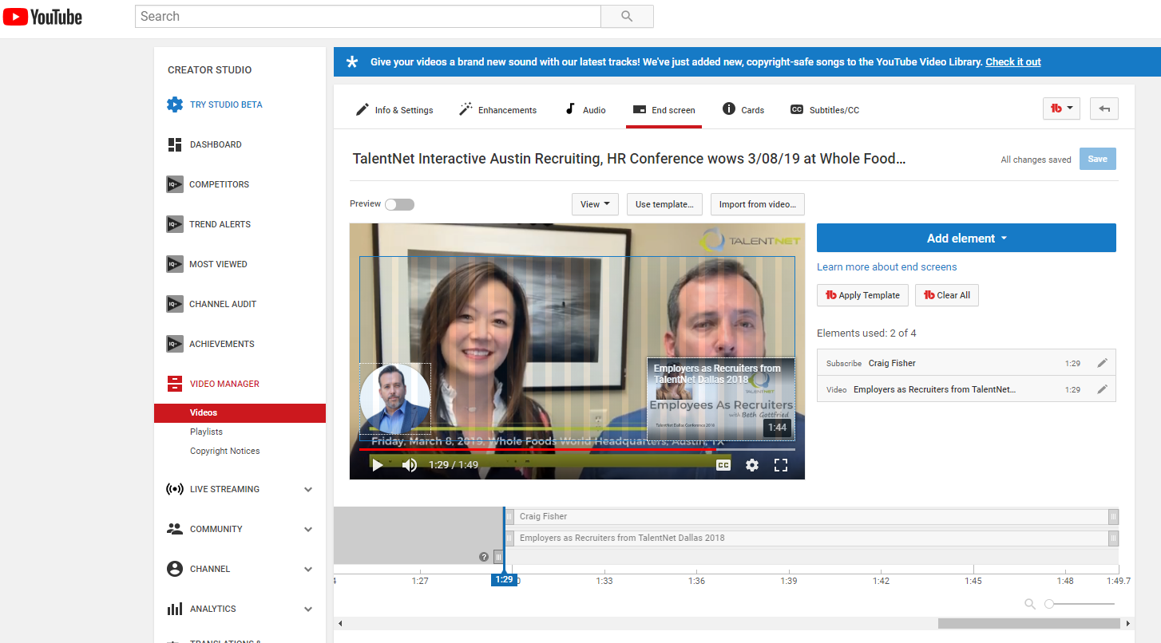
Add an End Screen

Slide 22
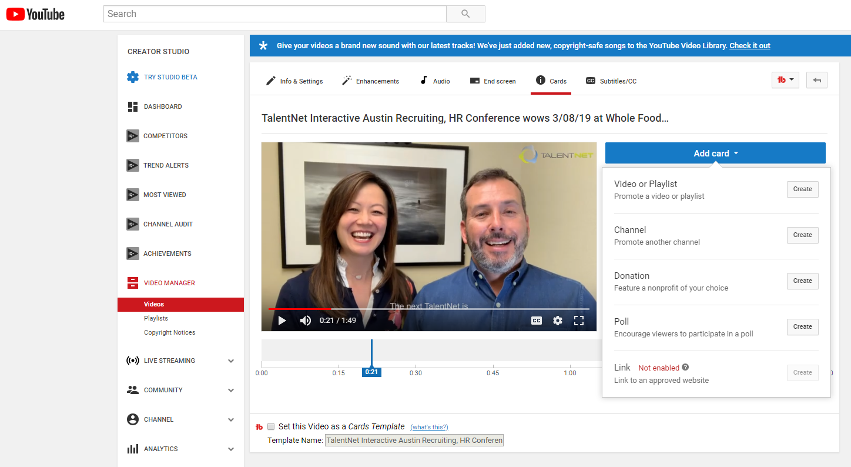

Slide 23
VIDEO CREATES 20X MORE SHARES ON LINKEDIN THAN OTHER CONTENT 54% of executives share work related videos with colleagues weekly 80% OF VIDEO CONTENT IS VIEWED WITH SOUND OFF 57% IS VIEWED ON MOBILE
LINKEDIN

Slide 24
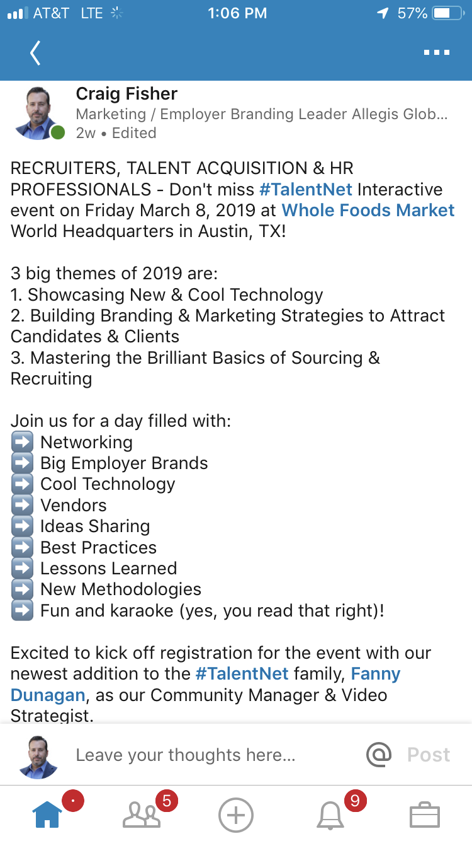
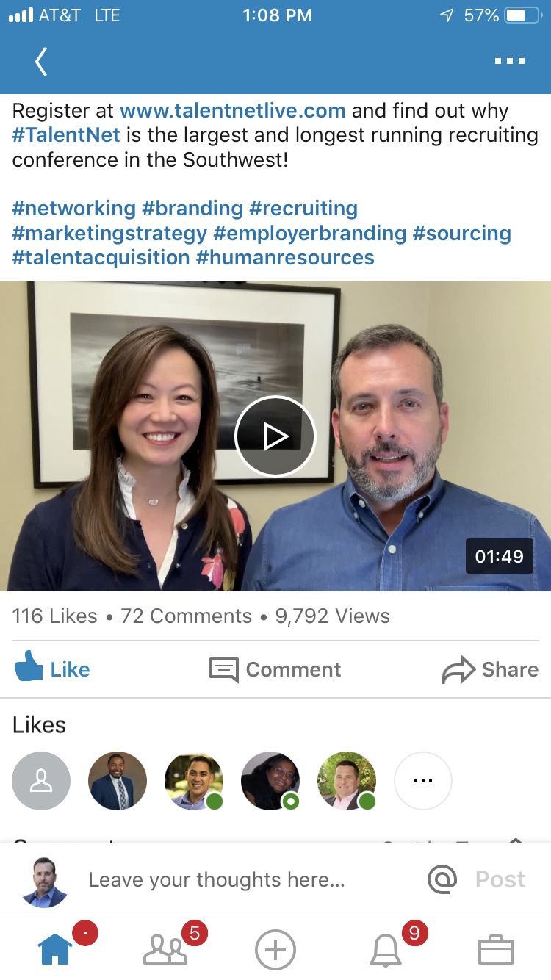

Slide 25
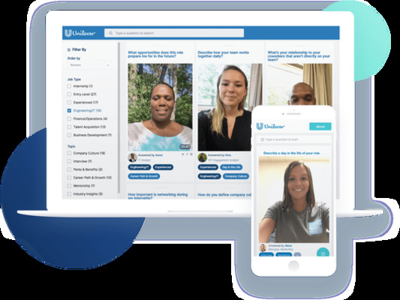

Slide 26
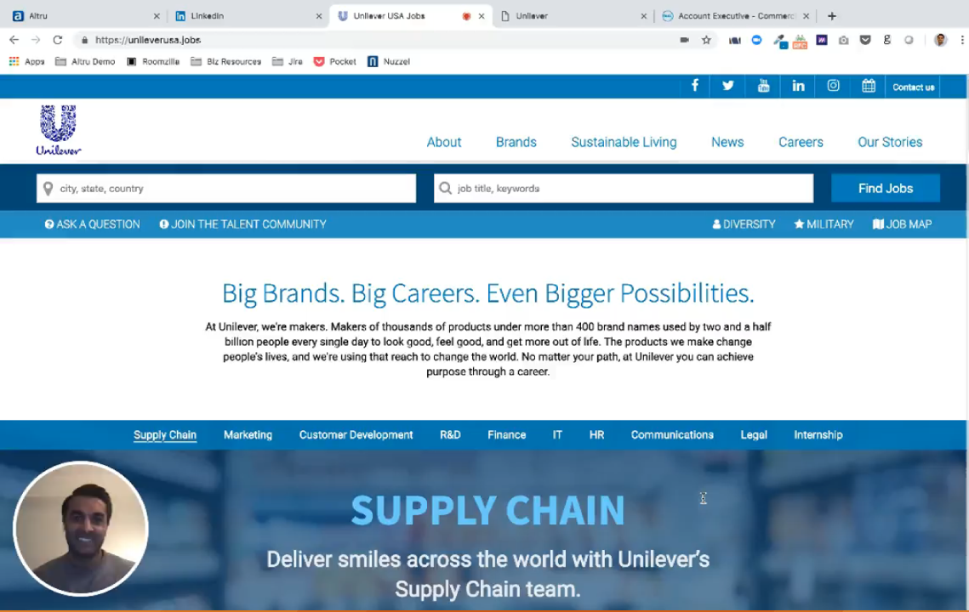

Slide 27
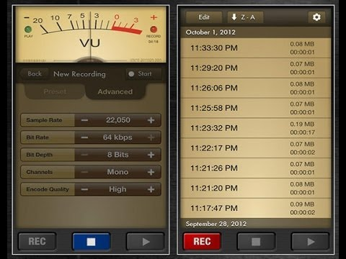
Clip mic
Voice Record Pro

Slide 28
VIDEO PLAN
Just start
Career site, job postings, candidate communication, job fairs, video interviews, social channels, talent community
Proper saved videos
Behind the scenes live videos
Measure engagement!

Slide 29
Thank You!
CONTACT INFORMATION:
Craig Fisher
Head of Marketing, Allegis Global Solutions
Mobile: +1 214-394-0909
Craig@Fishdogs.com

