Slide 1
DFW Texas Recruiter Network
Sourcing - Boolean, X-Ray and Seekout… Oh my! (there’s more too)
Aquaman

Slide 2
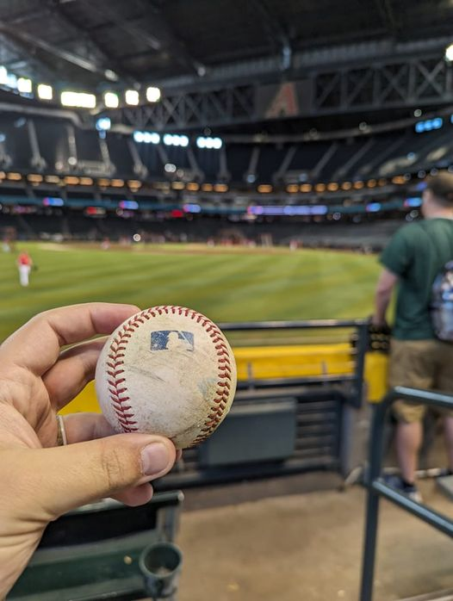
Introduction to Aquaman
Me…. not Jason Momoa or the comic accurate Aquaman
- Sr. Talent Sourcer at BECU
- Former Justice CoLeague at Wayne Tech
- Boolean Geek
- Adventurer and Wanderer
- Dad joke extraordinaire
- Baseball fan and coach
- Hot Sauce and Metal Music

Slide 3
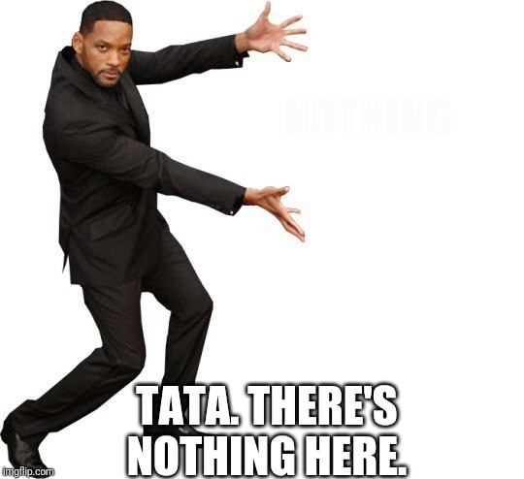
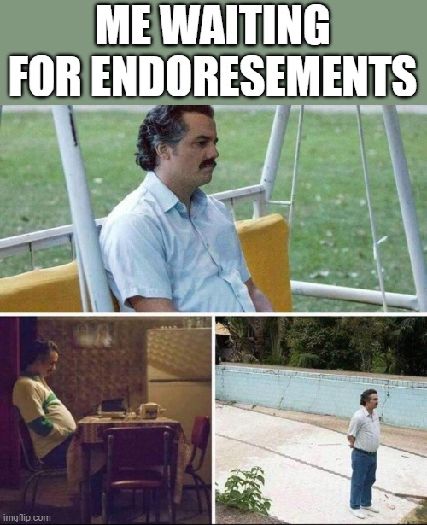
Disclosure / Disclaimer / Affiliations

Slide 4
What’s Next? Actionable Items and Questions
Now I Know Boolean, How Do I Use It?
Boolean Crash Course
Useful Tools to Begin
What is Sourcing & Why Should I Care?

Slide 5
What is Sourcing?
Definition: A Sourcer is someone who identifies and engages with passive talent to fill the top-of-funnel recruiting needs. (Dictionary of Aquaman)
What is the value-add with a sourcer?
Talent Market Insights
Larger Talent Pool
Data Driven Decision

Slide 6
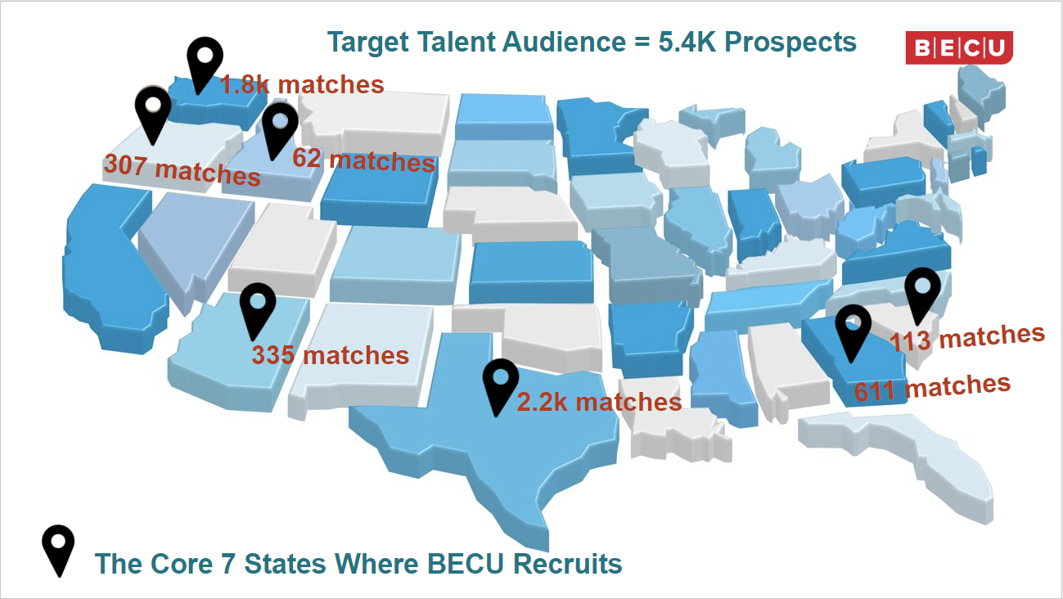

Slide 7
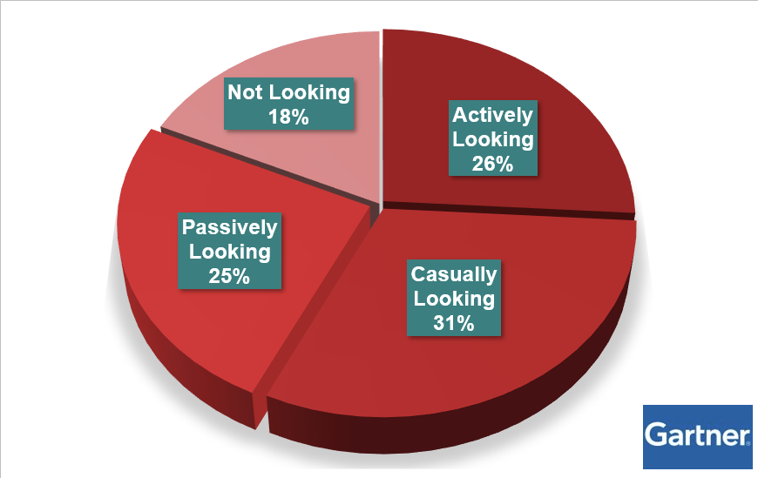
Active vs. Passive Talent

Slide 8
Approach Hiring from a Consultative Perspective - Data Driven Decision Making
What stories do the numbers tell?
Evaluating minimum qualifications
What is trainable and what must be known on day one, week one, month one of the job?
Quantifiable qualifications - avoiding subjective language in must haves
Approaching Hiring Managers with Objections
“This new person on your team will use XYZ to do ABC”
Addressing talent market

Slide 9
Sourcing vs. Recruiting - Process
Sourcing
Recruiting
Talent Identification
Talent Market Engagement
Phone Screen / Interview
Candidate Nurturing
Hiring / Job Offers
Debatable

Slide 10
Great, I Know What A Sourcer Is, How Do They Do It?
Tools - Boolean - Platforms

Slide 11
FREE Tools that Make Sourcing Easier
Brackets - A text editor that makes writing Boolean a lot more readable. Can share Boolean with ease. Free download at https://brackets.io/
Highlight This - Multi-highlight chrome extension that makes pages/profiles easier to digest. Free download in the chrome store.
https://chrome.google.com/webstore/detail/highlight-this-finds-and/fgmbnmjmbjenlhbefngfibmjkpbcljaj?hl=en
Instant Data Scraper - Scrape the LinkedIn profiles directly from your Google Search. Just like exporting a project. Free download in the chrome store.
https://chrome.google.com/webstore/detail/instant-data-scraper/ofaokhiedipichpaobibbnahnkdoiiah?hl=en-US

Slide 12
Boolean
Crash Course

Slide 13
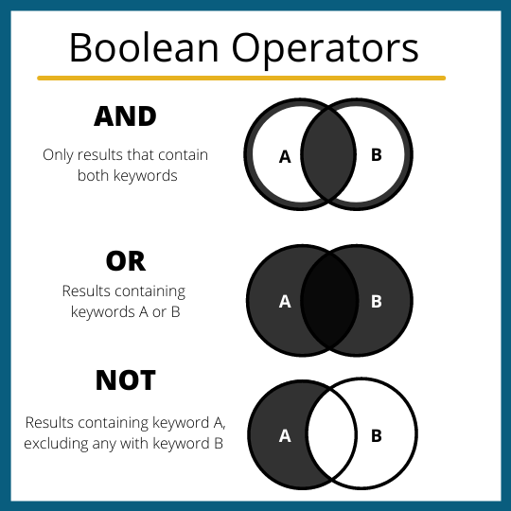
What do they do?
AND = +
handsome AND tall, handsome+tall
OR = |
handsome OR tall, handsome|tall
NOT = -
handsome NOT tall, handsome-tall

Slide 14
The Backup Dancers
(Parentheses)
“Quotations”

Slide 15
What do they do?
PEMDAS
Goal: Create single search terms out of Boolean operators or phrases
Examples: ((software OR .NET) AND (Developer OR Engineer)) “Human Resources” AND “Employee Relations”
(“Financial Service Representative” NOT (Banker OR “Loan Officer”)
Caveat: “Quotations” are also used to return exact inputs and not allow for stemming.

Slide 16
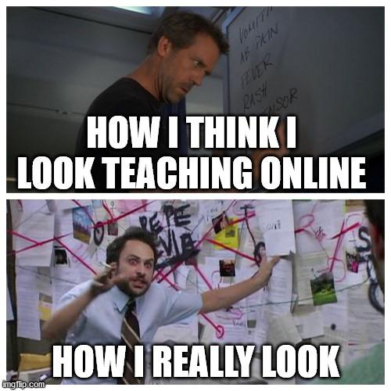
Questions on Boolean Operators?

Slide 17
Now I Know Boolean, How Do I Use It?
Determining your Platform
Google - Free, Learn Boolean Fast, Access to more than LinkedIn, No ATS Integration
LinkedIn Recruiter - Expensive, Less Precise, Highly Used, ATS Integration
SeekOut - Less Expensive, Highly Precise, has AI Functionality, Some ATS Integration, Access to more than LinkedIn
Are there more platforms? YES!

Slide 18
Google Cheat Sheet
site: (use this to tell google where to look)
AROUND (Boolean command for proximity)
intitle: (look for occurrences in title of web page)
inurl: (look for occurrences in the url of web page)
Look for constants (both present and absent) on profiles you are looking at

Slide 19
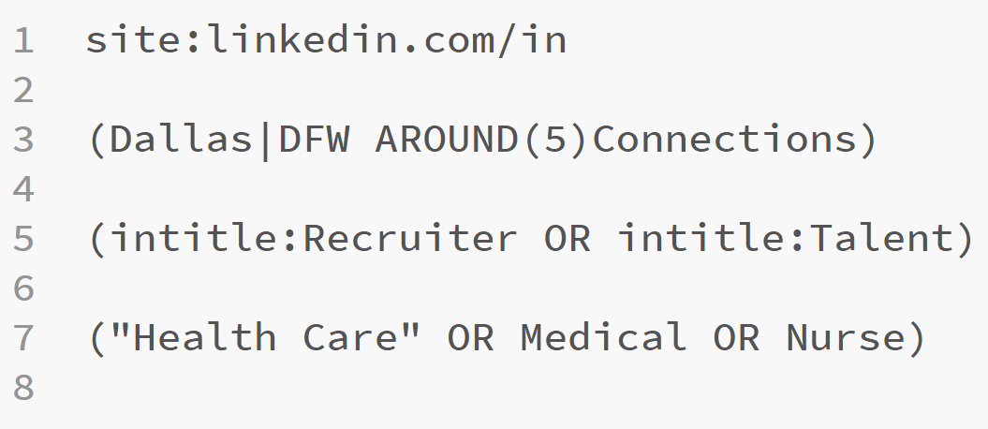
What Does A Google X-Ray Look Like IRL

Slide 20
Explaining the AROUND function
Format: (“TERM A” AROUND(#) “TERM B”) How it works: “Term A” will occur within # of terms of “Term B”
Both before or after!
Use cases: Location - tied to connections on LinkedIn, Natural language searching - no longer just playing buzzword bingo, relevant experience - tying job title occurrences to years.

Slide 21
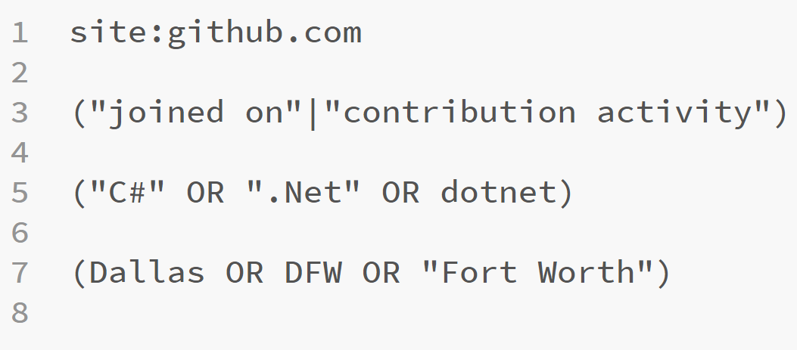

Slide 22
LinkedIn Guide
Bubble searches are a great place to start learning functionality
Boolean and Advanced Search options are more precise
LI Recruiter is a great project management tool for recruiting teams

Slide 23
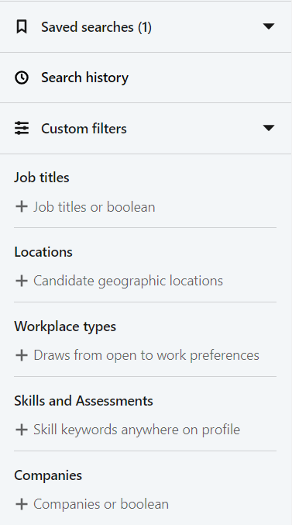
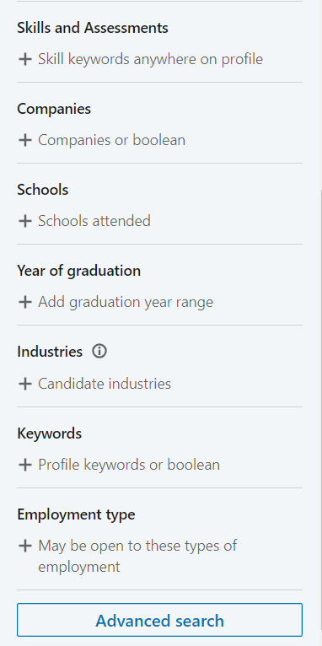
LinkedIn Recruiter Basics
KEY NOTES
Bubbles operate as OR statements
Keywords search the whole profile, Skills and Assessments only searches those two fields
Advanced search will be your best friend

Slide 24
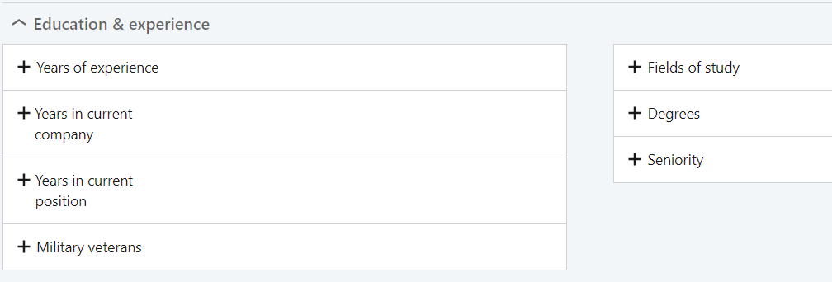
Advanced Search Fields

Slide 25
Advanced Search Fields cont.

Slide 26
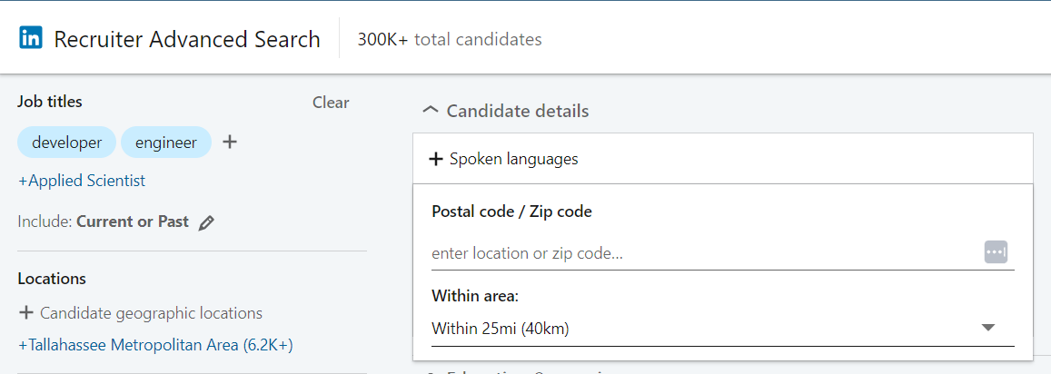
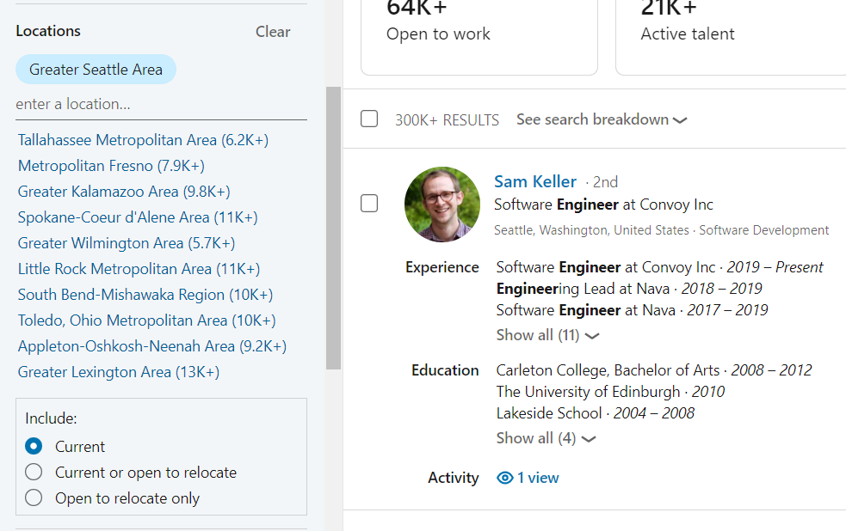
Specifying Location
Good
Better

Slide 27
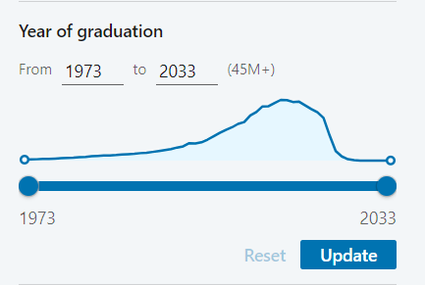
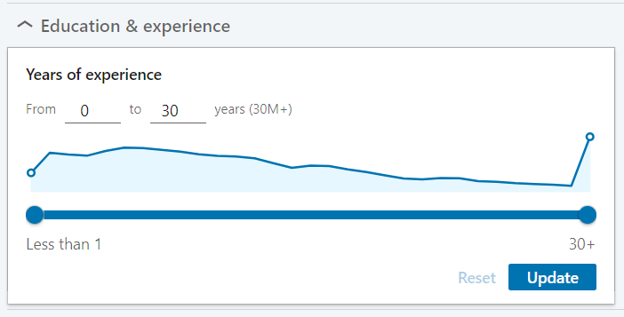
Specifying Years of Experience
Both of these have good functionality in narrowing your searches. A couple of things to keep in mind: Not everyone lists their entire work history, year of graduation biases, and degree anchor variability

Slide 28
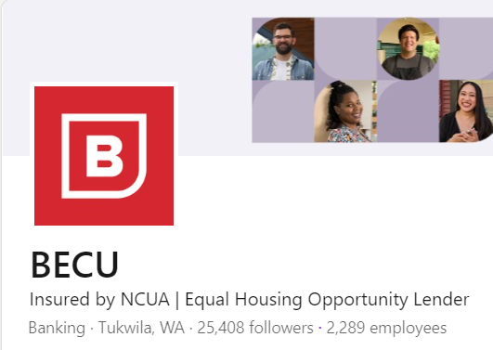
Company Searches
Bubbles and their problems.
Profiles have to have the company linked. How it works!
Every company has a nominal value assigned to it. Visible in the URL bar if you go to a company’s LinkedIn page and select #### employees

Slide 29
Company search solutions
Use OR statement Boolean! Have a list or need a list of competitors or specific companies? Have Chat GPT build the string for you! Once you have a list built, save it in a repository to access regularly.

Slide 30
SeekOut Guide
Function commands provide precision searches
Power Filters are your best friend
AI functionality provides easy talent mapping
Contact info finding and messaging components

Slide 32
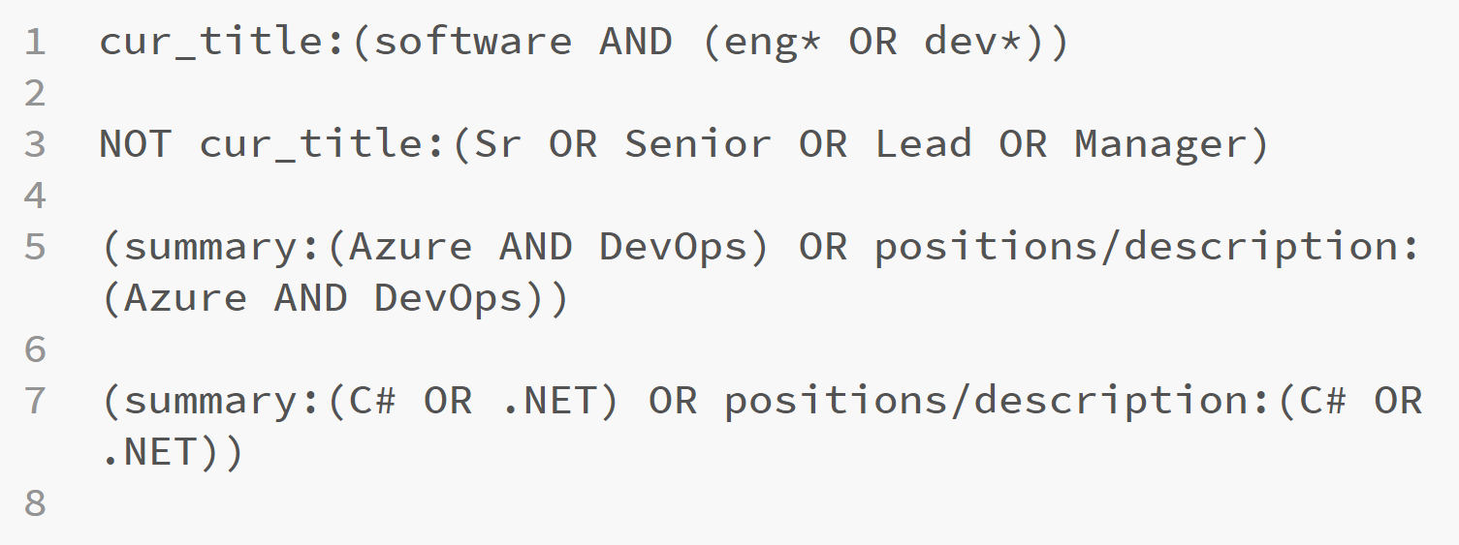
SeekOut Boolean

Slide 33
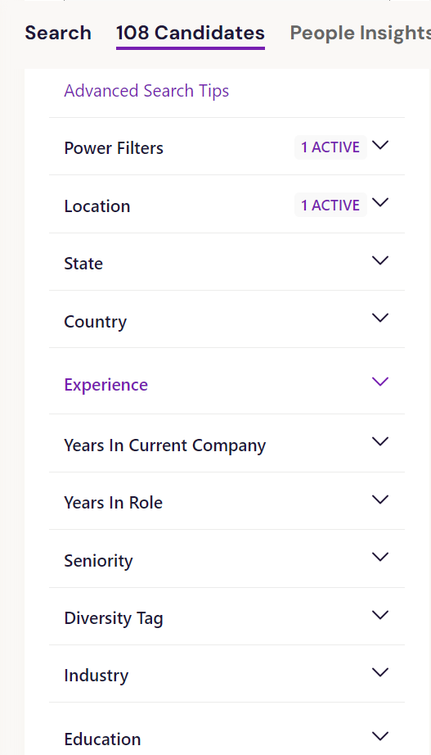
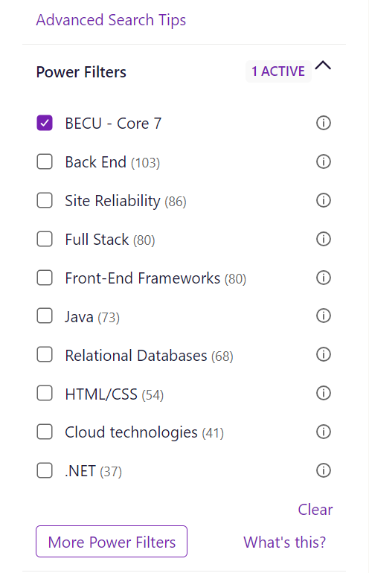
Advanced Search Tips
Shortcut to all search functions and specific syntax for writing them
Power Filters
Create custom power filters for searches or search components you do regularly

Slide 34
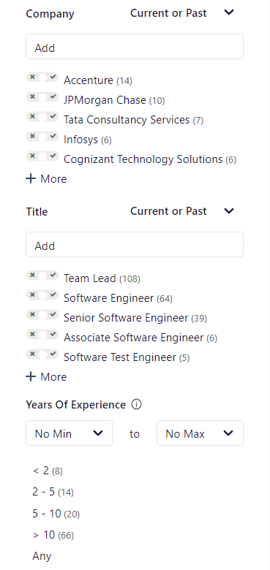
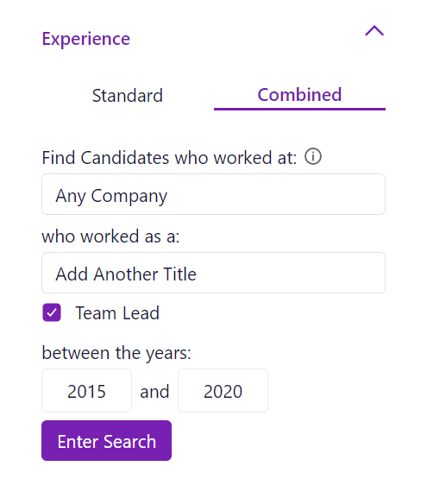
Experience Tricks
Dyanmic searching allows for companies or titles occurring in a specific timeframe
Also standard buttons for vanilla searching

Slide 35
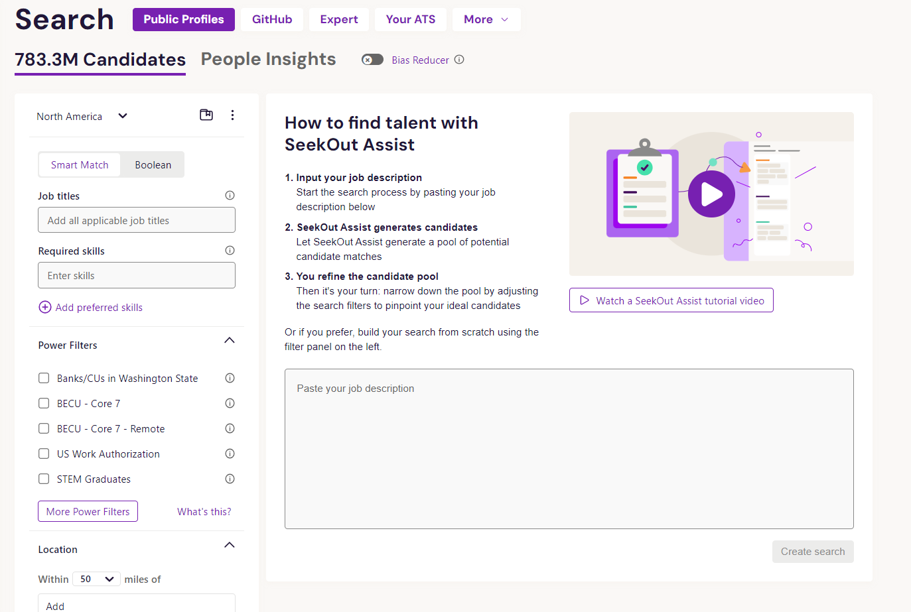
SeekOut AI Assist

Slide 36
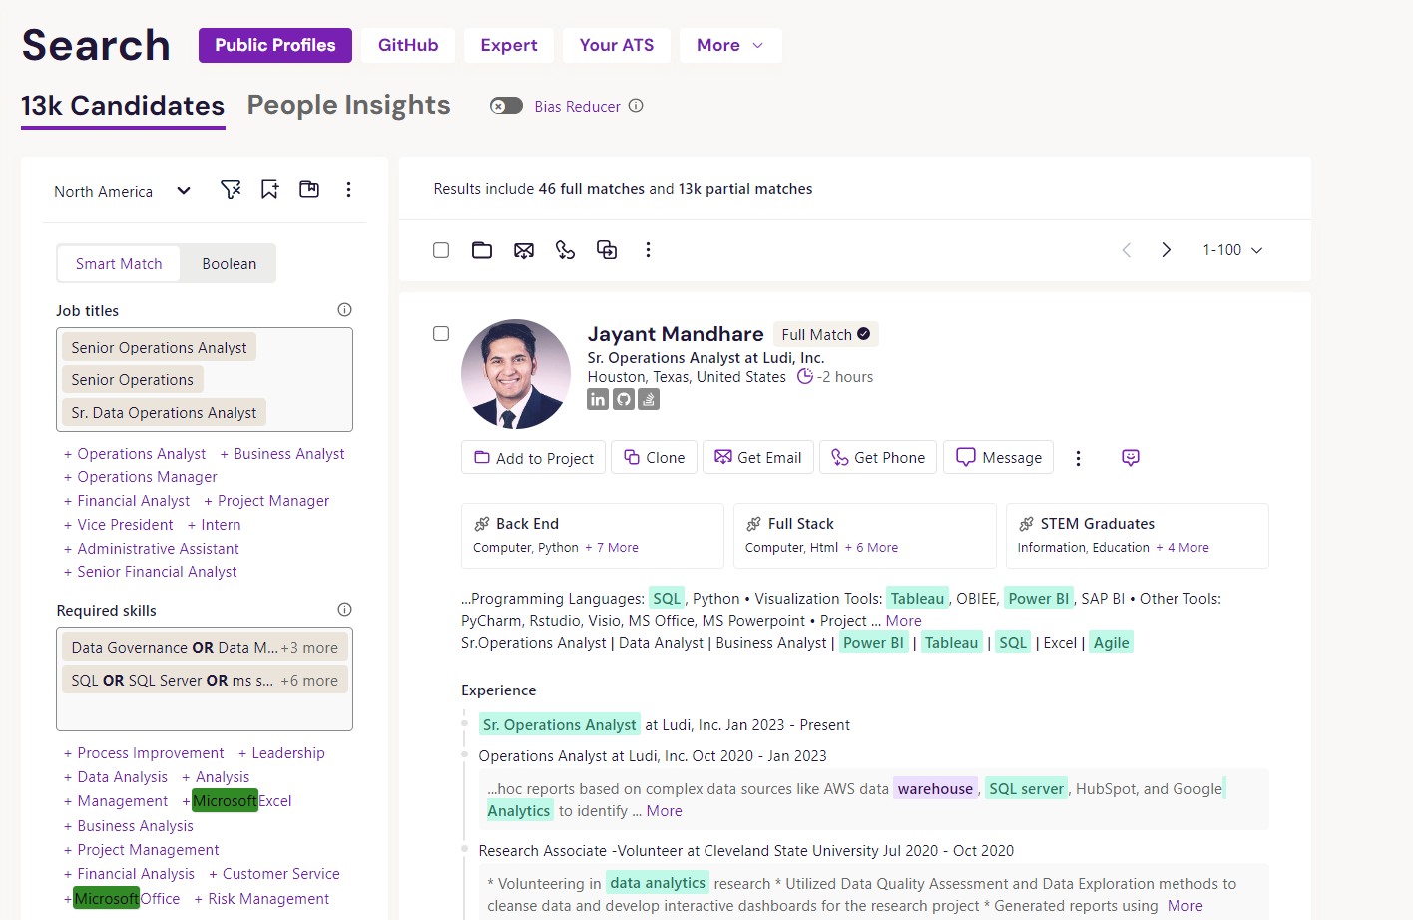

Slide 37
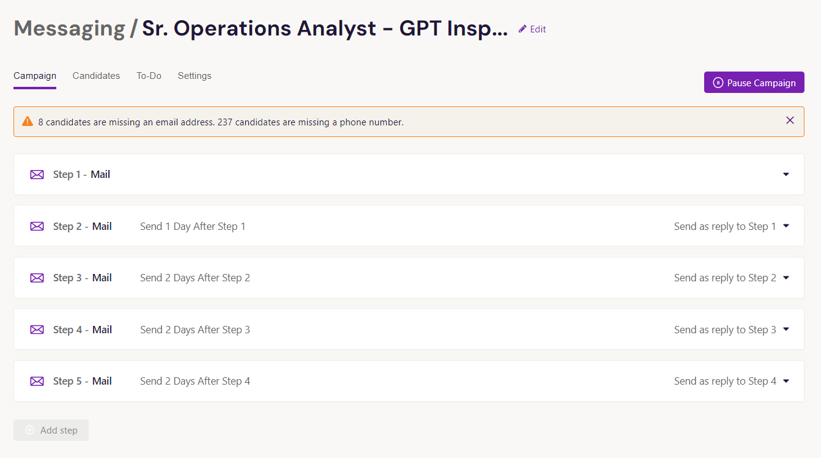
SeekOut Messaging

Slide 38
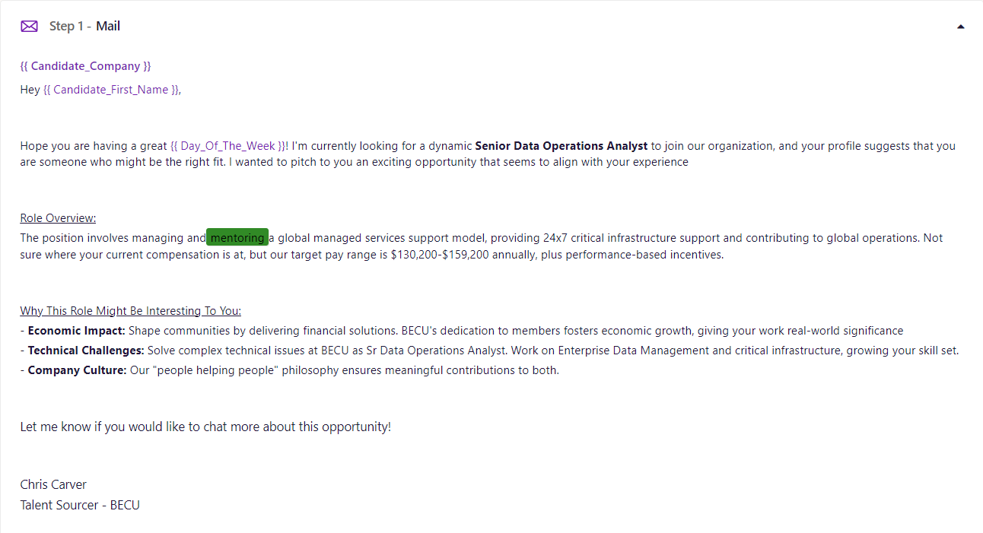
Subject Line
Variables

Slide 39
What’s Next? Actionable Items
Practice writing Boolean for real searches
Try different platform nuances
Try product demos - There are a lot more than three options for finding and engaging talent
Implement what makes sense for your team/org.

Slide 40
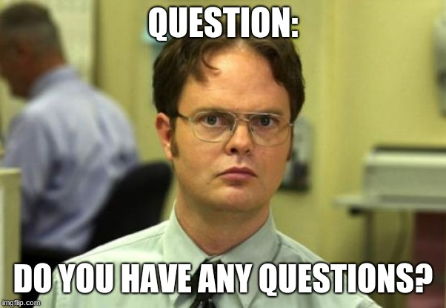

Slide 42
Chris “Aquaman” Carver
Email: christopher.carver94@gmail.com
LinkedIn: https://www.linkedin.com/in/chris-carver94/

