Slide 1
BUILDING PIPELINES (additional links and dialog in Notes section of this PowerPoint)
JIM SCHNYDER
GAIL HOUSTON
Linkedin.com/IN/JimSchnyder
jim@recruitingadvisors.com
Linkedin.com/IN/GailHouston
Gail_Houston@intuit.com
DFW TRN May 2020

Slide 2
JIM SCHNYDER FOUNDER/PRINCIPAL CONSULTANT
2 years - Recruiting Advisors
Strategic consulting firm for TA
Training - sourcing & recruiting
Technology best practices
Customers include:
Ernst & Young
Booz Allen Hamilton
17 Years at PepsiCo
past Sourcing Leader
2x SourceCon Grandmaster
2011 & 2014
DFWTRN Co-Director of Education
Notes:
At PepsiCo – I led the Talent Pipelines team focused on increasing pools of targeted and specific talent. I have been on my own as a consultant for over two years with Recruiting Advisors where companies hire me on project or hourly basis to train recruiters and help with system optimization and implementations – primarily around CRMs and its processes. (Shameless plug for my business – If your team is wanting sourcing training, technology advisement or a partner on an implementation or optimizations of a CRM – then email me at jim@recruitingadvisors.com). I am a SourceCon Grandmaster Sourcer - meaning that I have won a global sourcing challenge - twice! For people unfamiliar with SourceCon or the challenge – for context, this means that over 300 sourcers globally entered the contest and I made to the final round - winning the final round against the top 3-5 sourcers in the world.

Slide 3
GAIL HOUSTON EXECUTIVE RECRUITER -INTUIT
14 years - Intuit
Training - sourcing & recruiting
Social Media Strategy
Executive
Product Management
16 Years at EDS
Organizations
Co-founder DFWTRN, Co-Director of Education, former VP
Former President of SWHT Recruiters Group
Co-founder Career Transition Workshop – over 20k trained in DFW
Notes:
Gail is a true Rockstar. 16 years at EDS and 14 years at Intuit in corporate recruiting. She past Dallas Corporate Recruiter of the Year and is credited by Stacy Z as the person that taught her all she knows about Social Media. If you are not familiar with Stacey, at one point she was ranked as the most connected person on LinkedIn. Gail is part of the Intuit team and a driving force behind their processes and techniques. The Intuit team won the coveted “Recruiting Team of The Year” award in 2019.

Slide 4
AGENDA
Defining talent pipelining
Define the target
Building lists and talent maps
Creative ideas for sourcing
Interviewing in advance of need
Technology to use
How to do this in today’s marketplace
Resources for recruiters
Looking for work

Slide 5
BUILDING PIPELINES
COVID SUCKS
PEOPLE DON’T
Notes:
Let’s also talk about something – everyone has been impacted by this pandemic in one way or another, everyone! If you have been laid off or furloughed, that totally sucks and we are here for you. At the end of our presentation, we have some resources for you if you are a job seeker. If you are seeking talent, we have some resources too. If your leadership is not discussing sourcing now and building pipelines, then take the opportunity to share some things you will learn today and take them as ideas to your management and talk about what value you can bring to the organization NOW. Many of your jobs may have been cancelled. If you cannot be doing active recruiting, you may be seen as expendable for the short term. Don’t forget that you can also build a pipeline of talent of YOUR OWN employees if there have been layoffs (to help them land elsewhere) turn into a sort of OUTPLACEMENT CONSULTANT. https://www.slideshare.net/ghouston/doing-outplacement-inhouse

Slide 6
BUILDING PIPELINES
Notes:
We just want to start out with a basic understanding or definition of building pipelines. What this basically means is that you are working in a proactive fashion in advance of need. If you think of it in a warehouse or retail analogy, this is making sure you have “inventory” in advance of need. It is a strategic model where you are not 100% “reacting” to a demand, but you are either looking at growing a pool of targeted talent or ramping up knowledge of where this talent might be so when you need to tap into it, you are not scrambling and starting from zero. One point to make, me personally, I do not believe that Building a pipeline of talent means you have to have the identified people ready to do interviews or accept and offer immediately. You are just getting the pieces of the inventory ready so that when you need to “assemble”, you are able to ramp up faster. It likely also leads to a better quality of a pool since you are “stocking a pond” versus “posting and praying.”

Slide 7
DEFINE THE TARGET
Persona (Marketing term)
Talent Profiles
Define
Calibrate
Notes:
Persona (Marketing term) –
“A persona is a fictional character that communicates the primary characteristics of a group of users, identified and selected as a key target through use of segmentation data, across the company in a usable and effective manner.
Recruitment Marketing and how many of these techniques are utilized today in Recruitment Marketing. In Pipeline Building, you have to know your target.
Gail will be sharing a really cool example of how Intuit partnered with Marketing and utilized this.

Slide 8
DEFINE THE TARGET
Persona (Marketing term)
Talent Profiles
Define
Calibrate
Notes:
At PepsiCo, we had some marketing intelligence and studies that were done on targets and persona but that didn’t really help our Sourcing Team at PepsiCo since we didn’t have all the funds. What we did was converted the targets into “Talent Profiles.” This is an offshoot of the persona that more or less means your are applying more tangible things to the persona, like Schools, potential companies, required/preferred + years exp. I looked at a blend of 15 -20 job descriptions and resumes for top hires to create Talent Profiles. Basically if you were to define your target
Calibrate them with hiring managers

Slide 9
TECHNOLOGY YOU CAN USE
ATS – retargeting
Excel & Google Docs
LinkedIn Recruiter
CRM abilities
No export
CRM
Free / Paid
Email hunting (ZapInfo, SeekOut, Loxo Source)
Scrapers – (DataMiner & Table Capture)
Notes:
Simple things
LinkedIn Folders
Resumes from ATS
Google Forms
Excel file
Gather personal email
Technology - LI Recruiter folders (import) & CRM –
Hiretual, JobJet, others

Slide 10
BUILDING LISTS AND TALENT MAPS
Build a folder/list
Who, where, when
Talent Map
Inventory
Notes:
Where the magic happens and the executional work. A lot of time here. Build a folder/list – gather additional information on them
Goal - Talent Map!

Slide 11
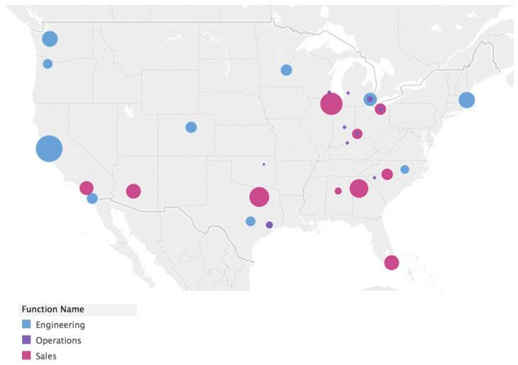
WHAT IS A TALENT MAP?
Visualization
Look at supply
QIA
Notes:
Jim to EXPAND -- Goal - Talent Map! -- Map by location with timing for making a change - QIA – Qualified, Interested and Available. This allows you to share with leadership.

Slide 12
INTERVIEWING IN ADVANCE OF NEED
Passive!
Sell!
Will your managers do them too?
HM – perceptions
Exploratory only
If no, why not?
You can still do this
Block times
Calendly
Notes:
Interviewing in advance of need
PASSIVES – prep your hiring manager (perceived desire)
SELL them, they are not ACTIVELY LOOKING
Set interview day – if don’t need it, give back the time

Slide 13
SOURCES FOR BUILDING LISTS
Your ATS
Employee Referrals
Silver Medalists
Alumni - Rehire
Offer Rejects
Speakers, White Papers
Top 100 Lists
University
LinkedIn
Job Boards
Facebook / LI Groups
Github / StackOverflow
Associations.
Webinars

Slide 14
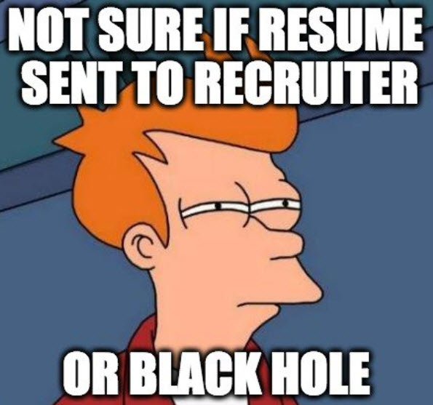
Pipeline Building - Utilizing Your Own ATS
First pilot at Intuit – utilized AI to review resumes
Reviewed over 6k applications for SWE and Data.
10% were deemed qualified.
Feedback was given though to every applicant
Filled positions 9 days faster
48% increase in our NPS score
Qualified but not hired
Moved into Talent Communities & marketers continually engage for future openings
Notes:
Nick Mailey, former Intuit VP conversation with CareerXRoads where he discusses the work we did with AI to make sure every application was reviewed
https://cxr.works/careerxroads-uncorked-with-nick-mailey/
A company’s spend for ATS and Marketing dollars can be in the millions yet most applications are not reviewed
Recruiter’s assume the quality is not there
Applicant’s assume it is a black hole
Intuit created AI to help to automate the candidate review process and save sourcers and recruiters time

Slide 15
Pipeline Building - Intuit’s Rehire Example
Situation – Must hire 1,000’s of CPAs, Tax Attorneys and Bookkeepers every year.
Proactive Strategy
“Shift left”
98% return rate, saving 100’s of thousands in recruiting cost and increased seasonal retention
Notes:
https://www.sourcecon.com/shift-left-intuits-change-in-sourcing-mindset/
Intuit needs to hire 1,000’s of CPAs, Enrolled Agents, Tax Attorneys and Bookkeepers every year
Many of these will be “rehires”
Our original strategy wasn’t working
We shifted left and created an engagement strategy for rehires that included letters of appreciation, coffee mugs, and created a marketing drip campaign to stay in touch

Slide 16
Building Pipeline - Intuit’s Product Management Example
Needed a pipeline for Product Management
Target companies
Proactive interviews
“Pipeline pulls”
Interviewed current high performing employees
“Research” interviews for targeted hires
Results:
33% of hires
20 days faster
Improved quality
Notes:
Needed a pipeline for Product Management
Created list of target companies
Interviewed whether we had an opening or not
Did “pipeline pulls” from community to engage with known talent
We did not have marketing support so we did work on our own
Interviewed current high performing employees
Identified and did research (paid) interviews with targeted hires
33% of hires for FY17 were from community
Roles filled 20 days faster
Quality improved from 4.5 to 4.6 with community hire

Slide 17
Building Pipeline – POD - Marketing Partnership
Organized by PODs
Create Talent Communities
Dedicated marketers
Proactively Survey with Knock-Out Questions
Proactively market thru email, webinars, podcasts, articles, newsletter, events
30-40% of hires influenced by marketing
Notes:
https://www.sourcecon.com/shift-left-intuits-change-in-sourcing-mindset/
Organized by PODs
Create Talent Communities
Dedicated marketers
Proactive ERPs
Silver medalists
Offer rejects
Alumni
Event Lists
ATS
Proactively Survey with KnockOut Questions
Proactively Market thru email, webinars, podcasts, articles, newsletter, events
30-40% of hires influenced by work marketing is doing with communities. Recruiters and Marketers must be closely aligned

Slide 18
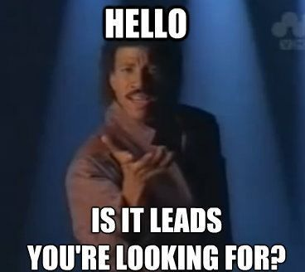
Proactively targeting Employee Referrals – NEW IDEA!
Can you say that you were able to get 150+ ERP’s within 6 hours?
Team meeting – All gathered in a room
Leaders described their open positions
type of talent they were looking for to their teams
Recruiters attended and gathered
6 hours worth of work
167 referrals
10 interviews
4 hires
Qualified added to Talent Communities for Future Roles
Notes:
https://www.sourcecon.com/shift-left-intuits-change-in-sourcing-mindset/

Slide 19
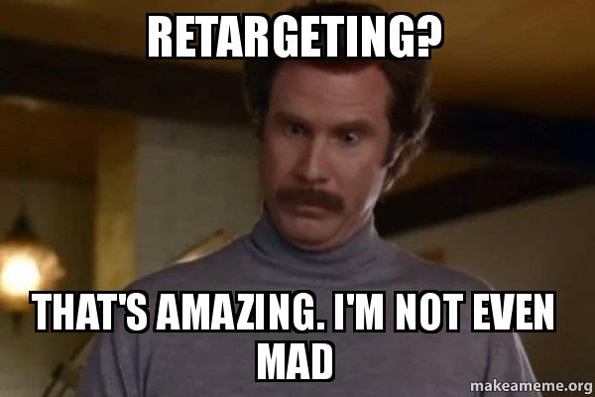
RETARGETING TECHNIQUE
ATS list with emails (137)
Status
Offer rejected
Withdrew
List uploaded to LinkedIn Recruiter
Import and refresh!!
Quick review/ trim to 57
Imported into Avature CRM
Personalized portal page
60 second ask
Notes:
Retargeting - Historic ATS List of candidates that withdrew or self selected out
ATS list with emails – 137 people
Status – offer rejected, withdrew or self selected out of our process
List uploaded to LinkedIn
Quick review of targets – trimmed to 59 targets
Imported into Avature CRM
Same technique - personalized portal page and 60 second ask

Slide 20
RETARGETING TECHNIQUE
60 second ask
One question – call to action link
Actively looking / ready now
Happy in role but will listen
Will move for the right opportunity
Not looking to make a change
Notes:
Avature sends – 58 total targets
One bounce
87% opened
Nearly 50% clicked on call to action

Slide 21
RETARGETING TEMPLATE
Hi ______,
I know that you had considered an opportunity with XYZ in the past. I am in Talent Acquisition with XYZ and specialize in engaging the top Marketing talent in the industry. I want to learn if you still have an interest in staying in touch or considering possibilities with us.
In an effort to be respectful of YOUR time while attempting to understand YOUR future desires and timing, I have created a private webpage that asks about your preferences when considering a career move. Can you please take 60 seconds and click on this link to answer the questions so we can learn more about what is important to you and follow up accordingly?
Thank you for your interest in XYZ!
Notes:
Avature sends – 58 total targets
One bounce
87% opened
Nearly 50% clicked on call to action

Slide 22
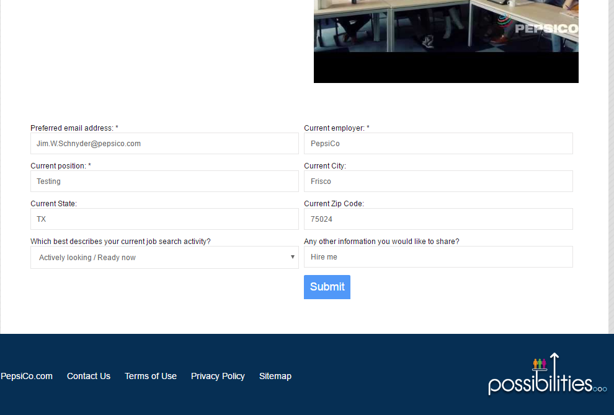
RETARGETING TECHNIQUE
Notes:
This slide builds…..Sample of a personal portal page. Email, employer, position, city state and zip code are usually populated already when they hit the page. Really only asking for updates on the info and the real CALL TO ACTION of best describes current job search activity……

Slide 23
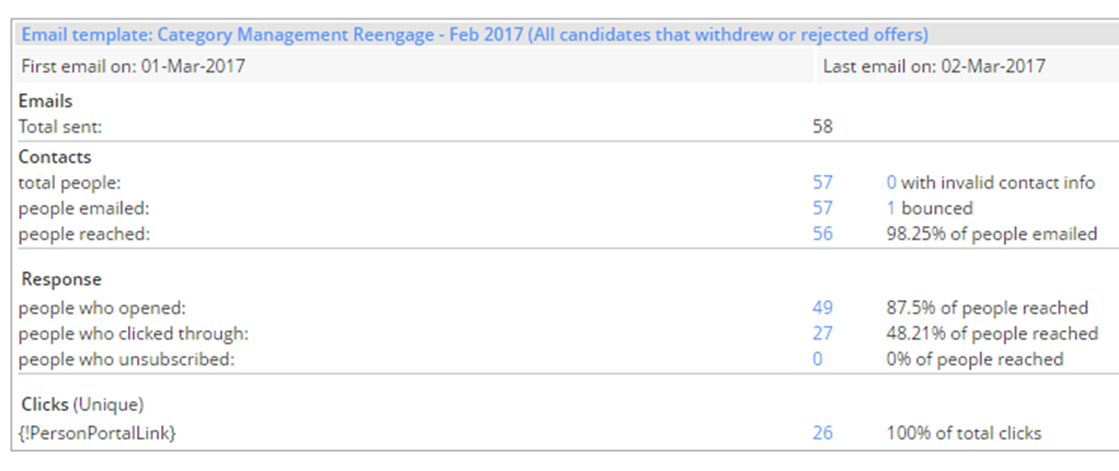
RETARGETING TECHNIQUE
Notes:
Avature sends – 58 total targets
One bounce
87% opened
Nearly 50% clicked on call to action

Slide 24
RETARGETING TECHNIQUE
75% of prospects that clicked, answered that they were either:
Actively looking / ready now ( 3 )
Happy in role but will listen (2)
Will move for the right opportunity (15)
Why do you care?
20 candidates within 24 hours
All automated
Quick use of inventory
Notes:
87% opened Nearly 50% clicked on call to action
20 out of 26 responses

Slide 25
HOW TO PIPELINE IN TODAY’S MARKETPLACE
Approach
Clear expectations
Under promise
WIIFM
Care & Share
Notes:
Riding the wave – pipeline –
Approach in today’s environment
Be authentic and do not promise what you do not know
Reason – WIIFM -- Why are you reaching out
Clear and realistic expectations
Help them too – don’t just ask
Can we share our resources(does it make sense to use in message?)

Slide 26
COVID TALENT PIPELINE – HOW INTUIT IS DOING IT
Organizations and individuals are proactively helping impacted candidates
Create strategy to engage whether you have openings or not
Follow Layoff sites and ingest the data
Create a strategy to engage talent in an authentic and caring manner
If your team has been impacted, create way to help them
Notes:
Layoff sites
Layoffs.FYI Live Tracker - Companies https://layoffs.fyi/tracker/ You can find a list of companies that have laid off and if available a google doc of those impacted Layoffs.FYI Live Tracker - Employees https://layoffs.fyi/tracker/?utm_campaign=Recruiting%20Brainfood&utm_medium=email&utm_source=Revue%20newsletter You can find lists of employees that are laid off The Layoff.com https://www.thelayoff.com/t/FCJ7YxL Layoff Community and Network https://layoffers.com/ Layoff Alerts for Talent Acquisition Professional (LATAP) on Facebook https://www.facebook.com/groups/LATAP/ Drafted's Whose Hiring List https://blog.drafted.us/post/whos-hiring-on-layoff-network Drafted's List of Companies Laying Off https://mailchi.mp/drafted/the-layoff-list-vol-5119373 Drafted List of Companies Laying Off - Past issues https://us10.campaign-archive.com/home/?u=973f9554e2e271feae1620ba0&id=61e6781f7d Layoff List Powered by Drafted https://www.layoffs.tech/ To share a layoff tip email tips@layoffs.fyi Tips about Layoffs layoffs@drafted.us One Soft Landing https://www.onesoftlanding.com/?fbclid=IwAR3lhuKPUOd9MmKrFEkXsRhWAGkhF3p1DtxXg6zxXIxGe8f6HSrA2cJcfKY RemoteLeaf.com - post jobs https://remoteleaf.com/covid RemoteLeaf.com - add yourself if impacted https://remoteleaf.com/covid Entelos TA Community https://resources.entelo.com/talentcommunity Entelo List for TA Impacted https://docs.google.com/forms/d/e/1FAIpQLSfRh-QVlr3wZ-47hC80nSY0aK2tHT54xpMftdcmFFtXOG5CPg/viewform Entelo List to add a TA Job https://docs.google.com/forms/d/e/1FAIpQLSdc2XVvivVn9zVmtzkgZ3zMCyqAJMxaC73HJXH04_Ga6L6gyw/viewform Lead411 - list of 350 confirmed layoffs https://www.lead411.com/2020/04/01/list-of-company-layoffs-due-to-covid-19-2020/ Greg's List - View SaaS SWE Talent https://gregslist.com/saas-talent-now/ Greg's List - the Comprehensive List of Software Companies https://gregslist.com/ Greg's List for Software Engineers - Get Listed https://gregslist.com/get-listed-saas-talent-now/

Slide 27
RESOURCES FOR YOU (ALSO IF YOU ARE LOOKING)
https://www.dfwtrn.org/Recruiter-Resource/
Recruitersrecruitingrecruiters.com
Free training
Job resources
Groups to join
Layoff alerts
Tools / Tips
Others
Notes:
https://www.dfwtrn.org/Recruiter-Resource/

Slide 28
BUILDING PIPELINES QUESTIONS?
JIM SCHNYDER
GAIL HOUSTON
Linkedin.com/IN/JimSchnyder
jim@recruitingadvisors.com
Linkedin.com/IN/GailHouston
Gail_Houston@intuit.com
DFW TRN May 2020
Notes:
Linkedin.com/IN/JimSchnyder
jim@recruitingadvisors.com
Linkedin.com/IN/GailHouston
Gail_Houston@intuit.com

